Slide 1
陕旅版英语六年级上册
Unit1 It’s time to play the violin
第3课时
WWW.PPT818.COM

Slide 2
演一演
老师和全班学生一起表演上节课所学的Let’s talk部分内容

Slide 3
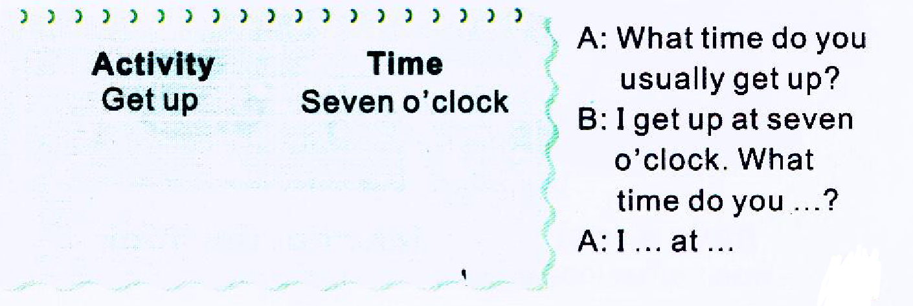
Fill in the form and talk

Slide 4
观看课文动画

Slide 5
6:30 gets up
brushes her teeth and washes her face
7:00 runs with her father
7:30 has breakfast
does her homework
9:00 watches TV
10:40 plays the violin for an hour
has lunch and has a rest
2:30 goes out to play with her friends

Slide 6
温馨小贴士：
频度副词常用于一般现在时态中，用来表示某人的日常活动发生的频率。目前学生已经学过的频度副词有often经常，sometimes有时，usually 通常，always总是。

Slide 7
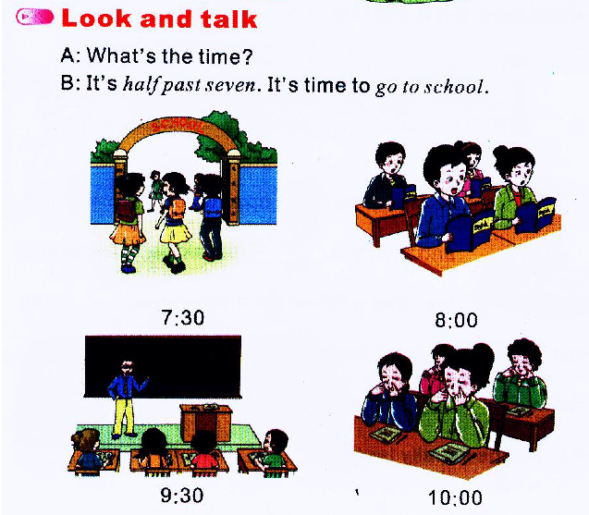
Look and talk

