Slide 1
Unit3 Lesson2
How are you feeling today?
WWW.PPT818.COM

Slide 2
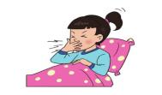
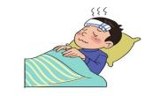
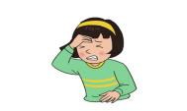
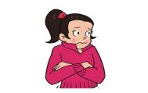
Read fill and act :
cough
1 What’s wrong with you ? I _____________
What’s wrong with you ?
have a fever
2 What’s wrong with you ? I _____________
have a headache
3 What’s wrong with you ? I _____________
feel cold
4 What’s wrong with you ? I _____________

Slide 3
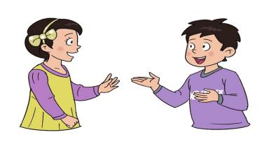
Practice in pairs
feel cold
have a fever
cough
have a headache
What’s wrong with you ?
I ……
Go to see the doctor, please .
ok

Slide 4
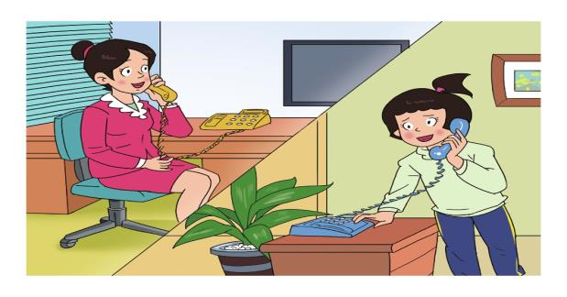
Listen ,watch and answer
1. How is she feeling today?
much better

Slide 5
Read the dialogue by yourselves and answer the questions.
2. What is Wang Hong
worried about ?
her lessons

Slide 6
默读课文，将人物和建议连线。
Take the medicine on time
and drink some water
Miss Zhang
Take a good rest .
You’ll get well soon.
Danny
An apple a day keeps the doctor away .
Mum

Slide 7
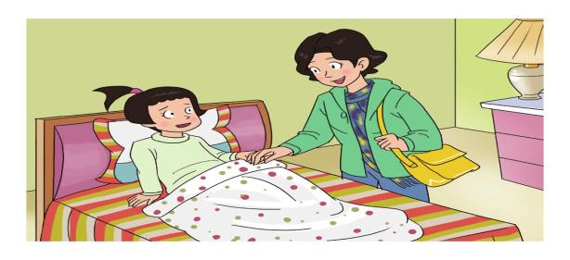
Look, listen and fill.
work
Take the medicine on time
drink some water
Mum: I’m going to ____, dear. __________________
and _____________
Wang Hong: OK. Don’t worry, mum . Goodbye.

Slide 8
Much better
Take a good rest
get well
Don’t worry
Miss Zhang: How are you feeling today , Wang Hong ?
Wang Hong: ___________ .Thank you, Miss Zhang .
Miss Zhang: _______________. You’ll_______ soon.
Wang Hong: But I’m worried about my lessons
Miss Zhang: __________ . We’ll help you .

Slide 9
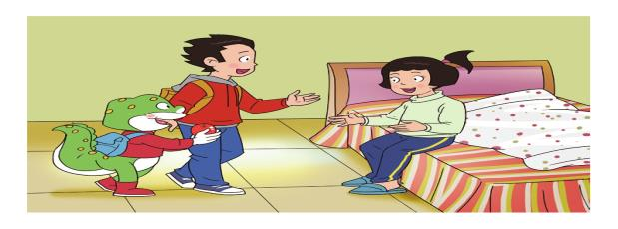
Are you feeling better ?
How was school today ?
An apple a day keeps the doctor away .
Li Ming: Hi, Wang Hong ! ___________________
Wang Hong: Yes. Thank you . ________________
Danny: Good. Good. Here’s an apple for you .
Wang Hong: Thank you .
Danny：_________________________________

Slide 10
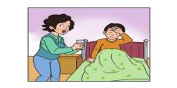
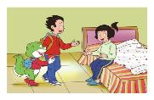
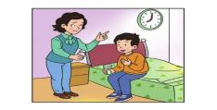
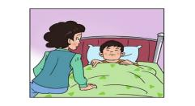
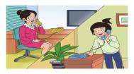
读句子或者短语选择相应图片
Take the medicine on time
Take a good rest
Much better
drink some water
An apple a day keeps the
doctor away

Slide 11
再读句子，与汉语句子连线。
Take the medicine on time
按时服药
Take a good rest
好好休息
Much better
好多了
drink some water
多喝水
get well
会好的 康复

Slide 12
Read the text in groups.
小组朗读课文。

Slide 13
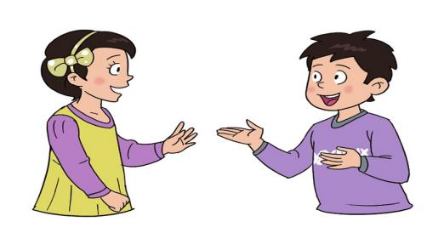
Let’s talk

Slide 18
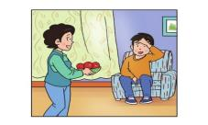
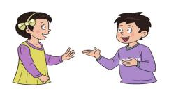
drink some water
have some fruit
take a good rest
take the medicine on time
How…….?
Much better
……
You’ll ……
Thank you

Slide 19
Let's do.
小组合作，制作建议卡。
Dear Wang Hong
Have a good rest .
You’ll get well soon.
Jenny.

Slide 20
Test:
1 I hope you feel ________ soon .
A. bad B. sick C. well D. goo
2. Are you ________ well ?
A. feel B. feels C. feeling D. felt
3. He _________ .
A. has a headache B. has the headache
C. have headache D have a headache
4 Please take the medicine ____ and drink some water.
A. In time B. on time C. much time D. for time
5 –How are you feeling ?--- _____
A. much good B. good C. much better D. good better

Slide 21
worried
much better
get well
on time
keep …. away
Read and fill in the blanks
1 Take a good rest , You’ll _______ sonn.
2 I’m _____ about my lessons .
3 Take the medicine _____ and drink some water.
4 How are you feeling today ? ________
5 An apple a day _____ the doctor _____

Slide 22
Homework
1、听课文录音，模仿跟读课文。
2、查找有关健康的名言、警语、谚语等并摘抄一下，大家交流分享。

Slide 23
Thank you!

