Slide 1
Unit 2 Hobbies can make you grow as a person.
Module 6 Hobbies
WWW.PPT818.COM

Slide 2
Words and expressions
person
interest
skill
activity
sailing
n. 人（通常指成年人）
n. 兴趣；爱好
n. 技能；技艺
n. 活动
n. 航海；航行

Slide 3
Words and expressions
come out
result
as a result
pleasure
success
出版；问世
n. 结果；后果
结果；因此
n. 愉悦；快乐
n. 成功；成就

Slide 4
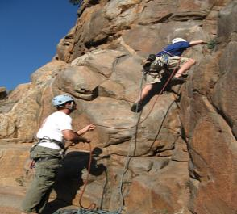
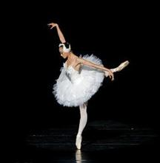
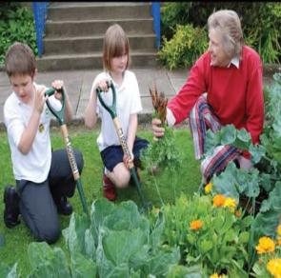
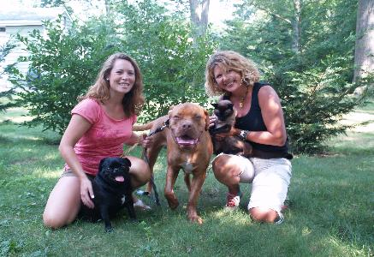
What’s the hobby?
climbing
dancing
growing vegetables
looking after animals

Slide 5
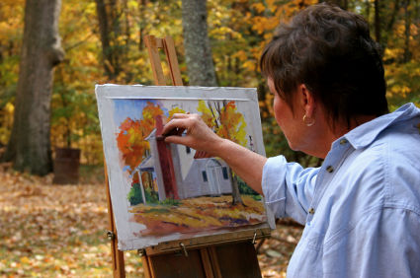
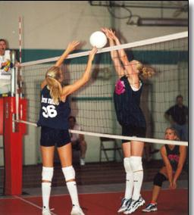
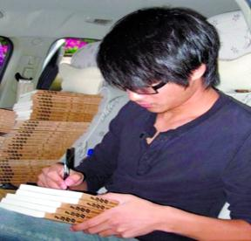
What’s the hobby?
painting
playing volleyball
singing
writing

Slide 6
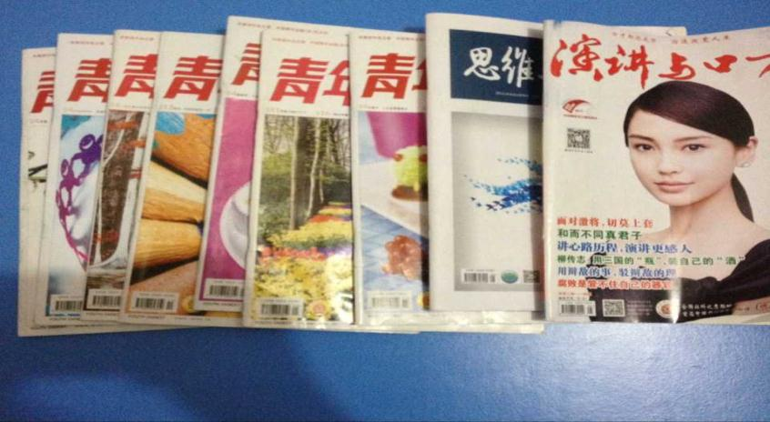
Collecting the Youth Digest

Slide 7
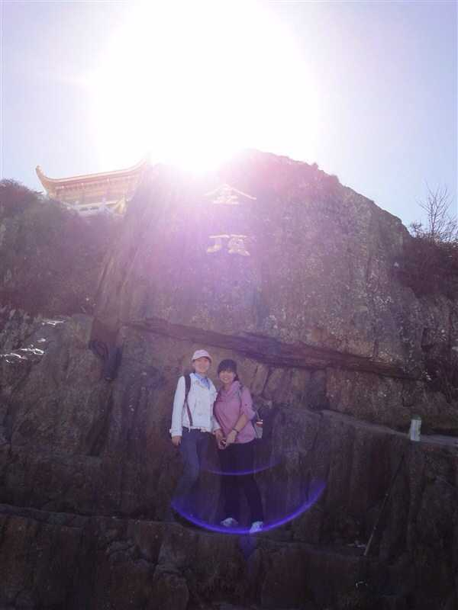
Travelling

Slide 8
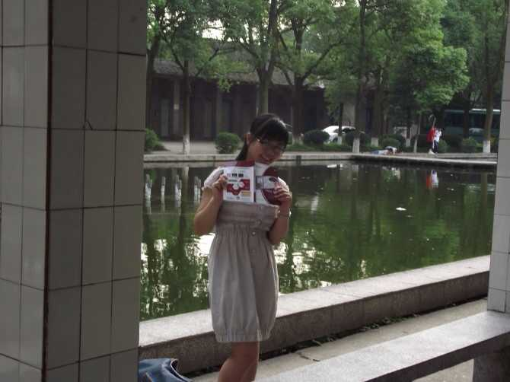
Speaking English

Slide 9
Discuss with your partners about your hobby.
I like … because…
I’m interested in…
My hobby is… because…

Slide 10
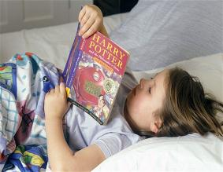
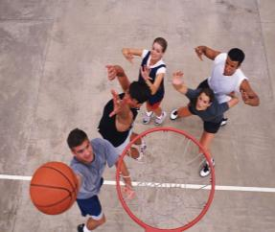
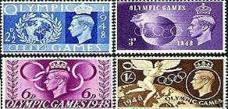
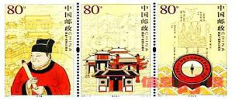
I like reading because it can teach me something special.
I am interested in playing basketball because it is relaxing and healthy.
My hobby is collecting stamps because they take up the least space.

Slide 11
Fast Reading
1.Match the meaning with each paragraph
Part A
para1
Hobbies' advantages
to young people
Para.1
Hobbies' advantages
to young people
Para.2
Part B
para2-4
David became successful.
David’s story
Para.3
David’s other hobbies and his future plan
Para.4
David's writing experience at a summer camp

Slide 12
判断正（T）误（F）
（1）David Smith likes writing. ( )
（2）He learned writing during a summer camp
of 2000.( )
（3）David wrote a story about his life in senior high school.（ ）
（4）David’s first book came out in 2003. ( )
（5）Writing was his only hobby in his
free time.( )
T
2010
F
the life of a 16-year-old boy
F
2012
F
wasn’t
F

Slide 13
Read the passage and answer the questions.
1. What advantages can hobbies bring to young people?
2. What hobbies does David have?
Hobbies can make you grow as a person, develop your interests and help you learn new skills.
David likes writing, playing volleyball and many other things.

Slide 14
3. When did David become a successful writer?
4. Will David’s new books be successful?
After his story about the life of a sixteen-year-old boy came out as a book in 2012.
Maybe. The passage doesn’t say.

Slide 15
Complete the sentences with the correct form of the words in the box.
activity pleasure result skill success
activities
1. What ________ do you enjoy doing?

Slide 16
2. What new _______ have you learnt through your hobbies?
3. Has any of your hobbies brought you ________ and ______?
4. Have you made new friends as a(n) _______ of your hobby?
skills
pleasure success
result

Slide 17
Homework
Ask your parents some questions about their hobbies.

