Slide 1
Unit 3 Winter in Canada
Lesson 16 A Skating Lesson
WWW.PPT818.COM

Slide 2
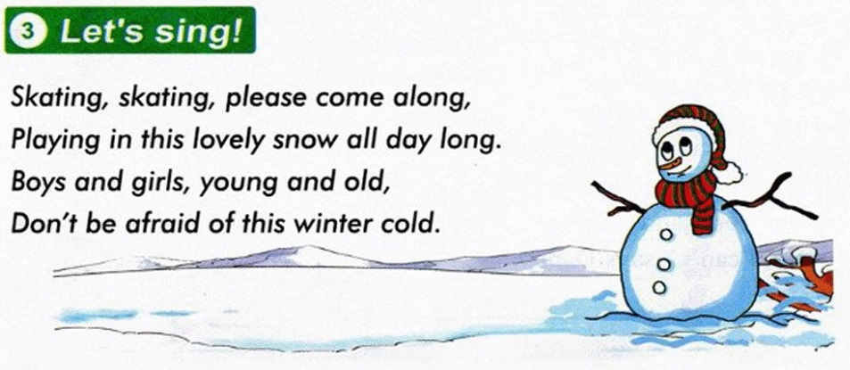
Warming up
1. Listen to a chant.

Slide 3
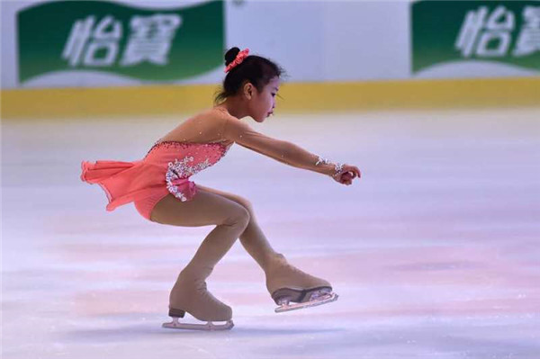
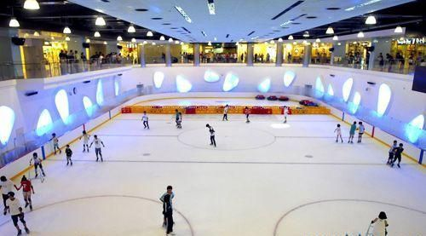
Warming up
2. Free talk
I can skate. I’m going to skate.
Can you skate?

Slide 4
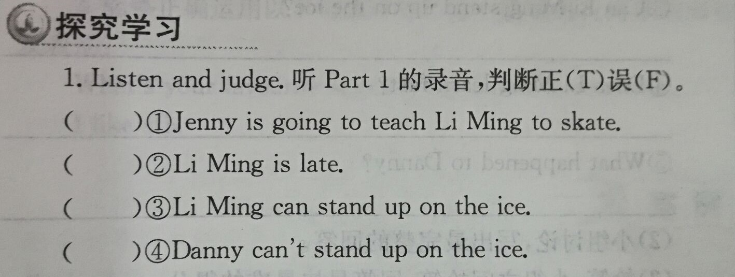
Presentation
闯关游戏
关卡1：
F
F
T
F

Slide 5
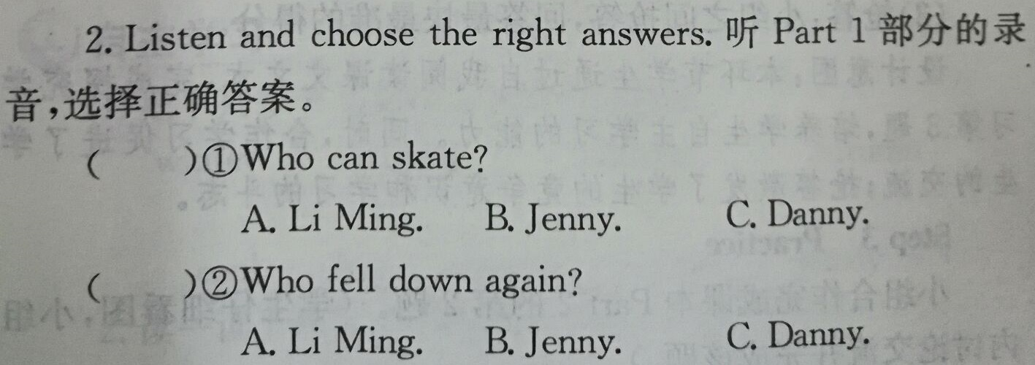
Presentation
闯关游戏
关卡2：
A
C

Slide 6
Presentation
闯关游戏
关卡3：
1.What is Danny going to do ?
_________________________________
2.Is Danny early or late?
__________________________________
3. Can Li Ming stand up on the ice? ___________________________________
4.Does Li Ming learn fast?
___________________________________
5.What happened to Danny?
____________________________________
He is going to teach Li Ming to skate.
He is late.
Yes, he can.
Yes, he does.
He fells down.

Slide 7
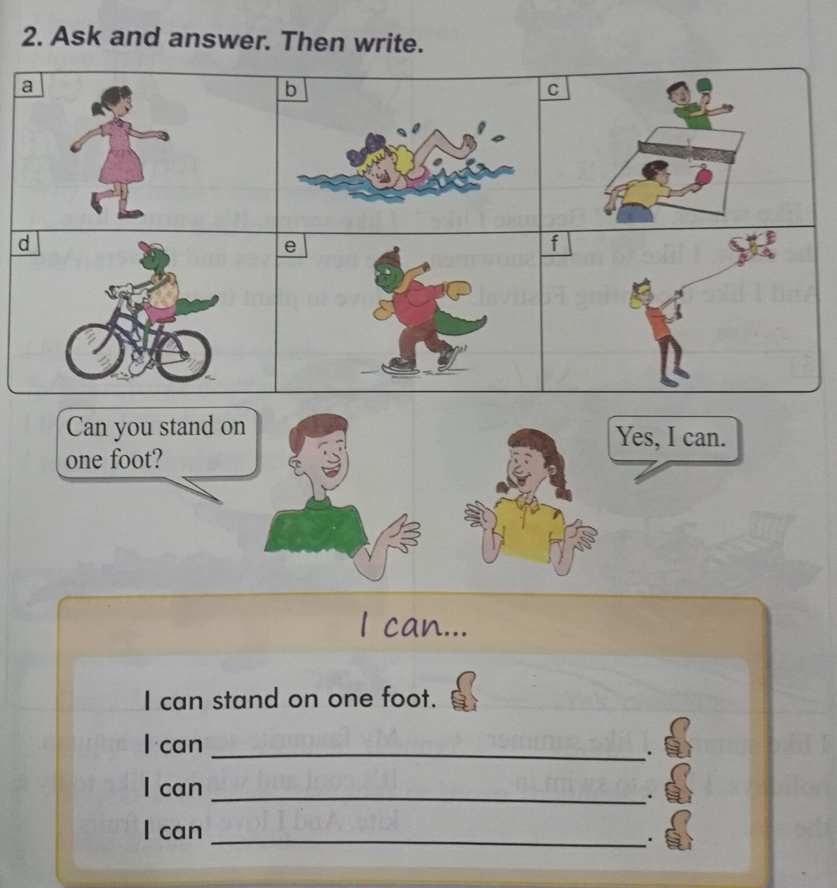
Practice
I can swim in the river.
I can play the table tennis.
I can ride a bike.
I can skate.
I can fly the kite.

Slide 8
Consolidation
Show and talk.
A: I can swim. Can you swim?
B: No, I can’t.
C: I’m going to teach you to
swim.
B: Oh, great！
D: I like skating, but I can’t.
Can you skate?
E: Yes, I can. I’m going to
teach you to skate.
D: Thank you！

Slide 9
Summing up
1.words:
skate, late, teach, ice, learn, fast, again, ask, say,
stand up, fall down
2. Sentences:
sb. be going to…
I can… can you …?
How did I do, Danny?
He falls down again.
3.
这节课我的收获是：_____________
这节课我的不足是：_____________

Slide 10
Homework
1.听录音，朗读本课的第一部分
2.完成相关习题
3.结合本课学习内容创编一个新对话，并将其表演出来。

