Slide 1
Unit 1 Know yourself
Comic strip
Welcome to the unit
WWW.PPT818.COM

Slide 2
Studying aims
1.To Learn some words to describe people’s personalities.
学会描述性格；
2.To be able to talk about your own personalities and the kind of job you like or dislike.
会谈论性格与所喜爱或不喜爱的工作；
3. To learn to have good personal qualities.
培养良好的性格特征

Slide 3
*who is your best friend/sister/brother? *What’s he/she like? (kind, lovely, organized, modest, humorous, helpful….) *Why do you think so?
Task1: Free talk

Slide 4
Some words are often used to describe people’s personalities
create curious energetic modest organized patient
Choose them to complete the following sentences

Slide 5
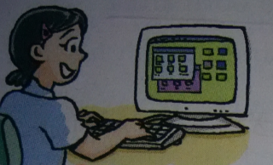
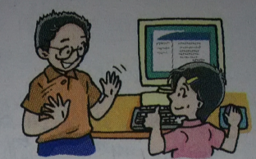
organized
Suzy is well _______. She keeps all her things in good order.
Daniel is very clever, but he is ______ and never shows off.
modest

Slide 6
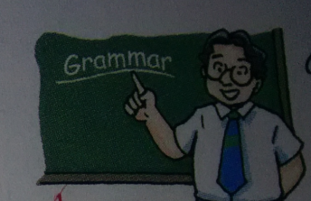
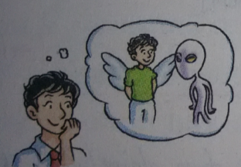
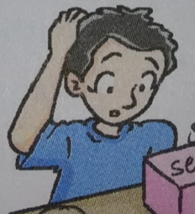
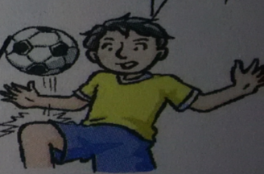
patient
creative
Mr Wu is _______.
Samuel is_______.
curious
energetic
Billy is_______.
Simon is_______ .

Slide 7
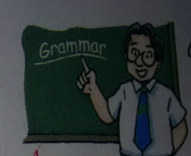
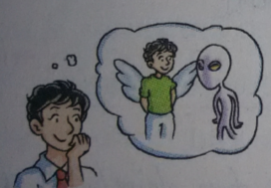
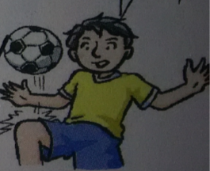
Task1:Talk about one of their personalities.
Suzy is organized…
Daniel is clever, but …
Mr Wu is patient…
Samuel is creative…
Billy is curious…
Simon is energetic…

Slide 8
Task2: Read and answer
1. Why does Millie think she can be a good
teacher or doctor?
2. What’s Paul like?
3. What job does Sandy like?
4. Does David like to work without speaking all day long?

Slide 9
Task3: Pair Work
A: I am …(性格). I think I can be a …(职业).What job do you like?
B: I am …(性格). I like…(职业)

Slide 10
Learn by yourselves
Have a look at Page 6 and Page 7, try to find out something difficult.
看6页和7页,找一找有没有疑难点?
智者善于动脑，
勇者敢于提问！

Slide 11
Task4: Read and answer
What’s Eddie like according to the article?
What happened to Eddie’s breakfast at last?
He is generous.
His breakfast was eaten up by Hobo.

Slide 12
1.这儿有一篇关于性格的文章.(倒装句)
Here is an interesting article about personality.
2.上面写道…
It says/ reads
3.和他人分享东西使得他们感觉良好。
To share things with others makes them feel good.
4.你吃光了我的早饭。
You’ve eaten up my breakfast
5.不同性格的人行为方式不同。
People with different personalities behave in different ways.
6.保持所有的东西井然有序
Keep all things in good order
7.炫耀
show off show it / them off

Slide 13
8.吴老师够有耐心向我们重复语法。
Mr wu is patient enough to repeat grammar rules for us.
9.想出新点子
come up with new ideas
10.对一切好奇
be curious about everything
11.容易生气
get angry easily
12. 我的父母和我都认为我不能成为一个好会计
Neither my partents nor I think I can make a good accountant.
13. 有令人振奋的好主意
Have exciting ideas
14. 对我来说整天工作不说话太恐
It’s terrible for me to work without speaking all day long

Slide 14
1. eat up 吃光，吃完
如: She made a cake and ate it up.
拓展:drink up 喝光，喝完
1). --It’s everyone’s duty to join the Clean Your
Plate Campaign.光盘行动
-- Sure. We should try to _____ all the food that
we’ve ordered.
A. give up B. eat up C. turn up D. show up
eat – ate--eaten
B

Slide 15
2. keep… in good order 保持…井然有序
order 名词，意为“顺序”
如: Please keep all the books in good order.
拓展: order in the right order （顺序）
orders soon came.（命令）
show your order (订单）
order sb. (not) to do sth./ order a pizza 动，点菜
keep … in order
in order to do sth.
3. show off 炫耀(show—showed-shown)
show it off 炫耀它
show sb. around sp 带领某人参观某地
show sth. to sb. / show sb. sth.把…拿给某让你看
be on show 展出
例：他从不炫耀他的成功。
He never shows off his success.

Slide 16
4. come up with 想出，不用被动
(1) We believe we can _____ a way to solve the problem in the future.
A. catch up with B. come up with
C. put off D. set off
5. neither … nor…就近原则决定谓语
既不…也不…, 两者都不…
Neither you nor he ________(know) it?
______ (do) neither you nor he know it?
只有Neither (of)… +动单
Neither of them _____(be) a teacher.
Neither sentence _____(be ) correct.
neither/ both/ none/ all /either
neither…nor either…or
B
knows
Do
is
is

Slide 17
1.eat---ate—eaten eat up eat it/ them up
2. creative—create
3. curious—curiously be curious about
4. energetic– energy a lot of energy
5. organized – organize –organization

Slide 18
1.这儿有一篇关于性格的文章.(倒装句)
Here is an interesting article about personality.
2.上面写道…
It says/ reads
3.和他人分享东西使得他们感觉良好。
To share things with others makes them feel good.
4.你吃光了我的早饭。
You’ve eaten up my breakfast
5.不同性格的人行为方式不同。
People with different personalities behave in different ways.
6.保持所有的东西井然有序
Keep all things in good order
7.炫耀
show off show it / them off

Slide 19
8.吴老师够有耐心向我们重复语法。
. Mr wu is patient enough to repeat grammar rules for us.
9.想出新点子
come up with new ideas
10.对一切好奇
. be curious about everything
11.容易生气
get angry easily
12. 我的父母和我都认为我不能成为一个好会计
Neither my partents nor I think I can make a good accountant.
13. 有令人振奋的好主意
. Have exciting ideas
14. 对我来说整天工作不说话太恐
It’s terrible for me to work without speaking all day long.

