Slide 1
Unit 2 School life
第3课时
WWW.PPT818.COM

Slide 2
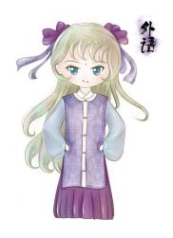
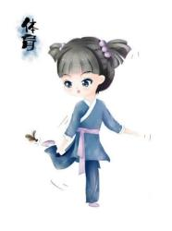
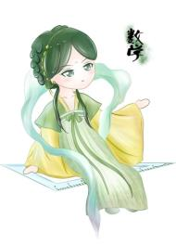
What’s your favourite subject?

Slide 3
B1) Daniel does not know the meanings of some words in the articles. Help him match the words on the left with the meanings on the right. Write the correct letters in the blanks.
1 foreign （line 5）
2 language （line 5）
3 discuss （line 9）
4 offer （line 17）
5 win （line 23）
___________
___________
___________
___________
___________
a talk about something
b give something to someone
c be best or first in a competition
d not in or from your own country
e words used in speaking and writing
d
e
a
b
c

Slide 4
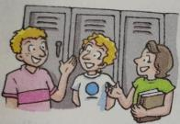
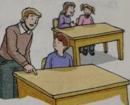
B2) Daniel found some pictures of Nancy's and John's schools. Help him complete the description of each picture.
1 In a ________ school, boys and girls study ________.
2 In the ________, older students help new students learn more about _________.
mixed together
club
the school
1.
2.

Slide 5
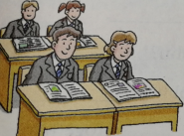
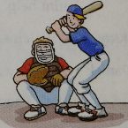
3.
4.
3 During _______________, students can _______________ from the library and can bring in __________________ from home.
4 Some students ___________ after school and they____________ every time.
the Reading Week borrow more books books and magazines
play baseball practice hard

Slide 6
B3)Daniel wrote about schools in the two countries. However, he made some mistakes. Write a T if a sentence is true or an F if it is false.
1 Both Nancy and John are Grade 8 students. _____
2 Nancy’s favourite subject is English. _____
3 There is a Reading Week at Nancy‘s school every year. _____
4 Nancy always brings in more books than her classmates. _____
5 The classes at John’s school are not the same every day. _____
6 John and his friends often go shopping on Friday afternoon. _____
T
F
T
F
T
F

Slide 7
B4) On the way home, Daniel tells Kitty about John's school life. Complete their conversation with the words in the box.
Daniel：I read an article by a boy from the USA. His name is John. He's in the 8th grade.
Kitty：Really？ What's his school life like？
Daniel：Every Monday, he goes to the Buddy Club. His friend Tony is in the 12th grade. Tony listens to John's problems and （1）_________ him help. He's John's （2） .
baseball ends hero offers sports twice won
offers
hero

Slide 8
baseball ends hero offers sports twice won
Kitty：What else do you know about John？
Daniel：On Friday afternoon， their school （3） earlier than usual. They often do （4） together.
Kitty：Does John like sports？
Daniel：Yes. His favourite sport is （5） . He plays it （6）_______ a week. Their team （7） two games last month.
ends
sports
baseball
twice
won

Slide 9
知识点
else/els/adv. 别的，其他的
1
eg： There is nothing else in the fridge. 冰箱里什么其他的东西也没有。
考向一
【重点】
用在疑问代词或不定代词后。
eg： What else do you want？你还要什么别的吗？
Nothing else happened. 没有其他的事发生。

Slide 10
考向二
else后可加's构成所有格。
【易错点】
eg： That must be somebody else's book；it isn't mine.
那一定是另外什么人的书，不是我的。
考向三
辨析else和other
other“别的”，修饰名词，位于名词前。
eg： What's that in your other hand？
你另一只手里是什么？

Slide 11
典例
His work is better than _______ .
A. else anyone B. anyone else
C. anyone else's D. anyone's else
C
【点拨】else修饰不定代词时应位于不定代词之后。表示“其他任何人的”用anyone else's。

Slide 12
本节课主要学习了以下知识点，请同学们及时巩固练习：
else的用法

Slide 13
一、单项选择
1. There is a car wash of the highway.
A. with the end B. of the end
C. for the end D. at the end
D
【点拨】本题用句意理解法。题意为：在高速公路的尽头有一个汽车冲洗处。at the end of表示“在……尽头”。

Slide 14
2. Betty often helps her mother housework.
A. to do B. do C. does D. A and B
3. —Can I a dictionary from you， Lucy？
—Sorry， I don't have one. （遂宁）
A. borrow B. lend C. lent
D
【点拨】help sb. (to) do sth.为固定用法，意为“帮助某人做某事”。
A

Slide 15
二、根据汉语完成句子
4. 我们也可以把家里的书和杂志带来。
We can also _______ _______ books and _________ _______home.
5. 我们的英语老师让我们在课堂上讲英语。
Our English teacher asks us to speak English _____ ______ .
6. 格林先生经常在英语方面帮助我们。
Mr Green often ________us _________ our English.
bring in magazines
from
in class
helps with

Slide 16
7. 我想更多地了解你们学校。
I want to _______ ________ ________ your school.
8. 我姐姐在学校一周打两次棒球。
My sister _______ _______ _______ _______ _______ at school.
learn more about
plays baseball twice a week

