Slide 1
Unit 8
Pets
Revision
WWW.PPT818.COM

Slide 2
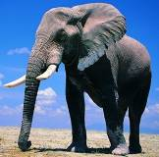
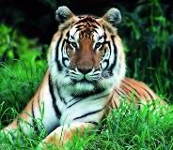
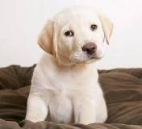
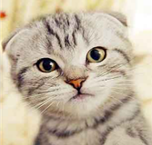
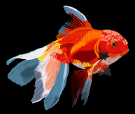
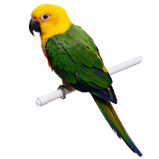
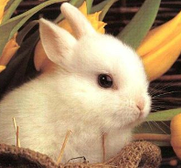
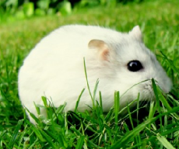
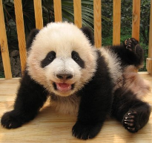
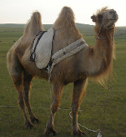
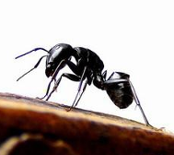
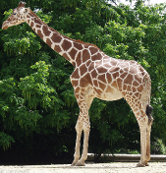
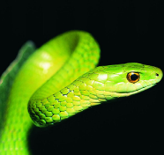
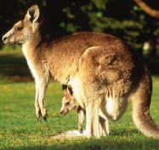
elephant
tiger
dog
cat
goldfish
parrot
rabbit
mouse
panda
camel
ant
giraffe
snake
kangaroo

Slide 3
Guess what I am!
I have fur. I have four paws. I sleep a lot. My favourite food is fish.

Slide 4
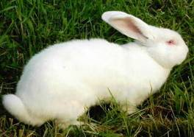
Guess what I am!
I have long ears. I eat lots of carrots.

Slide 5
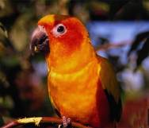
Guess what I am!
I have two legs. I like to sing. I have feathers. I can fly.

Slide 6
Guess what I am!
I’m orange. I live in a tank. I have fins.

Slide 7
Guess what I am!
I love to go to the park and play with balls and sticks. Sometimes, I bark at people.

Slide 8
Free talk:
A: What’s your favourite pet?
B: My favourite pet is…
A: Why ?
B: Because…

Slide 9
基础强化
Fill in the blanks using the right form of the words given.
more polite
You should be much___________ (polite).
Kate doesn’t like dogs because they’re very _____ (noise) and need a lot of care.
We should always keep our classroom _____ (clean) and tidy.
People hate all _____ (mouse) except one mouse --- Mickey mouse.
5. The students will go__________ (camp) this Sunday.
noisy
clean
mice
camping

Slide 10
5.A tortoise has four legs and it has a shell, too. But it moves very _____ (slow)
6.This bike belongs to me, I am the _____
(own) of this bike.
7.It says that we eat about 27,000 kilos of food during our lives. That’s the _____ (weigh) of about six elephants.
8.English is used _____ (wide) in the world.
9.Is there anybody _____ (hide) behind the door?
10.The twin brothers are quite ________ from each other. Do you know the __________ between them?(different)
slowly
owner
weight
widely
hiding
different
differences

Slide 11
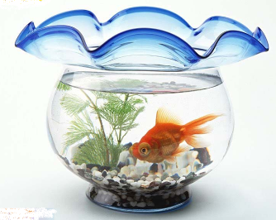
How to keep a goldfish?
1. Give it clean water.
2. Change the water once a week.
3. Don’t give it too much food.
4. Don’t take it out of the water.
5. Don’t put it in the sun.

Slide 12
语法回顾
祈使句 giving instructions
看例句，总结规律
Please come earlier next time.
Stop talking, please.
Don’t be too noisy.
Don’t frighten the cat
2) 否定祈使句：用Don’t + 动词原形。
1）肯定祈使句：用动词原形开头，可通过please使命令的口气变得客气一点。Please可放在句首，或放在句尾时，通常用逗号与句子的前面部分隔开。

Slide 13
Rearrange the words to make sentences.
1. feed/don’t/too much/food/goldfish
2. the cat/don’t/play with/let/the dog
3. the cat/healthy/please/keep/Simon
Don’t feed goldfish too much food.
Don’t let the cat play with the dog.
Simon, please keep the cat healthy.

Slide 14
4. in /sun/read/don’t/the
5. frighten/don’t/the child/please
6. bring/my lunch/me/Eddie
Don’t read in the sun.
Don’t frighten the child, please.
Eddie, bring me my lunch.

Slide 15
语法回顾
祈使句的反意疑问句
Put the book over there, _______ ?
Don’t leave your pet alone, _______ ?
Let us walk the dog,___________?
Let’s clean the fish tank, _______ ?
will you
will you
will you
shall we

Slide 16
“must” “should”
语法回顾
情态动词must意为“必须”,表示一种义务，主动去承担.否定mustn’t表示“不许可”,表示一种禁止.must可表示现在或将来的情况.疑问式的否定回答常用”needn’t”.
情态动词should意为“应该”，否定形式为“shouldn't"意为“不该”，他们都用来向别人提出建议，告诉别人最好做哪些事或做那些事是正确的。

Slide 17
Differences between ‘should’ and ‘must’
‘must’ 比 ‘should’ 语气更强烈，
而mustn’t表示禁止做某事或不允许做某事
mustn’t
1. You _______ bring your pet to school.
2. They ______ come earlier next time.
3. You ____ keep quiet in the library.
4. We ________ spend too much time watching TV.
should
must
shouldn’t

Slide 18
中考相关语法链接
1. Cars, buses and bikes _____ stop when the traffic light is red.
A. can B. must C. may D. need
2. --_____ I fill in the check-in form right, sir?
--No, you needn’t. You can complete it this afternoon.
A. May B. should C. Must D. Would
3. _____ I have to show the school report to my parents, Miss King?
A. Must B. Do C. Can D. May
B
C
B

Slide 19
4. --Must I return the book tomorrow morning?
--No, you_____. You _____ keep it for a day.
A. mustn’t, may B. mustn’t, must
C. needn’t, can D. needn’t, must
5. --May I go surfing alone this afternoon, Dad?
--No, you _____. It is dangerous.
A. may not B. can’t C. needn’t D. don’t
6. Alice has been in China for several years. She
_____ be a big girl now.
A. need B. must C. can D. may
C
B
B

Slide 20
7. –Look ! Mr Hu is on the other side of the street.
-- It ______ be him. He has gone to Shanghai.
A. mustn’t B. can’t C. shouldn’t D. won’t
B

Slide 21
写作部分
A presentation on your favourite pet
My favourite pet…
Its name is …
It is always very friendly.
It Looks like
It likes/ It doesn’t like
It lives in …
We should / we shouldn’t
We must/ we mustn’t
Write down your own presentation on your favourite pet
Hurry up! You have only 4 minutes

Slide 22
`
Thanks for joining us!
Goodbye!

