Slide 1
Unit 1 Li Ming Goes to Canada
Lesson 1 At the Airport
WWW.PPT818.COM

Slide 2
WARMING-UP
one
抢答啦！
fourteen
three
thirteen
two

Slide 3
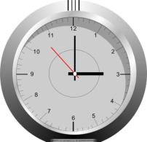
WARMING-UP
A guessing game！
What time is it now?
It’s…

Slide 4
WARMING-UP
Li Ming, English, Canada, home, tired
A: Hello, everyone. I have a good friend. He is Li Ming.
Look! He is coming.
B: Nice to see you, Li Ming.
C: Nice to see you, too!
B: Where do you live now?
C: I live in Canada.
B: Why?
C: Because I study English in Canada.
B: When do you get up/go home every day?
……

Slide 5
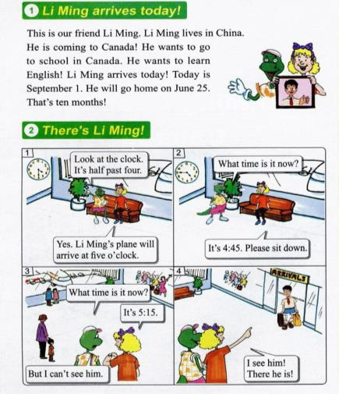
Presentation
Where is Li Ming?
Where will he go?
Li Ming is at the airport.
He will go to Canada.

Slide 6
Presentation
回答问题。
1.Does Li Ming live in Canada?
2.Why will Li Ming go to Canada?
3.When does Li Ming arrive?
4.How long will Li Ming be in Canada?
No, he doesn’t.
He wants to go to school in Canada.
He will on September 1.
Ten months.

Slide 7
Presentation
Keys: 1.F 2.F 3.F 4.T

Slide 8
Presentation
观察图片，回答问题。
When will Li Ming’s plane arrive?

Slide 9
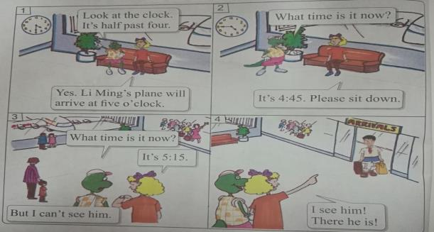
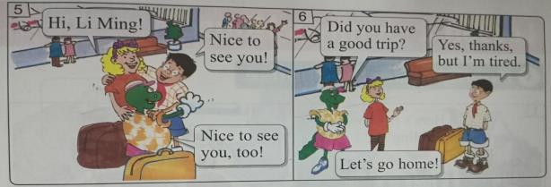
Presentation
Part 2

Slide 10
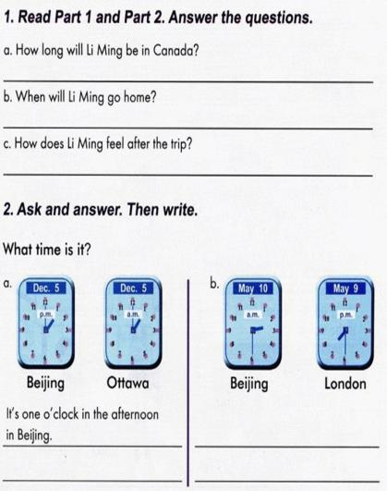
Practice
小组合作学习，完成Part 3。
Keys：
1.a. Ten months.
b.He will go home on June 25.
c. He feels tired.
2.a.It’s one o’clock in the morning
in Ottawa.
b. It’s two thirty in the morning in Beijing.
It’s seven thirty in the afternoon in London.

Slide 11
Consolidation
1.完成调查表，并介绍。
Name | Place of birth | Foreign country | aim | When will you arrive? | vehicle
2.结合表格内容，仿照课文，创编对话表演。

Slide 12
Summing up
1.Words:
home, time, clock, half, go home, month, plane, past
2.Sentences:
Li Ming arrives today!
What time is it now?
It’s …
Did you have a good trip?
Yes, thanks, but I’m tired.
这节课我的收获是：_____________
这节课我的不足是：_____________

Slide 13
Homework
1.听录音，朗读本课的第一、二部分。
2.完成相关习题。
3.结合本课学习内容创编对话并表演。

