Slide 1
陕旅版英语五年级上册
Unit3
My Favorite Food Is Hamburgers
第1课时
WWW.PPT818.COM

Slide 2
教学目标:
1. 能听、说、读、写词汇：China, the USA, fruit, drink, food, chocolate, hamburger。
2. 能在教师的组织和带领下完成Warming-up: Think and match部分。

Slide 3
Warming-up
Let’s sing-Every Day

Slide 4
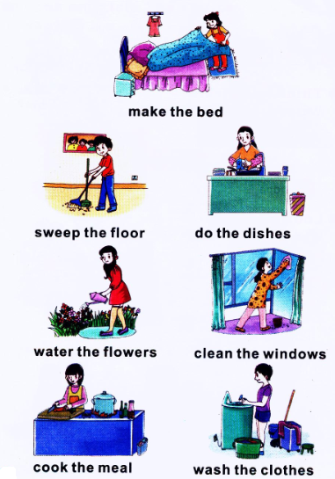
Free talk
What can you do at home?
I can…

Slide 5
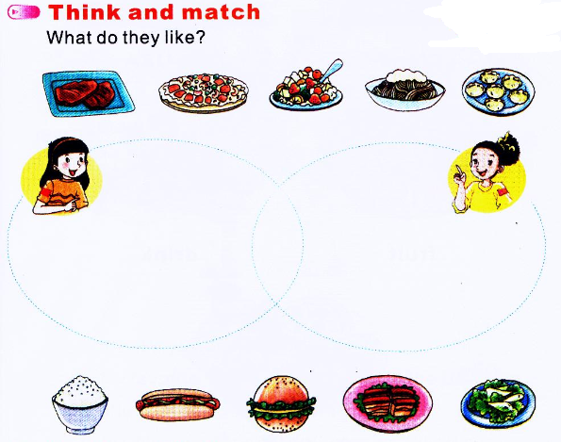
Kitty
Li Shan

Slide 6
Can you guess?
Where is Li Shan from?
Where is Kitty from?

Slide 7
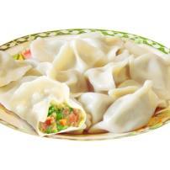
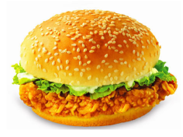
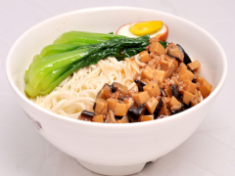
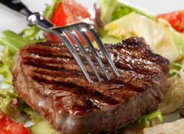
Guess what food do they like?

Slide 8
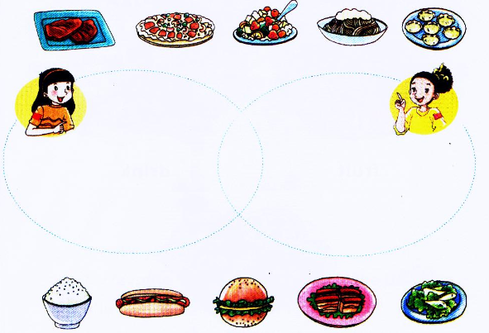
Think and match
What do they like?

Slide 9
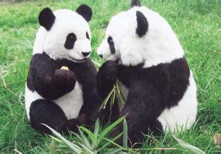
Where are the pandas from?
They are from China.

Slide 10
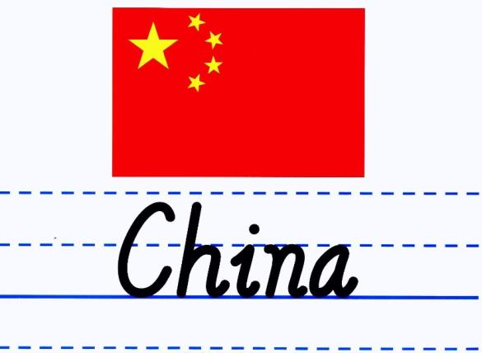
中国

Slide 11
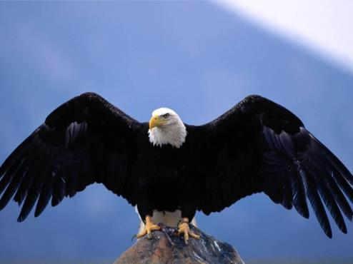
Where is the bald eagle（白头海雕） from?
It is from the USA.

Slide 12
美国

Slide 13
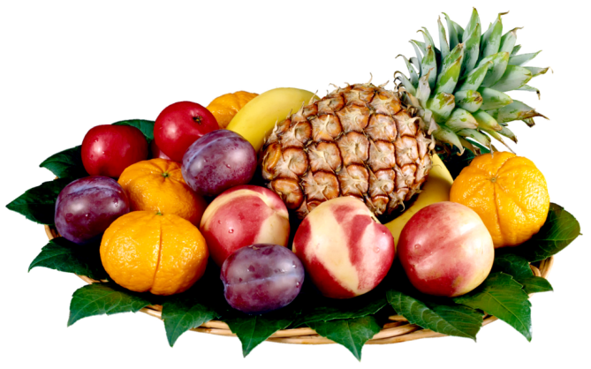
What are these?
They are fruits.

Slide 14
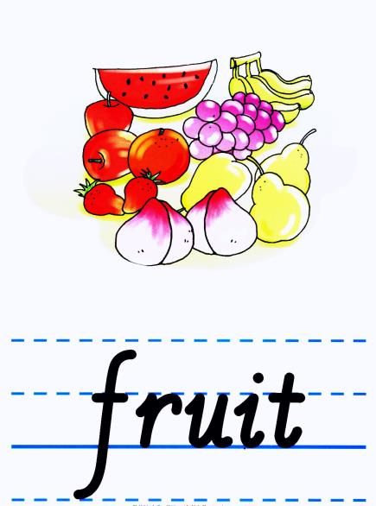
水果

Slide 15
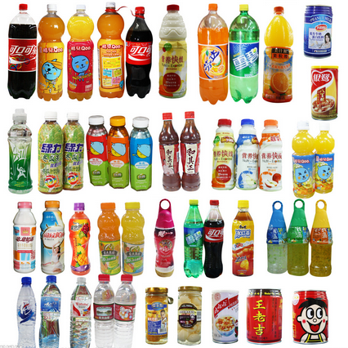
Which drink do you like best?

Slide 16
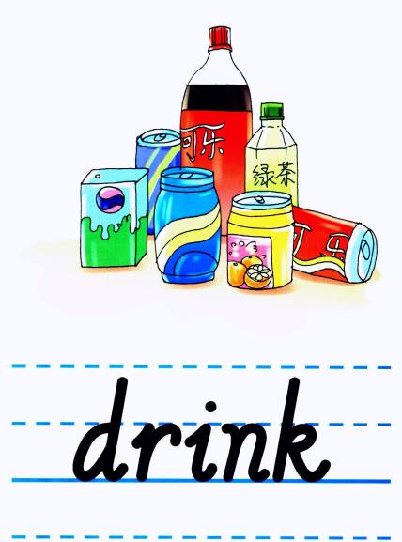
饮料

Slide 17
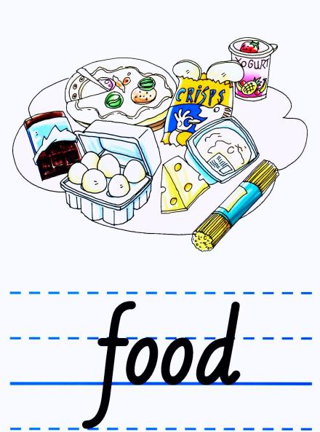
食物

Slide 18
巧克力

Slide 19
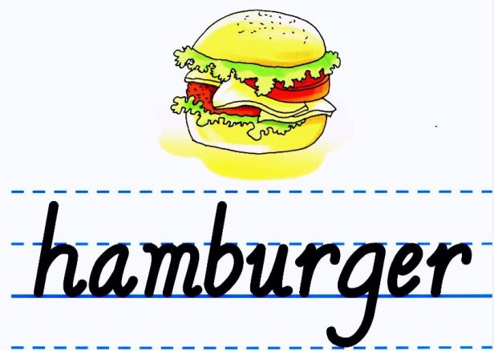
汉堡

Slide 20
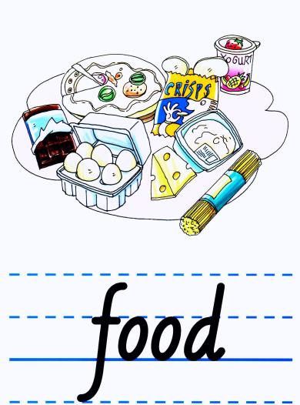
Let’s play-Flash cards

Slide 21
Let’s play-听声音找卡片

