Slide 1
Module 11 Body language
Unit 1 They touch noses!
WWW.PPT818.COM

Slide 2
Warming-up
Watch and answer
1. What do Japanese people do when they greet each other?
2. What do French people do when they see each other?

Slide 3
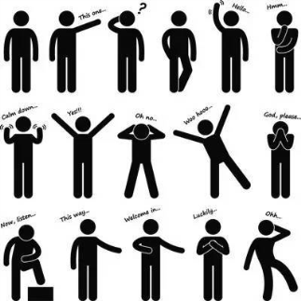
Warming-up
Look and say
What do they mean?
What?
Greet!
Thinking!
No!

Slide 4
Warming-up
Read and think
What is body language?
It’s the way (方式) you stand, sit and walk.
It’s your gestures (手势) and expressions (表情) on your face and in your eyes.
It’s your whole appearance (外貌) that communicates (交流) things.

Slide 5
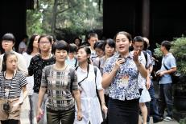
Pre-listening
Look and learn
visitor(s)
together
British
German(s)

Slide 6
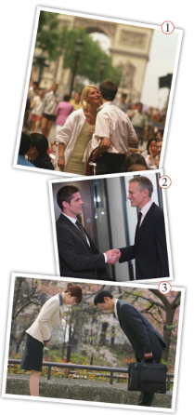
Pre-listening
2 Listen and match the pictures with the nationality.
British French
German Japanese
Russian
1
3
2

Slide 7
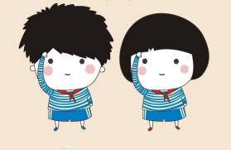
Pre-listening
Now work in pairs and check.
They’re shaking hands.
What are they doing?
Yes, they are.
Are they Russian?

Slide 8
While-listening
Listen and choose
What are they talking about?
A. Food in different countries.
B. Different ways to welcome the visitors.
C. How to travel to different countries.

Slide 9
While-listening
Listen again and answer the questions.
1. Who will come to Lingling’s school?
2. What will Maori people do when they meet?
3. How many countries are mentioned (提及)?
Some Russian teachers.
They will touch noses.
Five countries.

Slide 10
Post-listening
Language points
1. … in Russia, people usually kiss three times.
times在这里表示次数，three times表示 “三次”。
在英文中，一次是“once”，两次是“twice”，三次及三次以上都用“基数词+times”。
e.g. My mother goes shopping once a week.
我妈妈每周购物一次。

Slide 11
Post-listening
Language points
2. No, I didn’t know that.
这个句子之所以用一般过去时是因为玲玲现在已经知道了， 因为贝蒂刚刚告诉过她，所以她以前不知道，“不知道”已经是过去的事情了。
e.g. Oh, you have two children! I didn’t know that.
哦，你有两个孩子啊！我以前可不知道。

Slide 12
Post-listening
Language points
3. That’s because people do different things in different countries.
That’s because…是一个常用句式，其中，that表示刚刚谈到的内容。
注意，这里要用that，而不能用this，因为this表示将要谈及的内容。
e.g. That’s because you were not careful enough.
那是因为你不够细心。

Slide 13
Post-listening
3 Complete the table with the correct form of the
words from the box.
India kiss Russia together touch visitor
In China, people shake hands and smile.
kiss
when they meet
(6)
_______.
American people shake hands and sometimes (1) _______.
India
together
In (2) ________, people put their hands (3) ________ and nod their heads.
visitors
Russia
In (4) ________, people kiss each other three times.
touch
Maori people (5) ________ noses.

Slide 14
Post-listening
4 Listen and repeat.
/tʃ/ Chinese each French teacher touch
/ʃ/ British shake
/pl/ people
/fr/ French
/br/ British

Slide 15
Post-listening
5 Work in groups. Talk about what you do and say when you meet.
your teacher
your head teacher
your parents after school
your best friend
your best friend’s parents
your favourite film star
a visitor to your school
an American
a Russian

Slide 16
Post-listening
5 Work in groups. Talk about what you do and say when you meet.
I smile and say good morning.
What do you do and say when you meet your teacher in the morning?

Slide 17
Post-listening
Do the exercises
一、单项选择。
1. Some ______ visit the Great Wall
every year.
A. visiter B. visitor C. visitors
2. Chinese often ______ when they meet.
A. shake hands B. shakes hands
C. touch noses

Slide 18
Post-listening
Do the exercises
3. They help ______ when they are in trouble.
A. each B. each other C. the other
4. They all live ______ in a three-bedroom house.
A. together B. with C. each
5. Would you like to talk with ______?
A. German B. Germans C. Germen

Slide 19
Post-listening
Do the exercises
二、用所给单词的适当形式填空。
1. They are some __________ (Russia) people.
2. In __________ (India) people put their hands together and nod their heads when they meet.
3. People usually kiss three _________ (time), left, right, left.
4. There are a lot of _________ (country) in the world.
5. Peter and Julia are _________ (Japan).
Russian
India
times
countries
Japanese

Slide 20
Summary
Words and expressions:
bow, kiss, shake, smile, British, German, Japanese, Russian, visitor, Russia, what, nod, head, hug, each, India, together, Maori, touch, nose, shake hands, each other…
Sentence patterns:
1. How do I do that?
2. No, I didn’t know that.
3. So what do people in the US usually do when they meet?

Slide 21
Homework
1. Remember the different ways of greeting.
2. Listen and role-play the dialogue.

Slide 22
Goodbye!

