Slide 1
Unit 1
Where’s the bird?
第二课时
WWW.PPT818.COM

Slide 2
Introduce
Hello, boys and girls.
Hello, Miss …
Do you remember this little bird?
Yes.
Let’s sing the song “Where is the bird?”

Slide 3
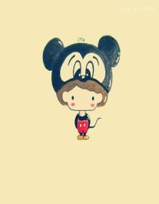
Words
guess /ges/
作动词，意为“猜；猜测”，
eg： I guess he was wrong. 我想他错了。
作名词，意为“猜测；猜想”，
eg： I'll give you three guesses. 我让你猜三次。
小练习：汉译英。
请猜出我的名字。_____________________
Please guess my name.

Slide 4
Expressions
Is it in your pencil case?
这是个一般疑问句，意为“它……吗？”。
其肯定回答为“Yes, it is.”，否定回答为“No, it isn’t.”
小练习：汉译英。
它在你的书桌里吗？_______________
Is it in your desk?

Slide 5
Dialogue
Guess and say
Where’s my pencil? Guess.
Is it in your pencil case?
No,it isn’t.
Is it in your schoolbag?
Yes,it is.
Is it…?
No,it isn’t.
Yes,it is.

Slide 6
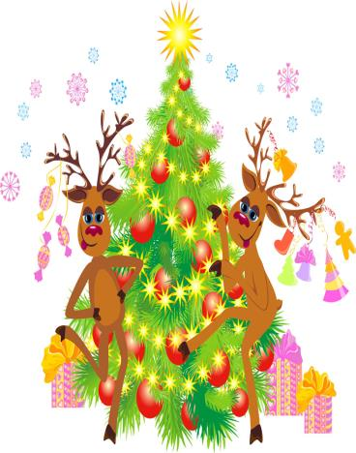
Expand
美国人过圣诞节的习俗
每年12月25日的圣诞节，是美国人最大最热闹的节日。圣诞夜是一个狂欢的夜晚。人们在小杉树上或小松树上挂满礼物、彩花和彩灯，树顶上还装上一颗大星。大人们站在一旁欣赏圣诞树， 孩子们更是手舞足蹈，甚至手拉手地围着圣诞树跳起欢快的舞蹈。

Slide 7
Summary
guess
Is it in your pencil case?

Slide 8
Exercise
将下列单词与图片连线。
desk chair under bird on

Slide 9
Exercise
给下列短语选择合适的译文。
（ ）1. in the tree
A.在树上
B.在树下
（ ）2. on your chair
A.在我的书桌上
B.在你的椅子上
（ ）3. in your pencil case
A.在你的铅笔盒里
B.在我的铅笔盒上面
（ ）4. under the desk
A.在桌子下
B.在椅子下
A
A
B
A

Slide 10
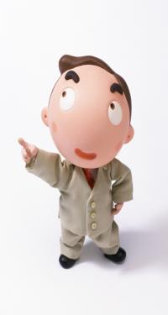
Exercise
给下列句子选择合适的答语。
( )1.Where is my schoolbag?
( )2.Is it in the tree?
( )3.Here you are.
( )4.Look! A bird!
B
A.Thank you.
B.It’s on the chair.
C.How beautiful!
D.No, it isn’t.
D
A
C

Slide 11
Homework
Make a conversation by using “Is it in…?”with your classmates.

