Slide 1
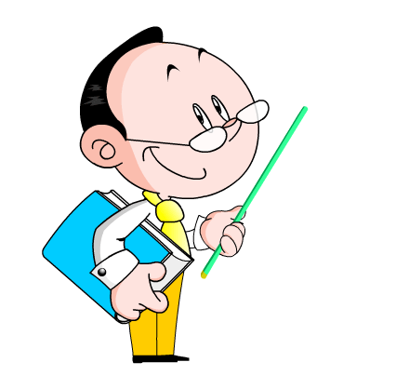
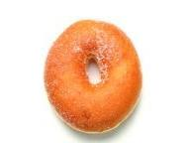
Lesson 22
Big Plans for the Weekend
WWW.PPT818.COM

Slide 2
Learning Aims:
1. Learn the new words and expressions.
2. Practise the usage of “be going to ”.
3. Talk about weekend activities.

Slide 3
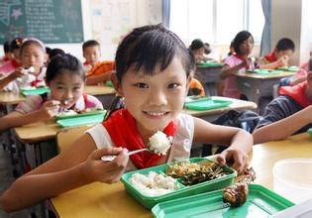
Presentation
have lunch

Slide 4
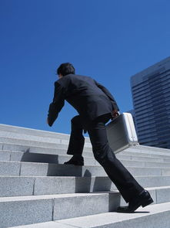
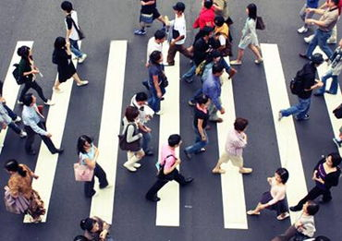
in a hurry to do ...

Slide 5
cooking

Slide 6
surf the Internet

Slide 7
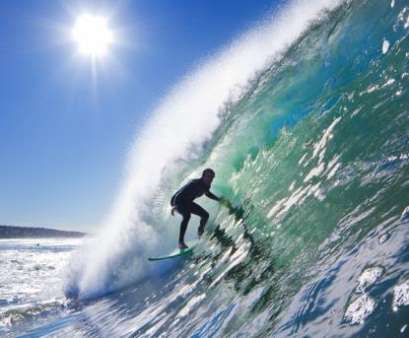
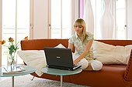
PPT模板：www.1ppt.com/moban/ PPT素材：www.1ppt.com/sucai/
PPT背景：www.1ppt.com/beijing/ PPT图表：www.1ppt.com/tubiao/
PPT下载：www.1ppt.com/xiazai/ PPT教程： www.1ppt.com/powerpoint/
资料下载：www.1ppt.com/ziliao/ 范文下载：www.1ppt.com/fanwen/
试卷下载：www.1ppt.com/shiti/ 教案下载：www.1ppt.com/jiaoan/
PPT论坛：www.1ppt.cn PPT课件：www.1ppt.com/kejian/
语文课件：www.1ppt.com/kejian/yuwen/ 数学课件：www.1ppt.com/kejian/shuxue/
英语课件：www.1ppt.com/kejian/yingyu/ 美术课件：www.1ppt.com/kejian/meishu/
科学课件：www.1ppt.com/kejian/kexue/ 物理课件：www.1ppt.com/kejian/wuli/
化学课件：www.1ppt.com/kejian/huaxue/ 生物课件：www.1ppt.com/kejian/shengwu/
地理课件：www.1ppt.com/kejian/dili/ 历史课件：www.1ppt.com/kejian/lishi/
Surfing is a sport. You can surf on the water, but you can also surf the internet.

Slide 8
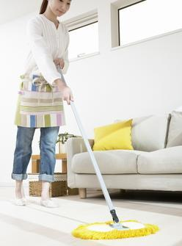
do the housework

Slide 9
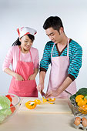
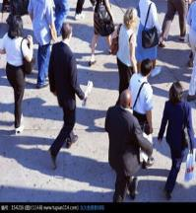
Match the words with the correct pictures.
housework surf hurry cooking

Slide 10
Let's listen to
the dialogue!
Think about it!
What is Danny going to do this weekend?
He is going to make donuts.

Slide 11
Listen and fill in the blanks
Danny and Jenny are having _____ together. But Danny can't stay still. Because he has big _____ for the weekend. He is going to make ______. Jenny would love to join him this weekend. It's going to be a _____ weekend!
lunch
plans
donuts
great

Slide 12
A: You have lunch so fast.
Are you in a hurry to go somewhere?
B: No. Actually, I have big plans for the weekend! I can't wait.
A: Oh! That's great. What are you going to do this weekend?
B: I'm going to help the old poeple surf the Internet.
Would you like to join me this weekend?
A: Really? I would love to come!
B: Wonderful! Now it's going to be a great weekend!

Slide 13
Language points:
1. Are you in a hurry to go somewhere?
in a hurry to do sth.
I'm in a hurry to go to school.
He is in a hurry to go home.
Tom is in a hurry to go to work.

Slide 14
Let's Do It!
1.The policemen are in a hurry _______ the boy.
A. save B. saves C. to save
2. Don't wait for me if you ______.
A. have a hurry B. are in a hurry C. in hurry

Slide 15
2. I usually just stay home, read a book, surf the Internet, watch TV and help my mum with the housework.
help sb. with sth. = help sb. (to) do sth.
He helps me with my math. = He helps me (to) learn math.

Slide 16
You can do it!
1. Tony often helps me learn Chinese.
=Tony often _____ me _____ my Chinese.
2. My English teacher often helps us ____ our English.
A. for B. with C. of
helps with

Slide 17
weekend activities

Slide 18
Interview your classmates and fill in the table. Then write a short report.
name | What do you usually do on weekends? | What are you going to do this weekend?
Li Dong | Surf the Internet Do the housework | Fly a kite

Slide 19
Big Plans for the Weekend!
Big Plans for the Weekend!
———————————
———————————
———————————
———————————
———————————
Li Dong likes weekends.
He usually ... on weekends.
He has a big plan for ...
He is going to ...

Slide 20
What did we learn in this lesson?
Big Plans for
the Weekend
Lesson 22
Learn some new words and expressions.
Use “be going to ”.
Talk about weekend activities.

