Slide 1
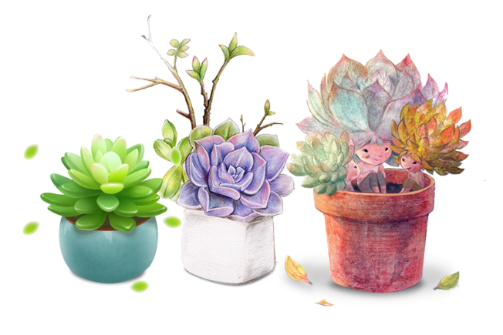
小 清 新 多 肉 通 用 模 板
THIS IS A ART TEMPLATE , THANK YOU WATCHING THIS ONE. THIS IS A ART TEMPLATE , THANK YOU WATCHING THIS ONE.
THIS IS A ART TEMPLATE , THANK YOU WATCHING THIS ONE. THIS IS A ART TEMPLATE , THANK YOU WATCHING THIS ONE.

Slide 2
1
YOUR TITTLE
Just for today I will try to live through this day only
2
YOUR TITTLE
C O N T E N T S
Just for today I will try to live through this day only
YOUR TITTLE
3
Just for today I will try to live through this day only
4
YOUR TITTLE
Just for today I will try to live through this day only

Slide 3
PART 01
THIS IS A ART TEMPLATE ,THE TEMPLATE DESIGN.THANK YOU WATCHING THIS ONE.

Slide 4
01
YOUR TITTLE
Just for today I will try to live through this day only and not tackle my whole life at once.
YOUR TITTLE
02
Just for today I will try to live through this day only and not tackle my whole life at once.
YOUR TITTLE
03
Just for today I will try to live through this day only and not tackle my whole life at once.
YOUR TITTLE
04
Just for today I will try to live through this day only and not tackle my whole life at once.

Slide 5
ADD TITLE HERE
hours that Just for today I will try to live through this day only and not tackle my whole life problem at once. I can do for twelve hours that
ADD TITLE HERE
hours that Just for today I will try to live through this day only and not tackle my whole life problem at once. I can do for twelve hours that

Slide 6
ADD YOUR TITTLE HERE
THIS IS A ART TEMPLATE , THANK YOU WATCHING THIS ONE.
STEP 01
STEP 02
STEP 03
STEP 04
Just for today I will try to live through this day only and not tackle my whole life problem at once
Just for today I will try to live through this day only and not tackle my whole life problem at once
Just for today I will try to live through this day only and not tackle my whole life problem at once
Just for today I will try to live through this day only and not tackle my whole life problem at once

Slide 7
ADD YOUR TITTLE
ADD YOUR TITTLE
You can click here to enter you text. You can click here to enter you text. You can click here to enter you text.
You can click here to enter you text. You can click here to enter you text. You can click here to enter you text.
ADD YOUR TITTLE
ADD YOUR TITTLE
You can click here to enter you text. You can click here to enter you text. You can click here to enter you text.
You can click here to enter you text. You can click here to enter you text. You can click here to enter you text.

Slide 8
PART 02
THIS IS A ART TEMPLATE ,THE TEMPLATE DESIGN.THANK YOU WATCHING THIS ONE.

Slide 9
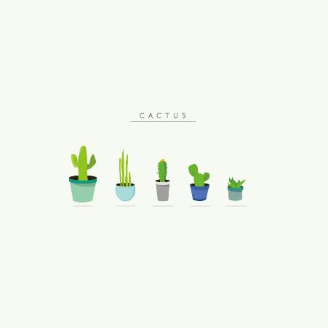
ADD YOUR TITLE
three ways. I will do somebody a good turnJust for today I will try to live through this day only and not tackle my whole three ways. I will
a good turnJust for today I will try to live through this day only and not tackle my whole three ways. I will do three ways.

Slide 10
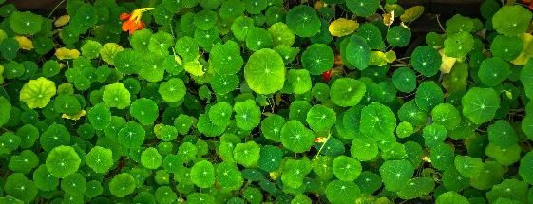
ADD YOUR TITTLE HERE
Just for today I will try to live through this day only and not tackle my whole life problem at once Just for today I will try to live through this day only and not tackle my whole life problem at once Just for only and not tackle my whole life problem at once Just for today I will try to live through this day only and not tackle my whole life problem at once Just for

Slide 11
Just for today I will try to live through this day only and not tackle my whole life at once. I can do Just for today I will try to live through this day only and not
Just for today I will try to live through this day only and not tackle my whole life at once. I can do Just for today I will try to live through this day only and not
Just for today I will try to live through this day only and not tackle my whole life at once. I can do Just for today I will try to live through this day only and not
Just for today I will try to live through this day only and not tackle my whole life at once. I can do Just for today I will try to live through this day only and not

Slide 12
ADD TITTLE
ADD TITTLE
60%
Just for today I will try to live through this day only and not tackle my whole life problem at once.
55%
Just for today I will try to live through this day only and not tackle my whole life problem at once.
ADD TITTLE
ADD TITTLE
80%
Just for today I will try to live through this day only and not tackle my whole life problem at once.
60%
Just for today I will try to live through this day only and not tackle my whole life problem at once.

Slide 13
PART 03
THIS IS A ART TEMPLATE ,THE TEMPLATE DESIGN.THANK YOU WATCHING THIS ONE.

Slide 14
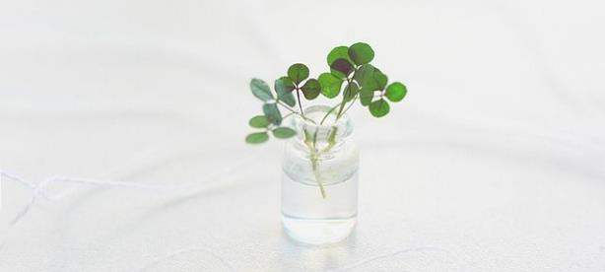
ADD YOUR TITTLE HERE
THIS IS A ART TEMPLATE ,THANK YOU WATCHING THIS ONE
THIS IS A ART TEMPLATE ,THANK YOU WATCHING THIS ONE
hours that Just for today I will try to live through this day only and not tackle my whole life problem at once. I can do for twelve hours that

Slide 15
ADD YOUR TITLE
I CAN DO SOMETHING FOR TWELVE HOURS THAT
three ways. I will do somebody a good turnJust for today I will try to live through this day only and not tackle my whole three ways.
I will do somebody a good turnJust for today I will try to live through this day only and not tackle my whole
Text content
Text content

Slide 16
three ways. I will do a turn Just for today I will try to live through this day only and not tackle my
three ways. I will do a turn Just for today I will try to live through this day only and not tackle my
three ways. I will do a turn Just for today I will try to live through this day only and not tackle my
three ways. I will do a turn Just for today I will try to live through this day only and not tackle my
30%
50%
70%
80%

Slide 17
PART 04
THIS IS A ART TEMPLATE ,THE TEMPLATE DESIGN.THANK YOU WATCHING THIS ONE.

Slide 18
leave night , Not a sound from the pavement Has the moon lost her memory She is smiling alone In the lamplight leave night , Not a sound
ADD YOUR TITTLE
ADD YOUR TITTLE
Just for today I will exercise my soul in three ways. I will do somebody a good turn
Just for today I will exercise my soul in three ways. I will do somebody a good turn
ADD YOUR TITTLE
ADD YOUR TITTLE
Just for today I will exercise my soul in three ways. I will do somebody a good turn
Just for today I will exercise my soul in three ways. I will do somebody a good turn

Slide 19
YOUR TITTLE
YOUR TITTLE
YOUR TITTLE
YOUR TITTLE
The waves beside them danced; but they
The waves beside them danced; but they
The waves beside them danced; but they
The waves beside them danced; but they
Just for today I will exercise my soul in three ways. I will do somebody a good turn and not get found out: If anybody knows of it, Just for today I will exercise my soul in three ways. I will do somebody a good turn and not get

Slide 20
感 谢 您 的 观 看
THIS IS A ART TEMPLATE , THANK YOU WATCHING THIS ONE. THIS IS A ART TEMPLATE , THANK YOU WATCHING THIS ONE.
THIS IS A ART TEMPLATE , THANK YOU WATCHING THIS ONE. THIS IS A ART TEMPLATE , THANK YOU WATCHING THIS ONE.

