Slide 1
Unit 1 Winter Holidays
Everyone was happy that day
WWW.PPT818.COM

Slide 2
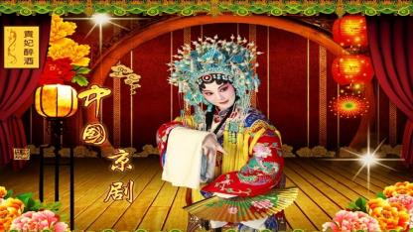
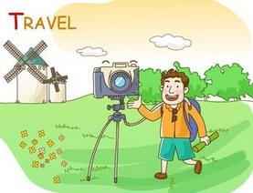
What did you do in the holidays?
I learned Beijing Opera.
I took pictures .

Slide 3
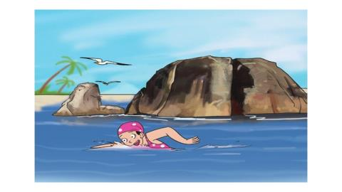
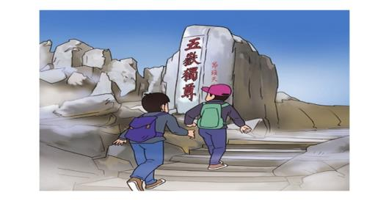
What did you do in the holidays?
went swimming
climbed the hills

Slide 4
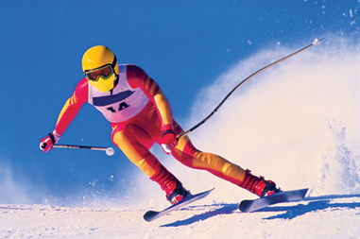
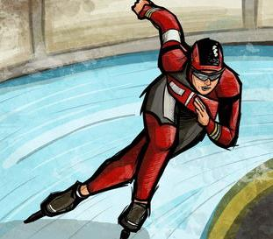
What did you do in the holidays?
went skiing
went skating

Slide 5
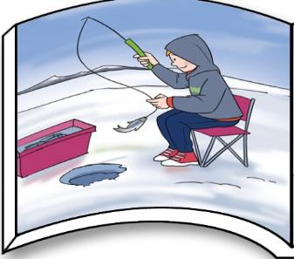
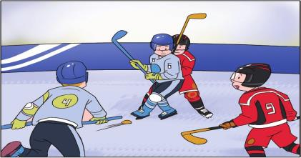
What did you do in the holidays?
played ice hockey
went ice fishing

Slide 6
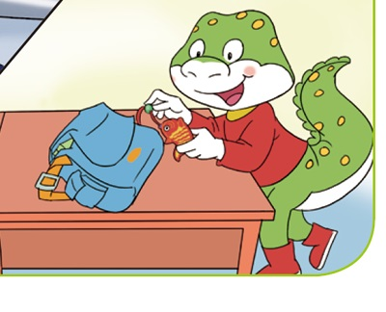
I didn’t go ice fishing, but I got a fish, too.

Slide 7
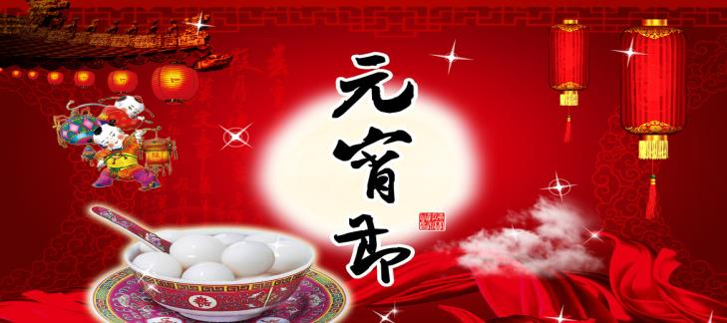
The Lantern Festival
(元宵节)

Slide 8
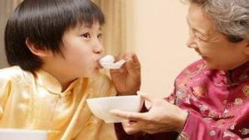
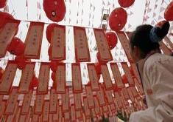
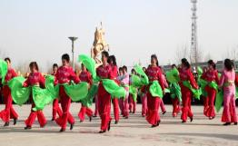
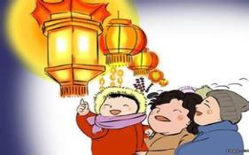
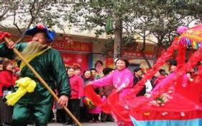
What did you do at the Lantern Festival?
eat yuanxiao
guess a riddle
yangge dance
watch the lanterns
watch a parade

Slide 9
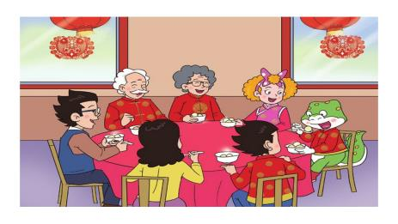
What did Li Ming, Jenny and Danny do at the Lantern Festival?
had yuanxiao
They ____________ for breakfast.
Then they___________________.
In the evening, they ____________.
It was very nice.

Slide 10
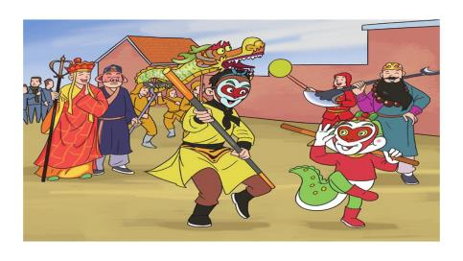
What did Li Ming, Jenny and Danny do at the Lantern Festival?
had yuanxiao
They ____________ for breakfast.
went to watch a parade
Then they________________________.
In the evening, they ____________.

Slide 11
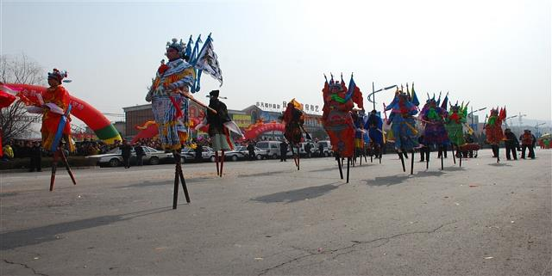
This is a parade.

Slide 12
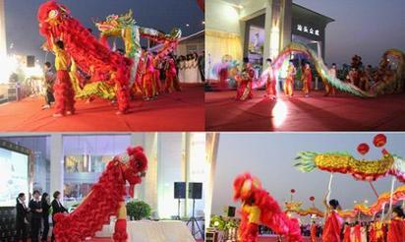
They are parades.

Slide 13
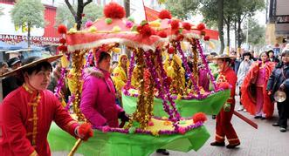
They watch the parade.

Slide 14
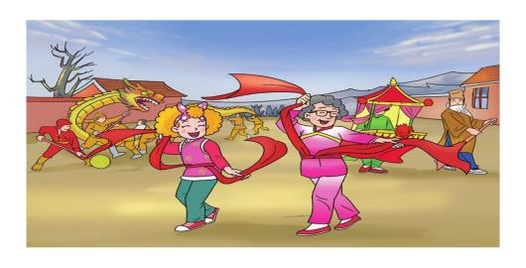
What did Jenny do in the parade?
Jenny learned the yangge dance from grandma.
It was fun.

Slide 15
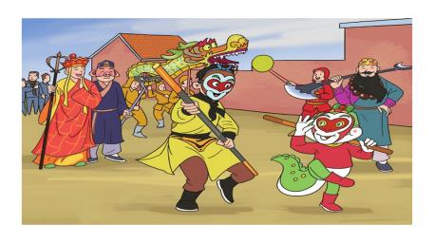
What did Danny do in the parade?
How interesting!
Danny joined the parade.
He acted like the Monkey King.

Slide 16
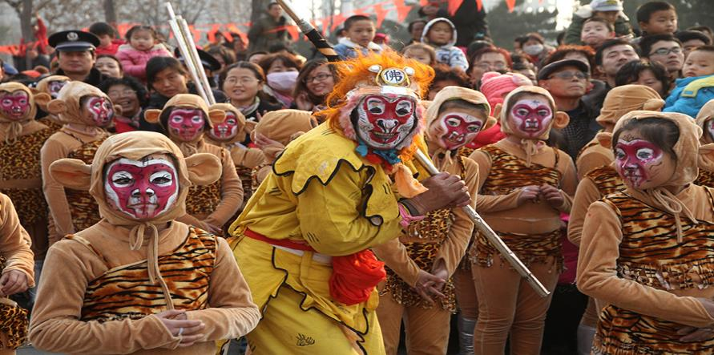
He acted like the Monkey King.

Slide 17
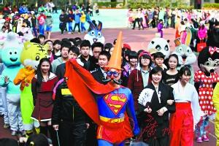
He acted like supper man.

Slide 18
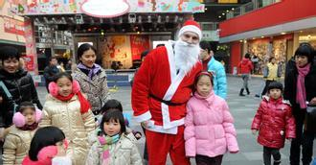
He acted like Santa.

Slide 19
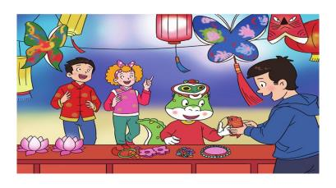
What did Li Ming, Jenny and Danny do at the Lantern Festival?
had yuanxiao
They ____________ for breakfast.
went to watch a parade
Then they________________________.
In the evening, they
__________________________.
watched the beautiful lanterns

Slide 20
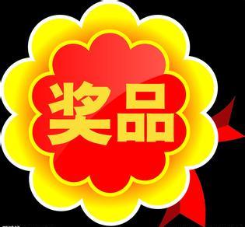
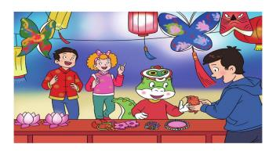
Read and fill in the blanks.
He was very excited.
What did Danny do in the evening?
guessed a riddle
Danny__________________.
and ____________.
got a prize

Slide 21
They guess __________.
a riddle

Slide 22
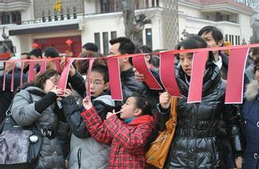
They guess riddles.

Slide 23
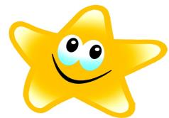
Did they have a good time?
Yes, they did.
Everyone was happy that day.

Slide 24
At the Lantern Festival
Li Ming _______ his grandparents.
They ________ a parade . Jenny ________ the yangge dance.
Danny _______ the parade.
Danny _______ like the Monkey King.
They ________ the beautiful lanterns.
Danny_______ a riddle and ___ a prize.
visited
watched
learned
joined
acted
watched
guessed
got

Slide 25
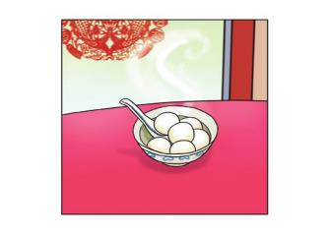
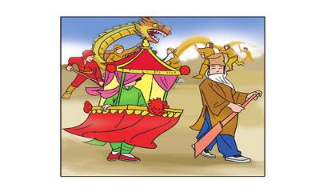
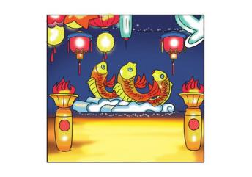
Let’s write.
watch breakfast evening beautiful visited

Slide 26
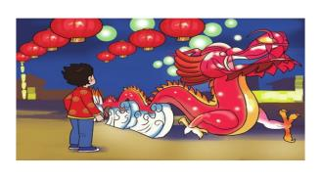
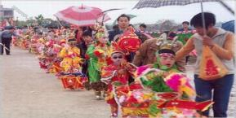
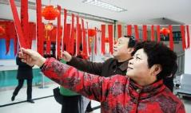
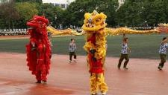
What do you usually do at the Lantern Festival ?
eat yuanxiao
watch beautiful lanterns
watch dragon dances
and lion dances
watch the parade
guess riddles

Slide 27
Thank You

