Slide 1
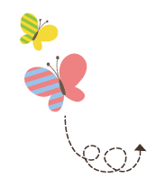
1111
Unit 2 In Beijing
五年级下册
Again, Please!
WWW.PPT818.COM

Slide 2
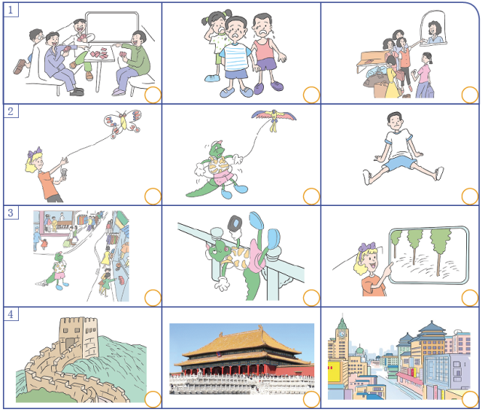
1. Listen and tick.
√
√
√
√

Slide 3
2. Listen and write.
1. Look, there are many ________ and ______ in the park.
2. Don’t be ________ ．I can ________ you.
3. Mary is playing. She is ________ ．
4. There are many ________ ．They are ________ ．
5. ________ ！ The tea is too hot.
women men
afraid help
happy
children talking
Wait

Slide 4
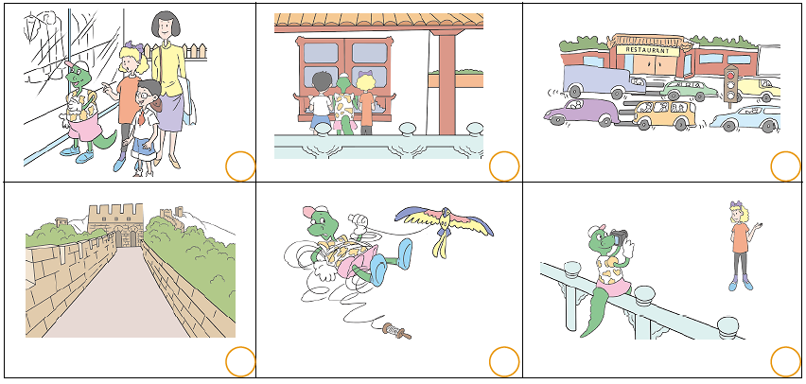
3. Listen and number.
4
3
5
2
6
1

Slide 5
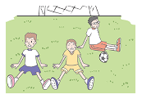
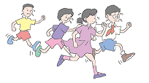
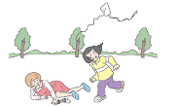
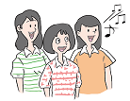
4. Look and write
girls women men singing crying sitting happy sad tired
These children are running. These _______are _______．
They are hot. They are _______
The _______ are _______ . These _______ are _______ .
They are _______ They are _______
men sitting
tired
girls crying
women singing
sad
happy

Slide 6
5. Read and match.
1. How old is the Palace Museum ？
A. Sure.
2. May I take your picture ？
B. No，I can’t.
3. Can you fly a kite ？
C. The woman is singing.
4. Who is singing ？
D. Let me help you.
5. I can’t find my camera.
E. It’s about 600 years old.

Slide 7
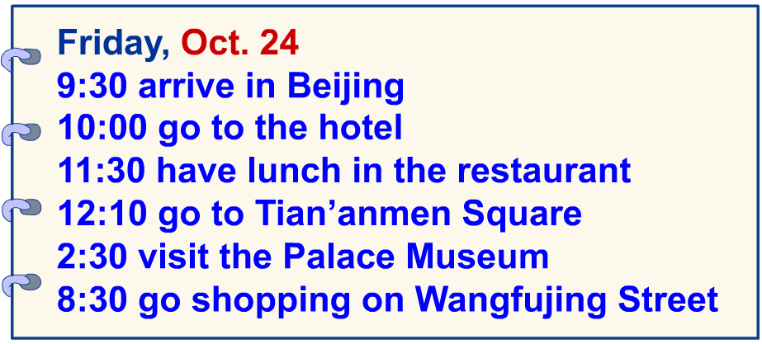
6. Read. Tick or cross.
1. Li Lin arrives in Beijing at nine twenty.
2. At ten o’clock, Li Lin goes to the hotel.
3. Li Lin has lunch in the restaurant at half past eleven.
4. At twelve ten, Li Lin goes to the Palace Museum.
5. Li Lin goes shopping at nine thirty in the evening.
×
√
√
×
×

Slide 8
7. Complete the dialogue.
Tom：It’s sunny today.____________
John：Great ！____________
Tom：Let’s take a bus.
John：How far is it from here to the park？
Tom：____________
John：It’s not far. ____________
Tom：Okay ！
C
A
B
D
A. How can we get there ？ B. About two kilometres.
C. Let’s go to the park. D. Let’s walk.

Slide 9
8. Read and write.
take help for feel be
Sue： Hi, Bill. Here is a new kite_____ you. Can you fly a kite ？
Bill：Sorry，I can’t.
Sue：Its’ easy. I can _____ you.
Bill：Oh，it’s too difficult.
Sue： _____ careful. The kite is falling. Run ！ Run ！
Bill：The kite is flying. I can fly it.
Sue： Let me _____ your picture. Say cheese.
Bill：Cheese ！
Sue：Do you _____ happy today？
Bill：Yes，I do.
for
help
Be
take
feel

Slide 10
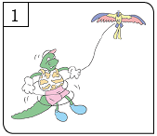
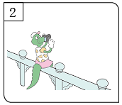
9. Look and talk.
Does Danny fly a kite on Tian’anmen Square ？
What happens ？
Does Danny take a picture at the Palace Museum ？
What happens ？
Yes, he does. Danny can't fly a kite. He hurts his arm. He is sad.
Yes, he does. Danny falls. He hurts his tail.

Slide 11
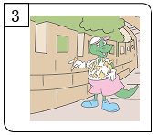
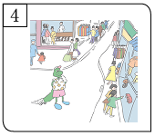
9. Look and talk.
Does Danny go to the Great Wall ？
What happens ？
Does Danny go shopping on Wangfujing Street ？What happens ？
Yes, he does. Danny wants to write his name on the Great Wall.
Yes, he does. Danny buys a big panda!

Slide 12
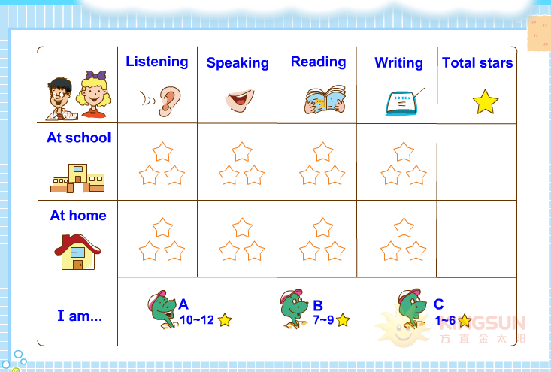
10. How am I doing?

