Slide 1
Unit 1 Winter Holidays
What did you do in the holidays?
WWW.PPT818.COM

Slide 3
Free talk:
How were your winter holidays?
Wonderful! 很精彩。
Great! 好极了。
So so. 一般般。

Slide 4
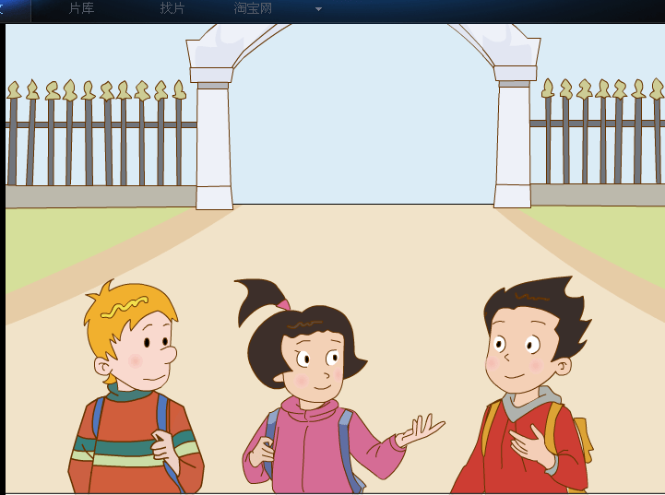
Look, our friends Wang Hong, Li Ming and Peter are back to school now.
What are they talking about?

Slide 5
They are talking about ____________.
winter holidays

Slide 6
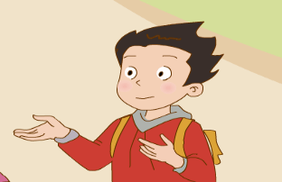
How were your winter holidays, Li Ming?
_______________________________________.

Slide 7
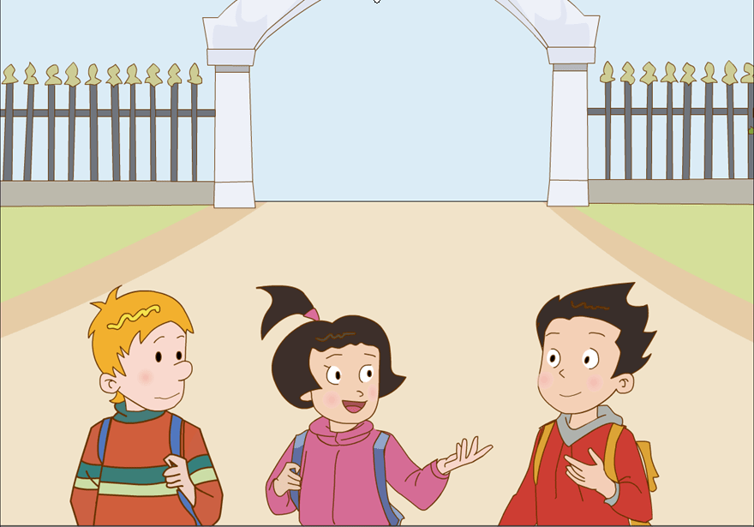

Slide 8
How were you winter holidays, Li Ming?
_____________
Wonderful!
What did you do?
I learned ______________.
Beijing Opera

Slide 9
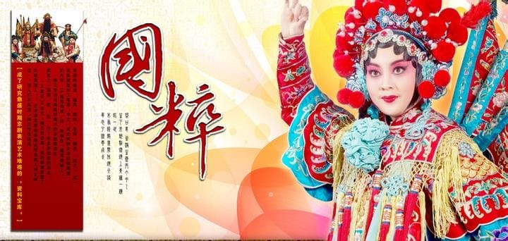

Slide 10
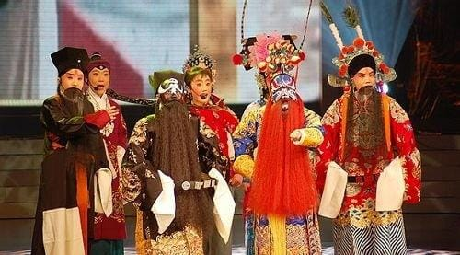

Slide 11
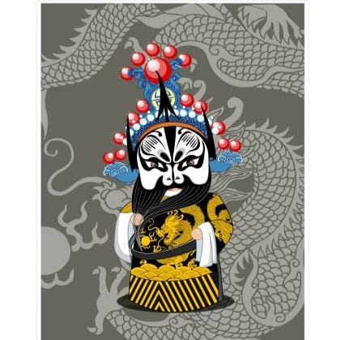
Beijing Opera
a little difficult
有点难

Slide 12
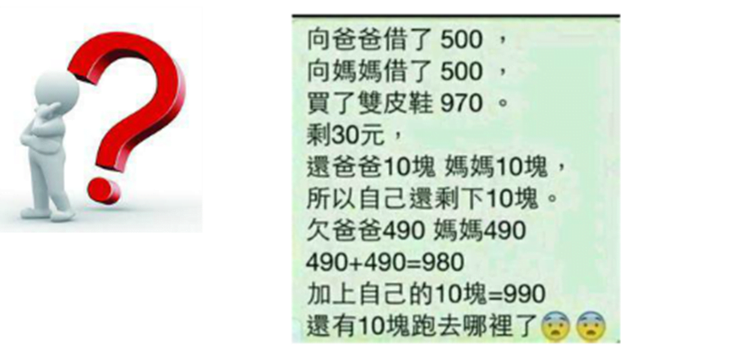
It’s a little ________.
difficult

Slide 13
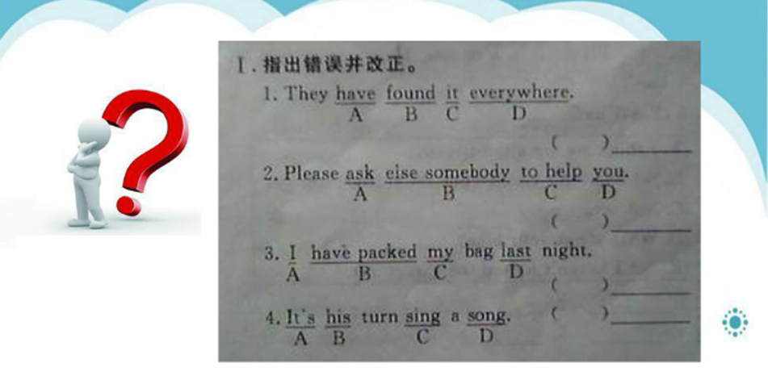
It’s a little ________.
difficult

Slide 14
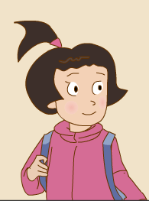
What did you do in the holidays,
Wang Hong?
_______________________________________.

Slide 15
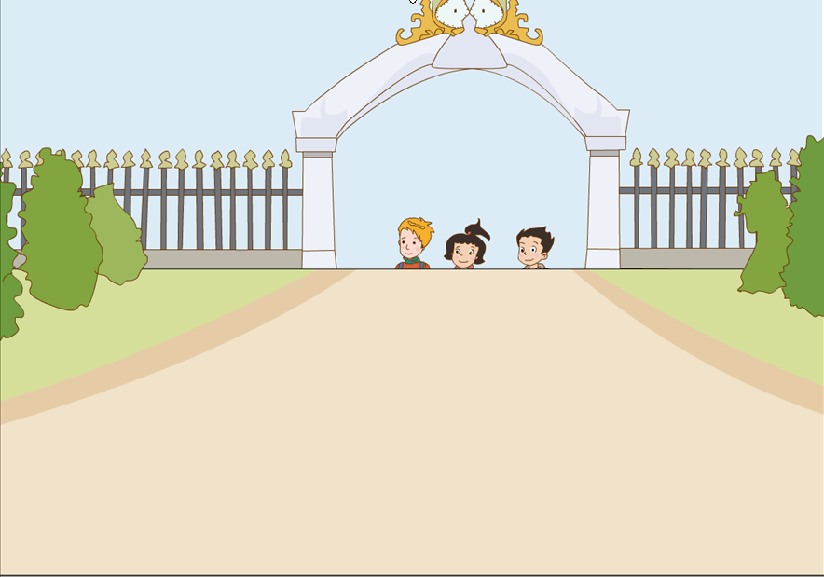

Slide 16
What did you do in the holidays,
Wang Hong?
____________________________________.
I went to Hainan
went (过去式）----------go（动词原形）

Slide 18
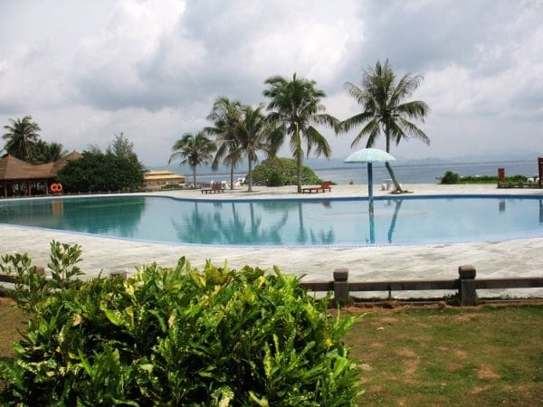

Slide 19
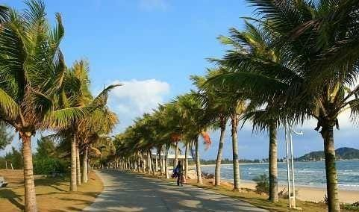

Slide 20
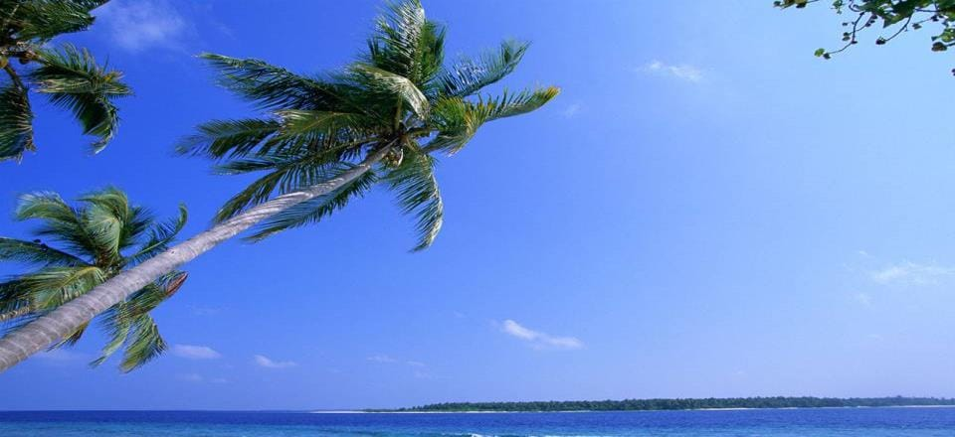
place
It’s a beautiful________.

Slide 21
enjoy = have a good time 喜欢，享受......乐趣

Slide 24
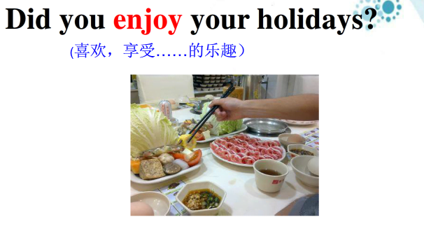
enjoy
_______ the food

Slide 25
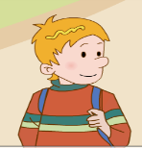
Let’s fill in the blanks.（填空）
What did you do in the holidays, Peter?
I went back to _______.
I ________ my friends
and __________________.
Canada
visited
took many pictures

Slide 26
What did you do in the holidays?
I learned Beijing Opera.
I went to Hainan.
I went back to Canada.

Slide 27
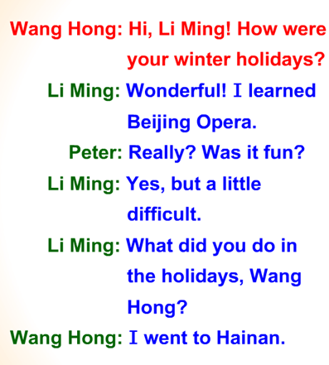
翻译：

Slide 30
A: How were your winter holidays?
B: Wonderful! / Great! / So so.
A: What did you do in the holidays?
B: I went to ...
A: Did you enjoy your holidays?
B: Yes, I did.

Slide 31
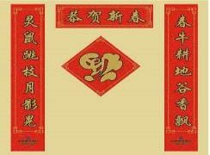
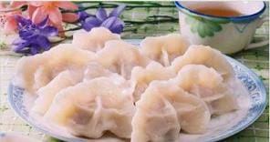
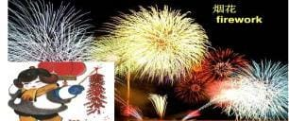
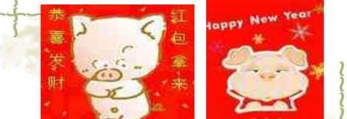
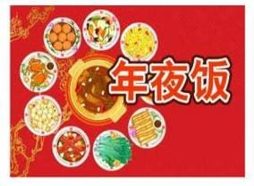
paste spring couplets
eat jiaozi
set off fireworks
get lucky money
New Year’s Eve dinner

Slide 32
Thank You

