Slide 1
Module 12 Western music
Unit 1 It’s so beautiful!
WWW.PPT818.COM

Slide 2
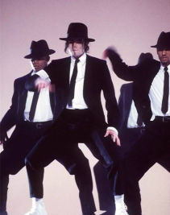
Warming-up
Look and listen
n. 摇滚乐
rock music
Beat It
adj. 吵闹的
Michael Jackson
The rock music is very noisy.

Slide 3
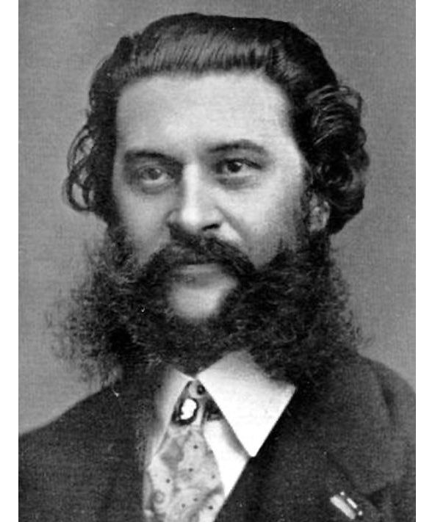
Warming-up
Look and listen
adj. 西方的
traditional Western music
The Blue Danube
prep. 由……创作；被；由
The traditional Western music is too slow.
The Blue Danube is by Strauss.
Johann Strauss

Slide 4
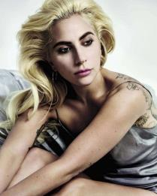
Warming-up
Look and listen
pop music
Bad Romance
adj. 现代的
adj. 活泼的；轻快的
The pop music is modern and lively.
Lady Gaga

Slide 5
Pre-listening
Free talk
I like…
What kind of music
do you like?
Because…
Why do you like it?

Slide 6
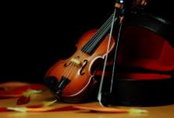
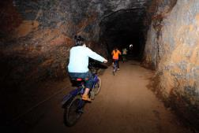
Pre-listening
Learn the new words
sound n. 声音
violin n. 小提琴
through prep. 穿过
both n. 两个；两者

Slide 7
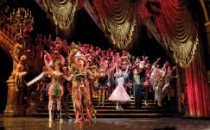
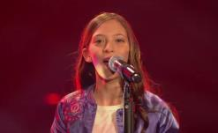
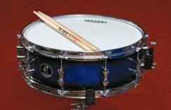
Pre-listening
Learn the new words
opera n. 歌剧
voice n. 声音
drum n. 鼓
believe n. 相信

Slide 8
Pre-listening
1 Listen and number the words as you hear them.
( ) lively ( ) modern ( ) music
( ) noisy ( ) pop ( ) rock
( ) sound ( ) violin ( ) Western
7
5
1
9
8
6
3
4
2

Slide 9
Pre-listening
2 Answer the questions in pairs.
(1) Which modern music does Tony like?
(2) What does Tony’s mum think about rock music?
(3) Why doesn’t Tony like traditional Western music?
(4) Which music does Tony’s dad think is too noisy?
He likes pop and rock music.
It’s lively.
It’s too slow.
He thinks pop music is too noisy.
Now listen again and check.

Slide 10
While-listening
Listen and answer
1. How many kinds of music are mentioned in the dialogue?
2. What are they?
Four.
They are traditional Western music, pop music, Beijing opera and rock music.

Slide 11
While-listening
Check ( ) the true sentences.
√
1. They’re listening to Western music.
2. Tony knows little about Strauss.
3. Strauss was born in the capital of
Australia.
4. The Blue Danube is pop music.
5. Lingling enjoys Beijing opera very much.
√
√
Austria
traditional Western music.
√

Slide 12
Post-listening
4 Check (√) the types of music the students like.
 | Tony | Lingling | Betty | Daming
traditional Western music
Beijing opera
pop
rock
Name
Music
√
√
√
√
√
√

Slide 13
Post-listening
Language points
1. Hmm, this is Western music, isn’t it?
You listen to pop music, Lingling, don’t you?
这两个句子都是反意疑问句，是由一个陈述句加上一个简短的疑问句构成的，常表示说话人在陈述自己的观点和看法后询问对方是否同意。如果陈述句是肯定意义，疑问句要用否定形式；陈述句是否定意义，疑问句要用肯定形式。
e.g. It’s rainy today, isn’t it? 今天下雨，不是吗？
Tom didn’t like vegetables, did he? 汤姆不喜欢蔬菜，是吗？

Slide 14
Post-listening
Language points
2. Is this by Strauss or Mozart?
Do you like traditional Western music or pop music, Betty?
这两个句子是选择疑问句，or连接的是两个并列成分。这里的by是介词，意思是“由……创作；被；由”。
e.g. Are you a doctor or a teacher?
你是医生还是教师？
I know it’s a play by Shakespeare.
我知道它是莎士比亚创作的剧本。

Slide 15
Post-listening
Language points
3. I’m (not) sure.
sure作形容词，意为“确信的，确定的”。常见用法：
be sure to do sth. 一定/务必做某事
be sure of sth. 相信某事（会发生）
be sure+that从句 确信……
e.g. Are you sure of your answer? 你能确信你的答案吗？
My teacher is sure to help me. 我的老师肯定能帮我。
I’m sure that I can pass the test. 我确信我能通过这次考试。

Slide 16
Post-listening
Language points
4. What a beautiful city!
这是一个由what引导的感叹句。常见句型结构有：
What a/an+adj.+可数名词单数 (+主语+谓语)!
What+adj.+可数名词复数/不可数名词 (+主语+谓语)!
e.g. What a nice gift (it is)!（它是）一件多好的礼物啊！
What beautiful flowers (they are)! 它们是）多么漂亮
的花啊!
What fine weather (it is today)!（今天）天气多好啊！

Slide 17
Post-listening
Language points
5. Listen to this fantastic voice.
Hmm, the sound is very… different, isn’t it?
【辨析】voice与sound
voice指说话声、歌唱声、电台声音、鸟叫声等。
e.g. I recognized his voice at once when he phoned.
他打电话时，我一下子就听出了他的声音。
sound指人能听到的任何声音。
e.g. We couldn’t hear a sound here.
在这里我们一点声音也听不到。

Slide 18
Post-listening
5 Complete the sentences with the correct form of the
words from the box.
believe both drum German noisy voice
(1) Strauss wasn’t _________. He came from
Austria.
(2) Daming thinks the _______ in rock music are
too ________.
German
drums
noisy

Slide 19
Production
believe both drum German noisy voice
(3) Tony can’t _________ that Daming doesn’t like
rock music.
(4) Betty likes _________ traditional Western music
and pop music.
(5) Tony thinks the sound of the ________ in
Beijing opera is very different.
believe
both
voice

Slide 20
6 Complete the sentences about yourself.
Post-listening
My favourite music is…
2. I like it because…
3. My parents like…

Slide 21
7 Listen and read.
Post-listening
(1) What a beautiful city!
(2) It’s so beautiful!
(4) I love his music!
(3) Listen to this!

Slide 22
8 Ask and answer the questions in pairs about the music you like or don’t like.
Post-listening
—What music do you like?
—I like pop. It’s lively and good to dance to, but I don’t like rock. It’s too noisy. What about you?

Slide 23
Post-listening
Do the exercises
一、单项选择。
( ) 1. Tom works in a big foreign company, ______?
A. does he B. doesn’t he
C. is Tom D. does Tom
( ) 2. Ling Shi went to the office yesterday, ______?
A. was he B. is he
C. did he D. didn’t he
B
D

Slide 24
Post-listening
( ) 3. _______ good children they are!
A. Why B. How
C. What D. What a
( ) 4. Which would you like, tea ______ coffee?
A. with B. but
C. or D. and
( ) 5. There’s a river going ______ this city.
A. over B. through
C. cross D. on
C
C
B

Slide 25
Post-listening
Do the exercises
二、根据汉语完成句子。
1. 谁是你最喜欢的古典音乐家？
__________________________________
2. 萨莉不喜欢流行音乐，是吗？
__________________________________
3. 让我们休息一下。
__________________________________
Who’s your favourite classical musician?
Sally doesn’t like pop music, does she?
Give us a break.

Slide 26
Post-listening
4. 你喜欢传统西方音乐还是流行音乐？
______________________________________________
5. 哪条河穿过上海？
______________________________________________
6. 你不喜欢摇滚乐？我不信。
______________________________________________
Do you like traditional Western music or pop music?
Which river goes through Shanghai?
You don’t like rock music? I don’t believe it!

Slide 27
Summary
反意疑问句：
Hmm, this is Western music, isn’t it?
You listen to pop music, Lingling, don’t you?
选择疑问句：
Is this by Strauss or Mozart?
Do you like traditional Western music or pop music, Betty?
感叹句：
What a beautiful city!

Slide 28
Homework
1. Remember the words and read the dialogue fluently.
2. Preview Unit 2.

Slide 29
Goodbye!

