Slide 1
Unit 7
Will people have robots?
WWW.PPT818.COM

Slide 2
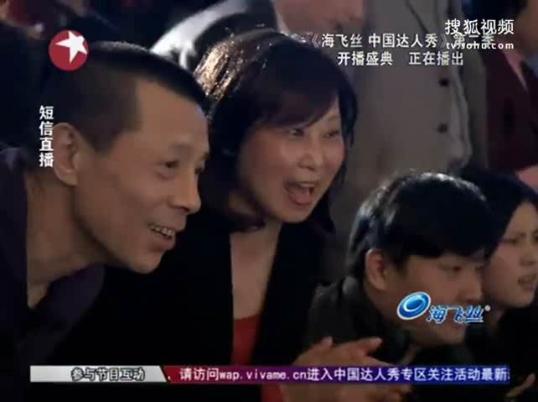
What can robots do?

Slide 3
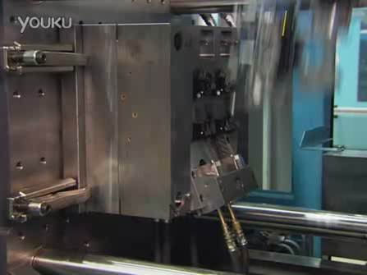
What can robots do?

Slide 4
What can robots do?

Slide 5
New words
1. even / 'i:vən/ adv. 甚至；连；愈加
e.g. The little girl can even read the
article.
小女孩甚至还能读这篇文章。
PPT模板：www.1ppt.com/moban/ PPT素材：www.1ppt.com/sucai/
PPT背景：www.1ppt.com/beijing/ PPT图表：www.1ppt.com/tubiao/
PPT下载：www.1ppt.com/xiazai/ PPT教程： www.1ppt.com/powerpoint/
资料下载：www.1ppt.com/ziliao/ 范文下载：www.1ppt.com/fanwen/
试卷下载：www.1ppt.com/shiti/ 教案下载：www.1ppt.com/jiaoan/
PPT论坛：www.1ppt.cn PPT课件：www.1ppt.com/kejian/
语文课件：www.1ppt.com/kejian/yuwen/ 数学课件：www.1ppt.com/kejian/shuxue/
英语课件：www.1ppt.com/kejian/yingyu/ 美术课件：www.1ppt.com/kejian/meishu/
科学课件：www.1ppt.com/kejian/kexue/ 物理课件：www.1ppt.com/kejian/wuli/
化学课件：www.1ppt.com/kejian/huaxue/ 生物课件：www.1ppt.com/kejian/shengwu/
地理课件：www.1ppt.com/kejian/dili/ 历史课件：www.1ppt.com/kejian/lishi/
PPT模板：www.1ppt.com/moban/ PPT素材：www.1ppt.com/sucai/
PPT背景：www.1ppt.com/beijing/ PPT图表：www.1ppt.com/tubiao/
PPT下载：www.1ppt.com/xiazai/ PPT教程： www.1ppt.com/powerpoint/
资料下载：www.1ppt.com/ziliao/ 范文下载：www.1ppt.com/fanwen/
试卷下载：www.1ppt.com/shiti/ 教案下载：www.1ppt.com/jiaoan/
PPT论坛：www.1ppt.cn PPT课件：www.1ppt.com/kejian/
语文课件：www.1ppt.com/kejian/yuwen/ 数学课件：www.1ppt.com/kejian/shuxue/
英语课件：www.1ppt.com/kejian/yingyu/ 美术课件：www.1ppt.com/kejian/meishu/
科学课件：www.1ppt.com/kejian/kexue/ 物理课件：www.1ppt.com/kejian/wuli/
化学课件：www.1ppt.com/kejian/huaxue/ 生物课件：www.1ppt.com/kejian/shengwu/
地理课件：www.1ppt.com/kejian/dili/ 历史课件：www.1ppt.com/kejian/lishi/
2. human/'hju:mən/adj. 人的 n. 人
e.g. A human can think and talk, but
an animal can’t.
人能思考、说话，但动物不能。

Slide 6
3. already /ɔ:l'redɪ/adv. 已经；早已
e.g. My aunt is already fifty, but she
looks very young.
我姑姑早已五十岁了，但她看起
很年轻。

Slide 7
4. dangerous /'deɪndʒə rəs/ adj.
有危险的；不安全的
名词danger +后缀ous → dangerous
e.g. Some animals are in great danger.
一些动物处于极大的危险中。
Lions are dangerous animals.
狮子是危险的动物。

Slide 8
5. factory /'fæktərɪ/ n. 工厂
e.g. There will be more factories
in the future.
将来会有更多的工厂。
6. fall / fɔ:l/ v. (fell/ fel/) 倒塌；跌倒；掉落
fall down 突然倒下；跌倒；倒塌
e.g. The house might fall down in a
few months.
几个月内这所房屋也许就会倒塌。

Slide 9
7. disagree v. 不同意 ；持不同意见；
有分歧
前缀(dis) + agree (同意)→disagree
e.g. My father agrees, but my
mother disagrees.
我爸爸同意，但我妈妈不同意。

Slide 10
8. believe/bɪ'li:v/ v. 相信；认为有可能
believe sb. 相信某人说的话
believe + that 从句
e.g. I believe that you can finish the
work on time.
我相信你会按时完成工作。

Slide 11
9. shape /ʃeɪp/ n. 形状
e.g. What is the shape of your kite?
你的风筝是什么形状的？
10. hundreds of 许多；大量= lots of
e.g. There are hundreds of flags in
front of the building.
在那个高楼前有很多旗帜。
【辨析】
具体数字+ hundred
如：three hundred 三百

Slide 12
11. over and over again 反复地；多次
还可以说over and over
e.g. They sang the song over and over.
他们反复地唱那首歌。
He called over and over again
but nobody answered.
他多次打电话但没有人接。

Slide 13
12. possible /'pɒsɪbəl/ adj.
可能的；可能存在或发生
(前缀)im+ possible →impossible 不可能的
e.g. Do you think it’s possible to beat them?
你认为战胜他们有可能吗?
To cross this river seems impossible.
穿过这条河似乎不可能。

Slide 14
2b
Read the article and match each paragraph with the question it discuss.
Will robots think like humans in the future?
What will robots be like in the future?
What can robots do today?
What are robots like in movies?
Paragraph 1
Paragraph 2
Paragraph 3
Paragraph 4

Slide 15
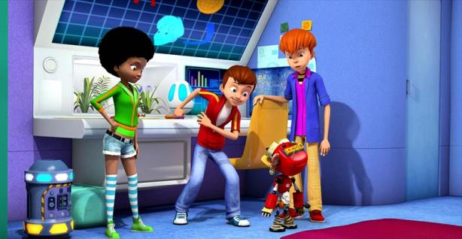
Section 2 While You Read

Slide 16
Paragraphs 1-2: Answer the questions.
1. What do the robots look like in the movies?
2. What can the robots do for people?
3. Where are the robots already working?
4. What kinds of the jobs do the robots do? Why?

Slide 17
Paragraphs 1-2: Answer the questions.
1. What do the robots look like in the movies?
2. What can the robots do for people?
Human servants.
They can help with the housework and do jobs like working in dirty or dangerous places.

Slide 18
3. Where are the robots already working?
4. What kinds of the jobs do the robots do? Why?
In factories.
They do simple boring jobs over and over again. Because they will never get bored.

Slide 19
Paragraphs 3-4: Mark True or False.
F
1. Japanese companies have already made robots sing and dance.
2. Some scientists think that there will be robots like humans, but Mr. White disagree.
3.It’s easy for a child to wake up and know where they are.
4. Some people believe that robots will be
able to talk in 35 to 50 years.
5. If buildings fall down with people inside, these snake robots can help look for people under the buildings.
T
T
F
T

Slide 20
Read the article again quickly. Complete the sentences about what robots can do now.
2c
1. Robots can build ____ in factories.
2. They can do _______ jobs many times and never get bored.
3. Some can _________ and _____________.
4. Some can help _______ people under _________.
cars
simple
walk
dance
look for
the buildings

Slide 21
Some robots are very human-like. They can walk and ______ like people. Some scientists think that in the future they will _______ robots more like humans. This may not _______ in the near future, but at some point, robots will even be able to ______ like people. However, some scientists ________.
dance
make
happen
talk
disagree

Slide 22
James White believes that robots will not be able to do the _______ things as we can. For example, he thinks that robots will ______ be able to wake up and know where they are. Which side do you ________ with?
same
never
agree

Slide 23
2. Fewer people will do such jobs in the future…
辨析such & so
such和so均可表示“如此；这样”。
1) such常用来修饰名词，so常用来修
饰形容词或副词。如：
Do you like such weather?
I’m so glad to see you.
He can draw so well.

Slide 24
2) 当名词前有many，much，few或little等词修饰时，要用so而不用such。如：
There are so many /few people in the hall.
You have so much /little homework
today.
3) “such + a / an +adj.+可数名词单数”相当于“so +adj.+ a /an +可数名词单数”，表示“如此……的一个……”。如：
She is such a lovely girl.
= She is so lovely a girl.

Slide 25
【运用】用such或so填空。
1. The man told us _____ funny a story.
2. She has _____ a beautiful dress.
3. How can you get _____ much money to buy the car?
4. Don’t go out in _____ cold weather.
5. Don’t eat _____ quickly.
so
such
so
such
so

Slide 26
即时练
1. Every year, _____ people go to visit their factory.
A. a thousand of B. thousands
C. thousand of D. thousands of
2. _______ people lost their homes in Japan’s earthquake.
A. Two thousands B. Thousand
C. Thousands of D. Thousand of
D
C

Slide 27
真题链接
B
1. ______ travelers come to visit our city every year. （2011 哈尔滨市）
A. Hundred of B. Hundreds of
C. Five hundreds D. Hundred
2. ______ trees have been planted near here, so the air is very fresh. （2010 四川达州）
A. Two hundreds B. Hundred of
C. Hundreds of D. Hundreds
C

Slide 28
3. The number of the students in our school is about nine ______. ______ of them are boys. （2010 贵州省铜仁市）
A. hundred; Two thirds
B. hundred; Two third
C. hundreds; Two thirds
D. hundreds; Two third
A

Slide 29
help with sth. get bored,
look like, hundreds of,
try to do sth be able to,
the same as, fall down,
talk with, look for,
wake up, seem (im)possible
over and over again,

