Slide 1
UNIT 3 The internet
人教版高中英语必修二
Section A Listening and Speaking
WWW.PPT818.COM

Slide 2
作为世界上最受欢迎的手机应用软件和社交网络之一,微信因其巧妙的零售创新设计“扫码购”而获得iF设计金奖。这是第一个获得iF服务设计类金奖的中国产品。

Slide 3
WeChat Scan & Go Wins iF Gold Award
WeChat,one of the world’s most popular mobile apps and social networks,brought home iF Gold Award for its smart retail innovation,Scan & Go.It is the first ever Chinese product to win gold in the iF Service Design category.
Scan & Go enables^{①} shoppers at retail(零售) stores to turn their mobile phone into a virtual checkout counter.When shopping,customers use their mobile phones to scan product barcodes(条形码),view product information,get discounts^{②},complete^{③} self-checkout,and pay directly within the app via WeChat Pay.There is no lining up at the counter.

Slide 4
According to statistics,sales during peak hours in traditional supermarkets account for 60% of total turnover,and on average^{④} customers spend three to five minutes on queueing and payment during peak hours.With Scan & Go,customers no longer have to queue,and the payment time is shortened to one minute.
In order to realize queue-less purchasing,the WeChat team greatly optimizes retailers’ in-store customer handling efficiency^{⑤} during peak hours,and enables overall management of the consumer traffic flow.By introducing dedicated^{⑥} lanes for Scan & Go,supermarkets have achieved over a five-fold increase in converting(转变) digital members within two months.

Slide 5
In addition to improving retailers’ checkout efficiency and providing customers with a better shopping experience,Scan & Go also combines promotion and marketing modes through Mini Programs,to help increase sales.Scan & Go is now widely used by retailers in China,including Wal-Mart and Carrefour.
词海拾贝
①enable vt.使能够
②discount n.折扣
③complete vt.完成
④average n.平均
⑤efficiency n.效率
⑥dedicated adj.专用的

Slide 6
典句欣赏
In order to realize queue-less purchasing,the WeChat team greatly optimizes retailers’ in-store customer handling efficiency during peak hours,and enables overall management of the consumer traffic flow.
翻译:为了实现无排队购买,微信团队极大地优化了零售商在高峰时段内店内客户处理效率,并能够全面管理消费者的客流量。
分析:本句是一个简单句。in order to realize...是目的状语,the WeChat team是句子的主语,optimizes和enables是并列谓语。
理解诱思
1.What does the second paragraph mainly tell us?
答案:The convenience of Scan & Go.
2.Have you ever used Scan & Go?What do you think of it?
答案:Open.

Slide 7
Ⅰ
Ⅱ
Ⅲ
Ⅰ.知识体系图解
blog
engine
chat
stream
identity

Slide 8
Ⅰ
Ⅱ
Ⅲ
以……开始
例如
太……以至于不……
查阅
与……聊天
顺便问一下
上网
把……保守秘密

Slide 9
Ⅰ
Ⅱ
Ⅲ
Ⅱ.释义匹配
1.blog A.the part of a vehicle that produces power to make it move
2.engine B.to talk to someone in a friendly informal way
3.chat C.a flow of water,air,smoke etc,or the direction in which it is flowing
4.stream D.who or what sb/sth is
5.identity E.a web page that is made up of information about a particular subject,in which the newest information is always at the top of the page
答案:1.E 2.A 3.B 4.C 5.D

Slide 10
Ⅰ
Ⅱ
Ⅲ
Ⅲ.完成句子
1.You’d better write something (你感兴趣的).
2.I often watch videos and (在网上听音乐).
3.I am (太忙了无法去) to your birthday party.
4.My brother often (查阅信息) on the Internet.
5.I enjoy (和……聊天) my friends online.
you are interested in
listen to music online
too busy to go
looks up information
chatting with

Slide 11
重点词汇
重点句式
随堂练习
1.stream vt.流播(不用下载直接在互联网上播放音视频);流出 vi.流动 n.小河;溪流
【课文原句】stream movies and music 流播电影和音乐
【词汇精讲】stream在句中是及物动词,意为“流播”。
The growth of smartphones has made it more attractive to own and stream music legally.
智能手机的发展已经使合法拥有和流播音乐更具有吸引力。
This would allow users to stream videos on two iPad screens at once.
它允许用户同时在两个iPad屏幕上播放视频。

Slide 12
重点词汇
重点句式
随堂练习
【词汇拓展】
stream可作不及物动词,意为“流动”,作名词,意为“小河,小溪”。
Hearing the news,tears streamed down her face.
听到这个消息,她泪流满面。
A mountain stream runs through this small village.
一条山涧流过这个小村庄。

Slide 13
重点词汇
重点句式
随堂练习

Slide 14
重点词汇
重点句式
随堂练习
2.chat vi.聊天;闲聊
【课文原句】I especially like to chat with my friends and family.
我特别喜欢同朋友和家人聊天。
【词汇精讲】chat可作动词或名词,意为“聊天;闲聊”。
I sometimes spend hours chatting on the phone with my friends.
我有时在电话上和朋友聊天一聊就是几个小时。
This garden is a nice place for a nice chat and a cup of coffee.
这个花园是一个舒服的好地方,可以边聊天边喝咖啡。

Slide 15
重点词汇
重点句式
随堂练习
【词汇拓展】
I feel much better when I go home to eat and chat with my parents and brother.
当我回家吃饭,与我的父母哥哥聊天时我感觉好多了。
A friend of mine visited me yesterday and we had a long chat about our schooldays.
我的一个朋友昨天来找我,我们在一起说了很多关于我们在学校的生活。

Slide 16
重点词汇
重点句式
随堂练习

Slide 17
重点词汇
重点句式
随堂练习
3.identity n.身份;个性
【课文原句】And so I used a nonsense name for my net identity.
因此,我为网上的身份造了个名字。
【词汇精讲】identity是名词,意为“身份;个性”。
He gave himself a new name to hide his identity when he went to carry out the secret task.
当他去执行这项秘密任务的时候,他给自己起了一个新的名字来隐藏自己的身份。
The boy wanted a sense of his own identity.
那个男孩想要确立自己的个性意识。

Slide 18
重点词汇
重点句式
随堂练习
【词汇拓展】
Even the smallest baby can identify its mother by her voice.
即使最小的婴儿也能辨识妈妈的声音。
Eye witnesses identified the gunman as a young man.
目击者确认持枪歹徒是一个年轻人。

Slide 19
重点词汇
重点句式
随堂练习

Slide 20
重点词汇
重点句式
随堂练习
Sometimes,I am too busy to go online.
有时,我太忙了无法上网。
【句式剖析】
句中too...to do sth意为“太……而不能做某事”,是一个表示否定意义的句型。
She was too excited to say a word when she heard the news.
当她听到这个消息时她激动得说不出话来。
They realized that it was too late to catch the last subway.
他们意识到太晚了赶不上最后一趟地铁了。

Slide 21
重点词汇
重点句式
随堂练习
【句式拓展】
“too...to...”不同搭配下的不同含义:
(1)某些形容词与“too...to...”句型连用时,too (=very) 表示肯定的意义。这些形容词多为表示情感的词,如glad,pleased,surprised,delighted,happy,easy,willing,ready,eager,anxious等。
(2)too...to...结构和never或not连用时,表示肯定意义。意为“无论……也不过分;越……越好”。
They seemed to be too nervous and were too anxious to leave.
他们看起来太紧张,并且急于离开。
I am only too glad to accept your invitation.
我很乐意接受你的邀请。

Slide 22
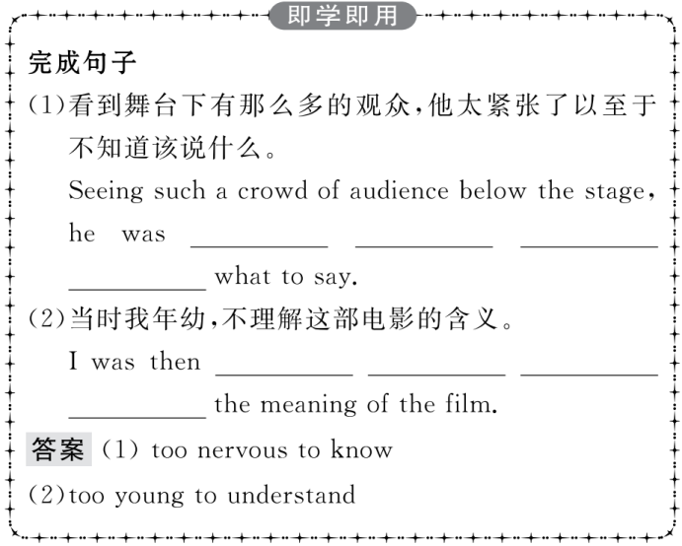
重点词汇
重点句式
随堂练习

Slide 23
重点词汇
重点句式
随堂练习
Ⅰ.单词拼写
1.We had to stop at the roadside because there was something wrong with the car’s (发动机).
答案:engine
2.I wonder if you’ll be free then so we can (聊天) about the good old days together.
答案:chat
3.You will be allowed to go in only when your (身份) has been checked.
答案:identity

Slide 24
重点词汇
重点句式
随堂练习
4.My sister writes a (博客) for parents about career development to help them guide their children.
答案:blog
5.We are playing near the bank of the (小溪),having fun with each other.
答案:stream

Slide 25
重点词汇
重点句式
随堂练习
Ⅱ.介词填空
1.The mother often makes long-distance telephone calls to have a chat the children.
答案:with
2.First of all,could I begin an apology for a mistake I made last week?
答案:with
3.A few simple precautions(预防措施) can be taken, example ensuring that desks are the right height.
答案:for

Slide 26
重点词汇
重点句式
随堂练习
4.I often use a search engine to help me find what I am looking .
答案:for
5.I never share my personal information strangers on the Internet.
答案:with

