Slide 1
Unit4 How’s the weather today?
人教精通版四年级上册
WWW.PPT818.COM

Slide 2
Let’s sing
Review

Slide 3
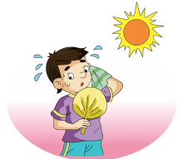
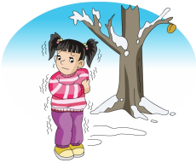
Practice
Review
Game
What’s missing?

Slide 4
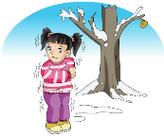
Free talk
How’s the weather today?
What weather do you like?

Slide 5
Presentation
Let’s learn
windy
It’s windy today.

Slide 6
Presentation
Let’s learn
rainy
It’s rainy today.

Slide 7
Presentation
Let’s learn
snowy
It’s snowy today.

Slide 8
Practice
Game 1
大小声
sunny cloudy
rainy windy snowy

Slide 9
Practice
Game 2
Quick response
How’s the weather today?
It’s …

Slide 10
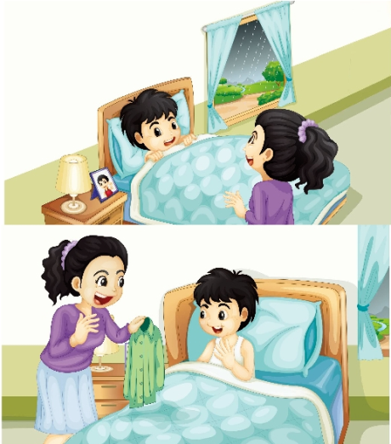
Presentation
Listen and say
Guess! What are they talking about?

Slide 11
Presentation
Listen and imitate
1
Mum, how’s the weather today?
2
It’s rainy.
Oh, dear!
3
5
OK, Mum.
4
Put on your shirt, please.

Slide 12
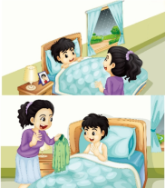
Practice
Let’s read
1
2
3
Read together.
(齐读)
Read in roles.
（分角色读）
Read in groups.
(分组读）

Slide 13
Show time
两人一组，练习对话并表演，其他同学评价。
 | 模仿录音中的语音语调，有感情地朗读。
 | 可以脱离课本，适当改动其中部分，语音地道。
 | 适当添加内容，意思完整，有创新，表演生动。
Good
Great
Excellent

Slide 14
Practice
Just read and write

Slide 15
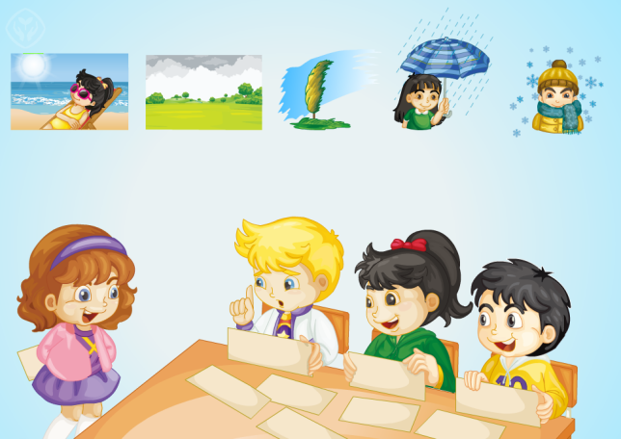
Let’s play
Practice
小组合作，其中一人手拿天气类的图片并提问，其他同学来猜。

Slide 16
Look and match
Practice

Slide 17
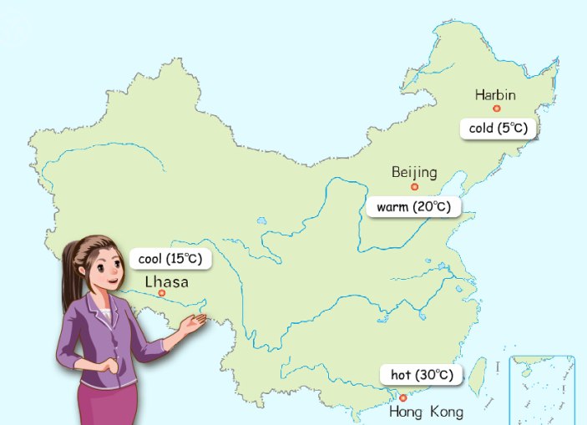
Practice
活动
我是天气预报员
Hello. This is the weather report. I’m … It’s snowy in Harbin.

Slide 18
Summary
本课学习的描述天气状况的单词有:
windy
rainy
snowy

Slide 19
Summary
如何询问天气状况，并做相应回答呢？
—How’s the weather today?
—It’s … today.

Slide 20
Homework
1. 跟读Just talk部分的课文录音，并注意语音、语调。
2.运用本课所学句型“How’s the weather today?”，询问你的爸爸妈妈各个城市今天的天气情况。
3. 预习Lesson 24。
Close

