Slide 1
Unit 2 Topic 3
Whose cap is this?
Section B
WWW.PPT818.COM

Slide 2
看谁填得又对又快！
my |  | his | her | it |  | your
 | yours |  |  |  | ours |  | theirs
your
our
their
mine
his
hers
its
yours

Slide 3
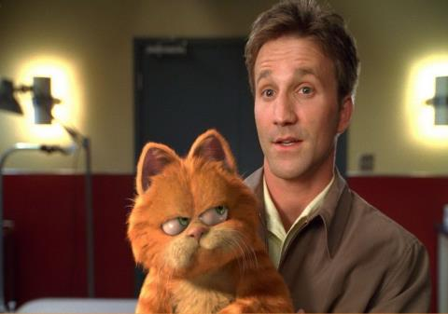
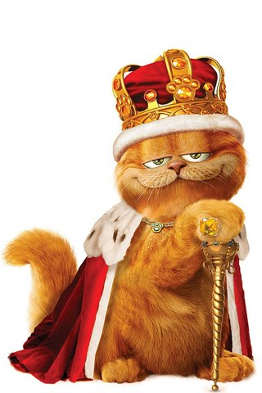
Whose cat is this?
It’s his cat.
It’s his.

Slide 4
Whose baby is this?
It’s her baby.
It’s hers.

Slide 5
Whose bike is this?
It’s QQ’s bike.

Slide 6
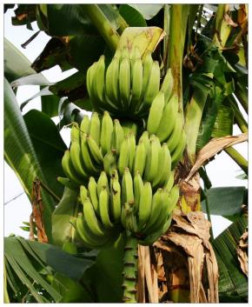
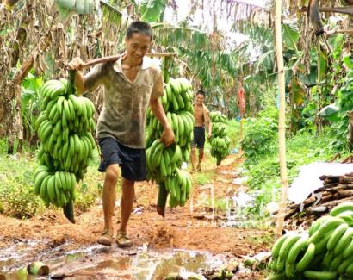
Whose bananas are these?
They are their bananas.
They are theirs.

Slide 7
Whose football is this?
I think it’s Kangkang’s.

Slide 8
名词所有格
“Kangkang’s” 意为“康康的”，是名词所有格的一种形式。其构成方式是在名词后面加“’s”；而以s结尾的复数名词，只加“ ’ ”。 如：
Teachers’ Day 教师节
注意：Kate and Lucy’s room 凯特和露西的房间
(两人共有的房间）；Kate’s and Lucy’s rooms 凯特
的房间和露西的房间（两人各自的房间）。
另外，of 短语也可以用来表示所属关系。如：
a map of China 一幅中国地图

Slide 9
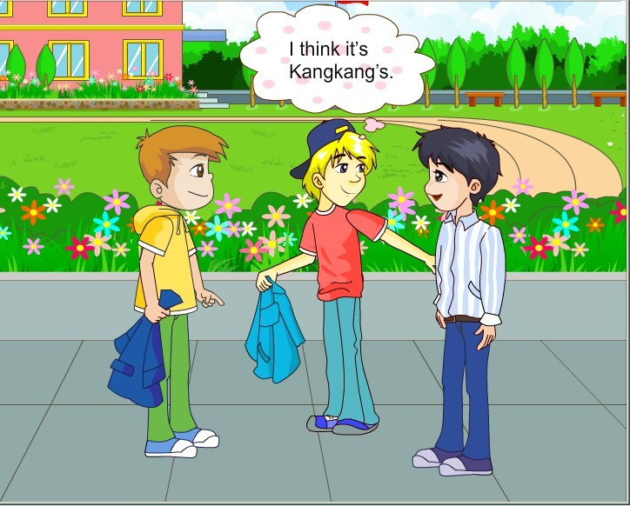
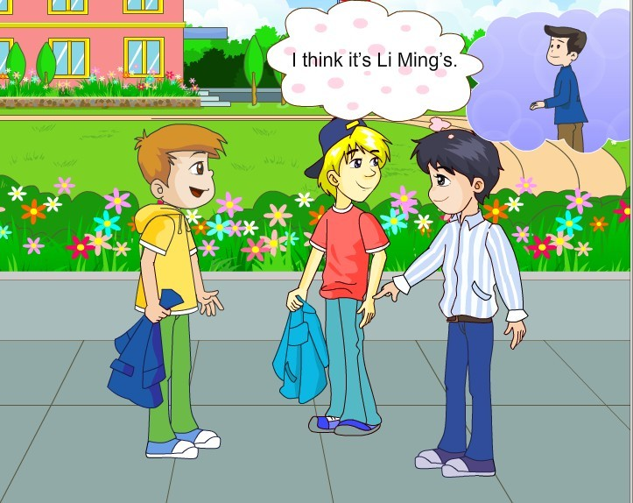
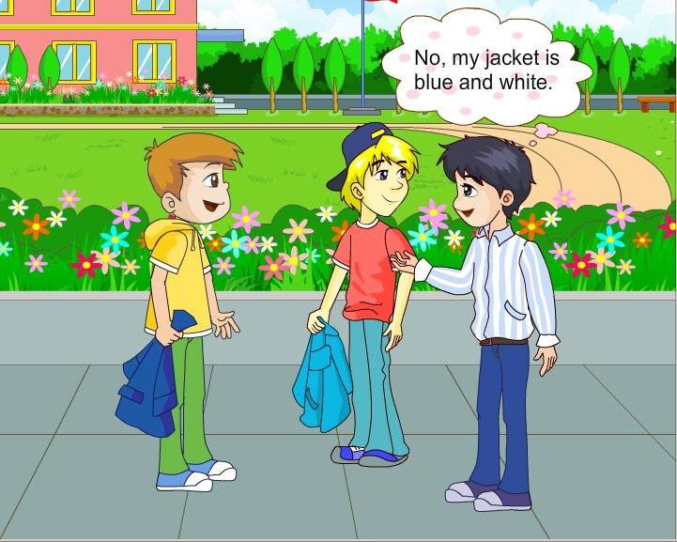
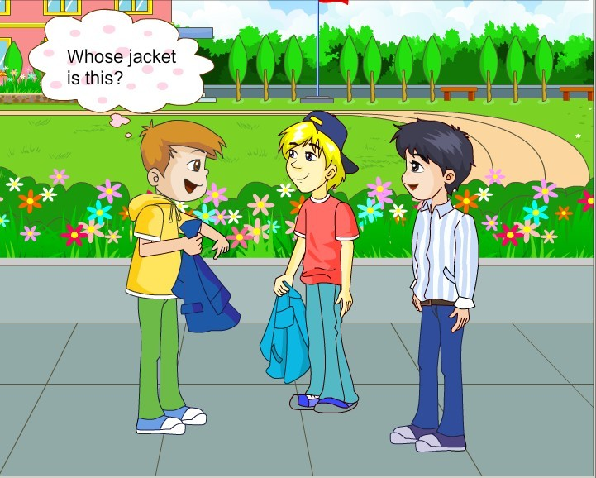
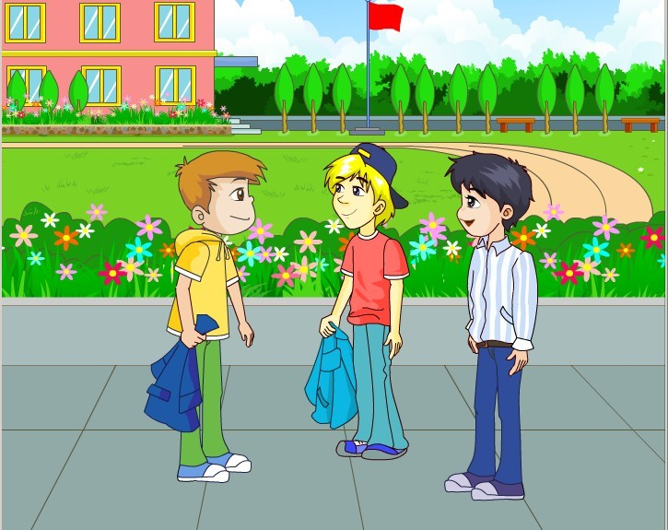
1a Look, listen and say

Slide 10
1b
Work alone
Complete the passage according to 1a.
This is a blue jacket. It’s not Ben’s. It’s not_________ . And it isn’t__________. His is blue and white. Then______ jacket is it? Kangkang thinks it’s_________
Michael’s
Kangkang’s
whose
Li Ming’s

Slide 11
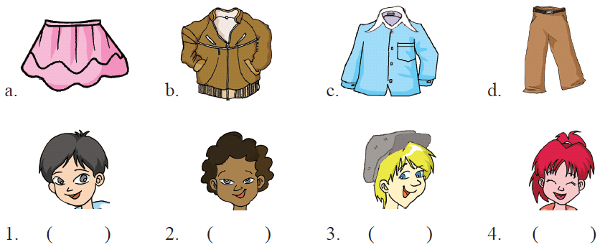
Listen and match.
2a
B
A
C
D

Slide 12
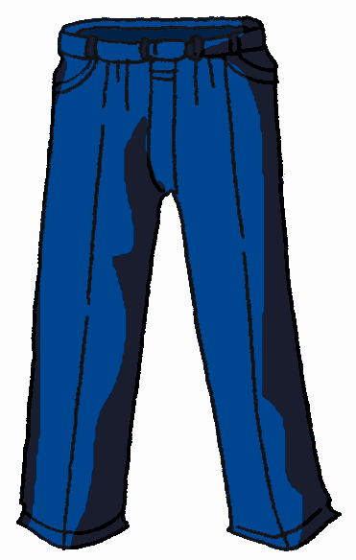
2b
Make up dialogs with your partners.
A: Whose … is this/that?
B: It’s …
A: Whose … are these/those?
B: They’re …

Slide 13
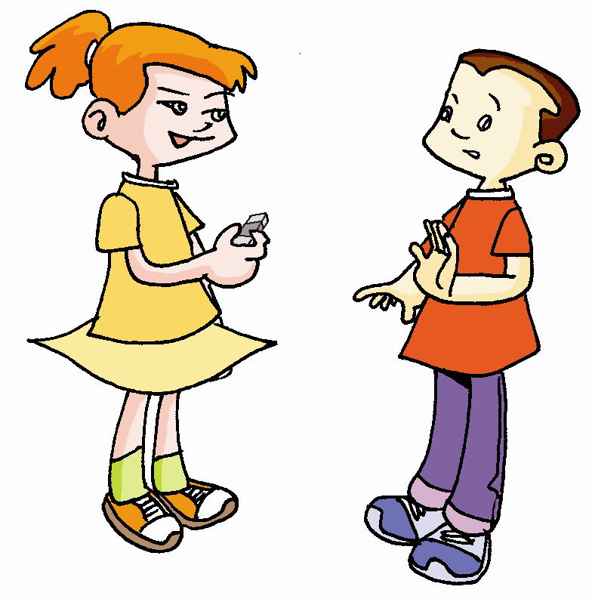
3
Pair work
Fill in the blanks with his, mine, your and whose. Then practice with your partner.
①
your
Is this eraser?
No, it’s not .
mine
Whose
eraser is it, then?
It’s Zhang Lan’s.

Slide 14
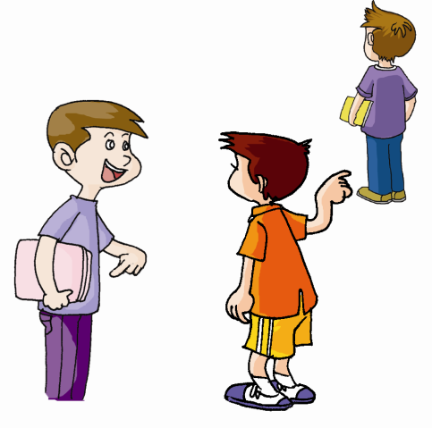
your
②
Are these
boxes?
mine
No, they are not .
Whose boxes are they, then?
his
They’re .

Slide 15
practice
4
This shirt
is Lily’s.
That schoolbag
is his.
These babies
are hers.

Slide 16
5
Work alone
Match the questions with the correct answers.
He is short and he has blond hair.
b. No, it’s hers.
c. It’s Kangkang’s.
d. It’s pink.
e. They are his.
Whose pants are these?
What does Steve look like?
Is this coat his?
What color is your coat?
Whose jacket is this?

Slide 17
Summary
①大部分的形容词性物主代词在后面加-s构成名词性物主代词。有3个特殊情况my—mine, his—his, its—its。
②形容词性物主代词后面跟名词；名词性物主代词有名词的含义，相当于对应的形容词性物主代词加上名词。
③名词性物主代词作主语时，如果含义是单数，后面的be动词用is；如果含义是复数，那么be动词用are。

Slide 18
Summary
本单元学到了什么？
名词的所有格
whose 引导的特殊疑问句
谈论物品的所属

Slide 19
Homework
每人按要求制作一幅“物主代词卡”。
要求：
规格：10cm×5cm
正面是汉语，反面用英语写出它的两种形式：名词性物主代词和形容词性物主代词。
两人一组互相看卡片，说出(或读出)与之相对的汉语或英语。
三人一组，利用自己的物品，利用物主代词表演对话。

