Slide 1
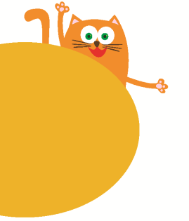
Look and see
3
第三课时
WWW.PPT818.COM

Slide 2
Look and say
high
again
sky
rise
moon
noon
evening
night

Slide 3
Humf and his father

Slide 4
Where is Humf?
What does Humf do ?

Slide 5
What does Humf do in the park?
He plays in the park and he finds his shadow. He thinks it’s very funny.

Slide 6
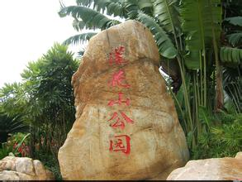
What can we do in the park?

Slide 7
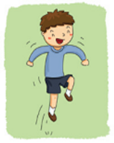
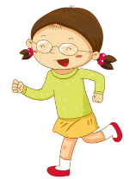
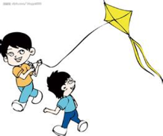
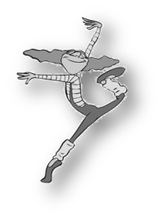
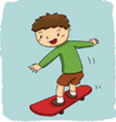
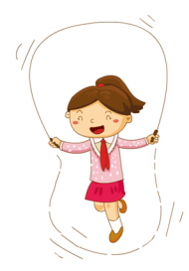
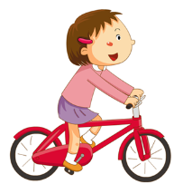

Slide 8
He has a friend, he likes playing in the park, too.
This is Henry.
What does Henry do in the park?

Slide 9
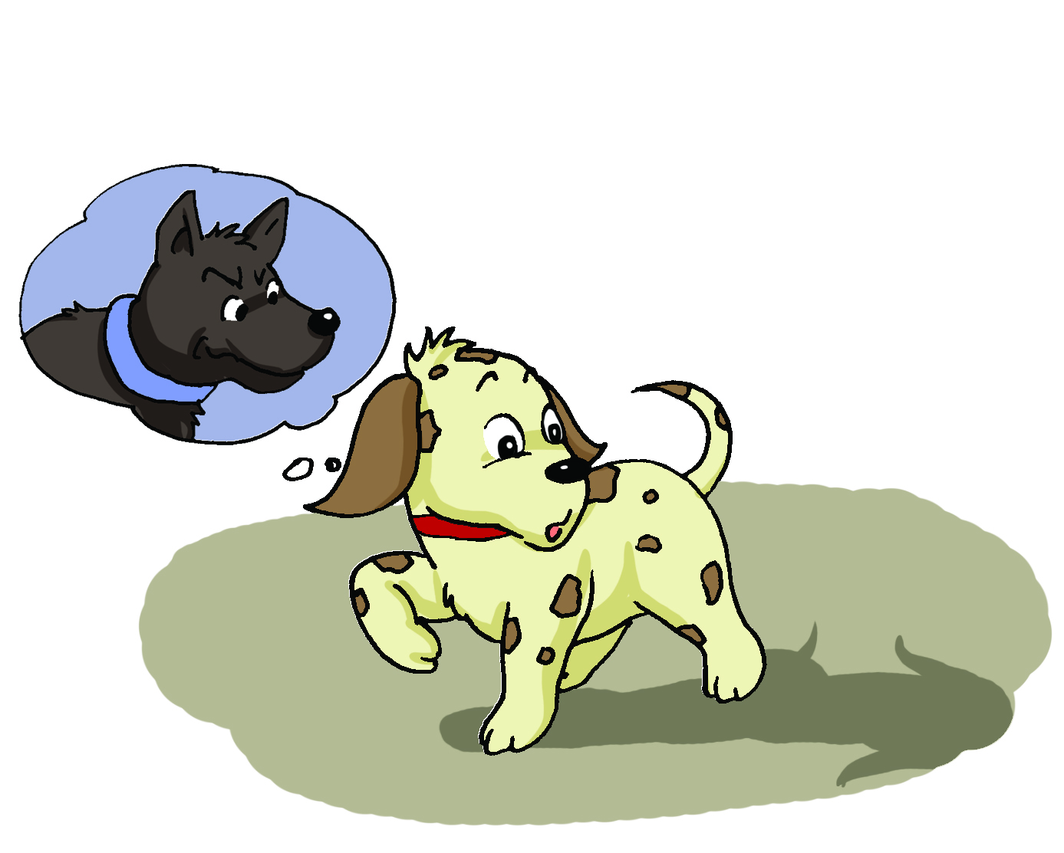
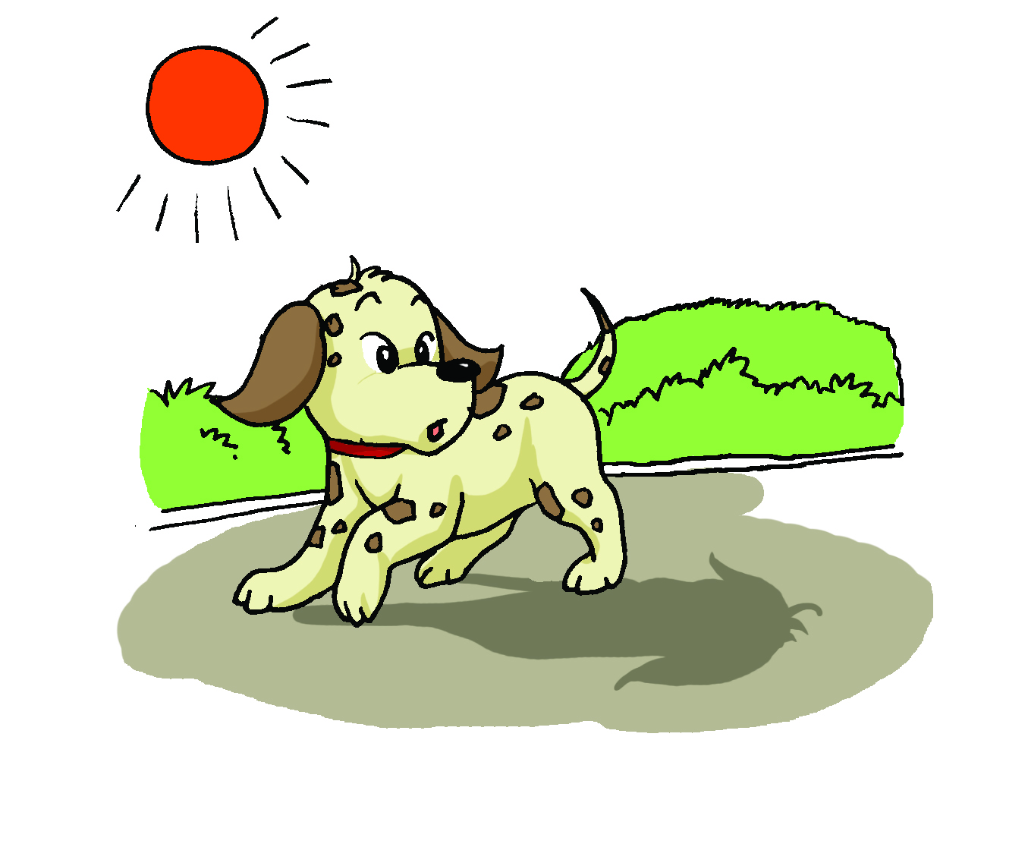
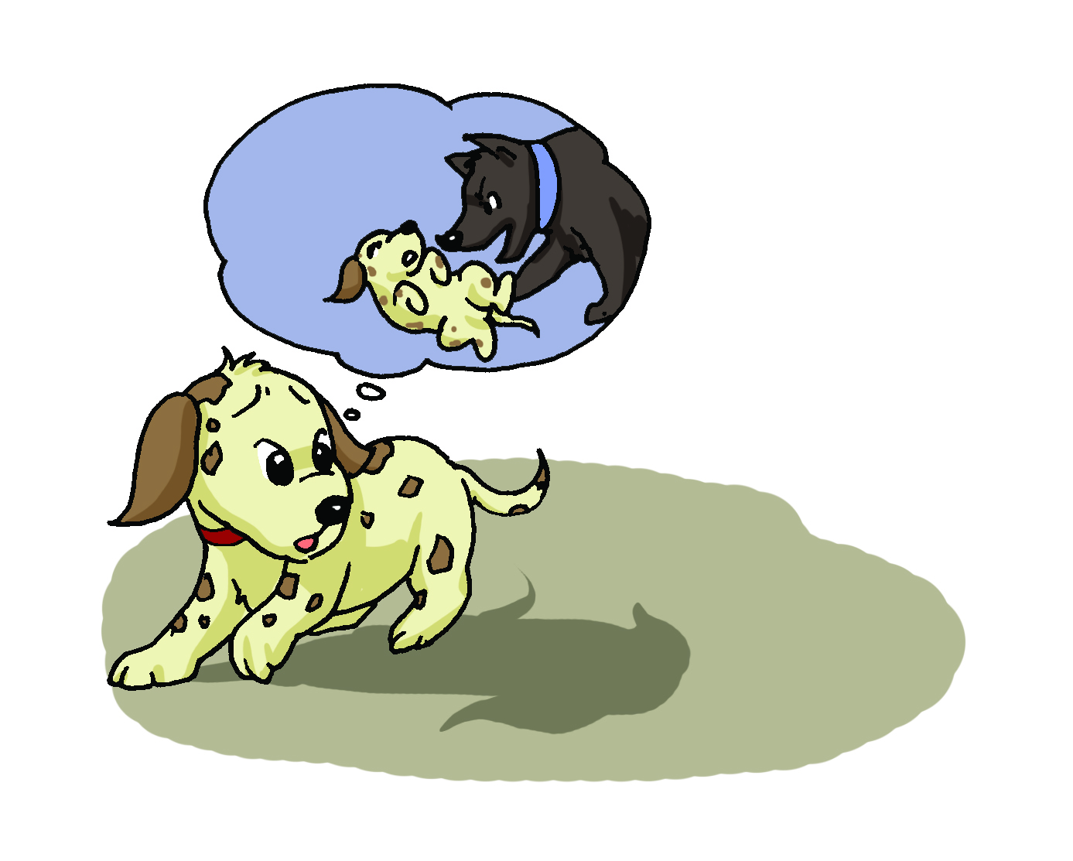
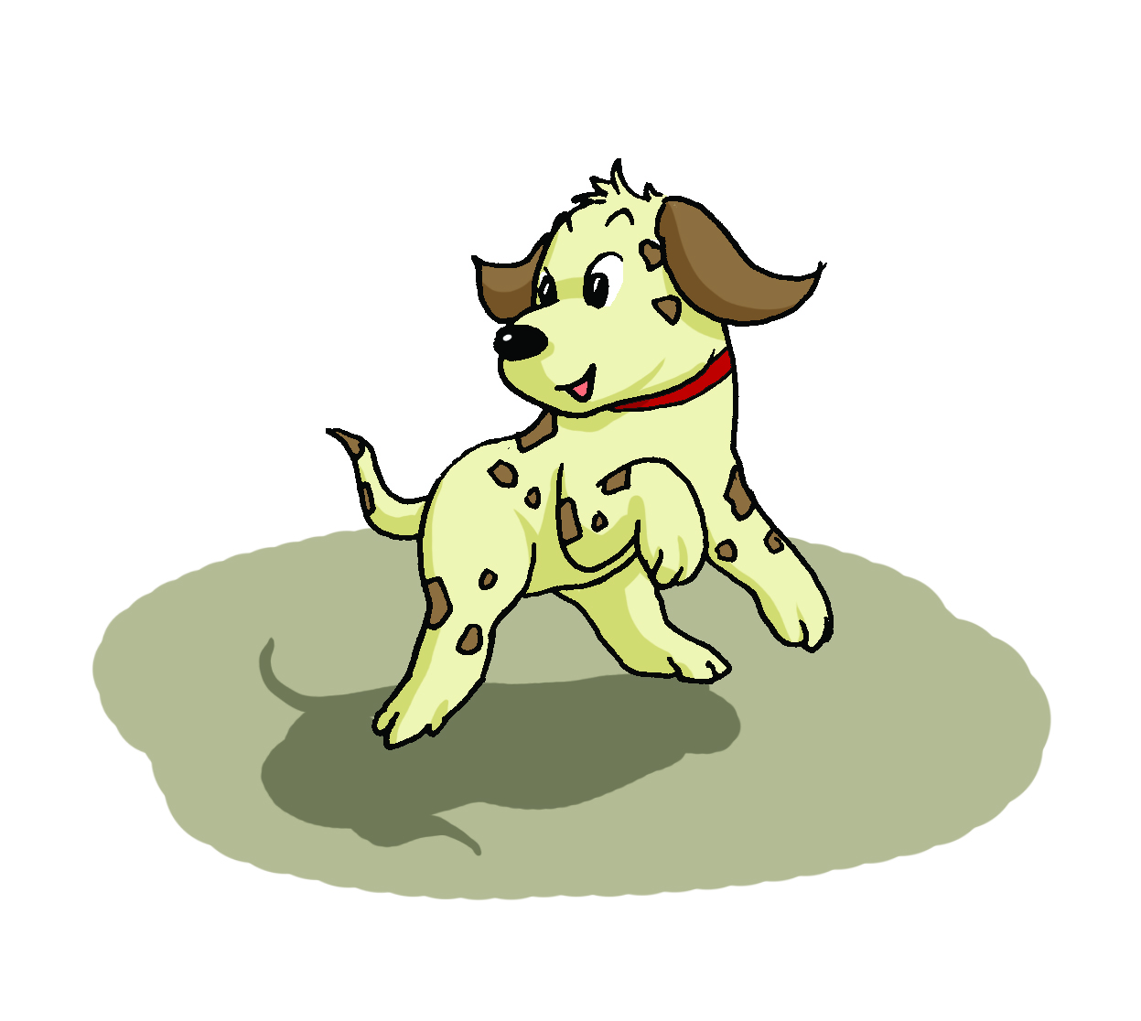
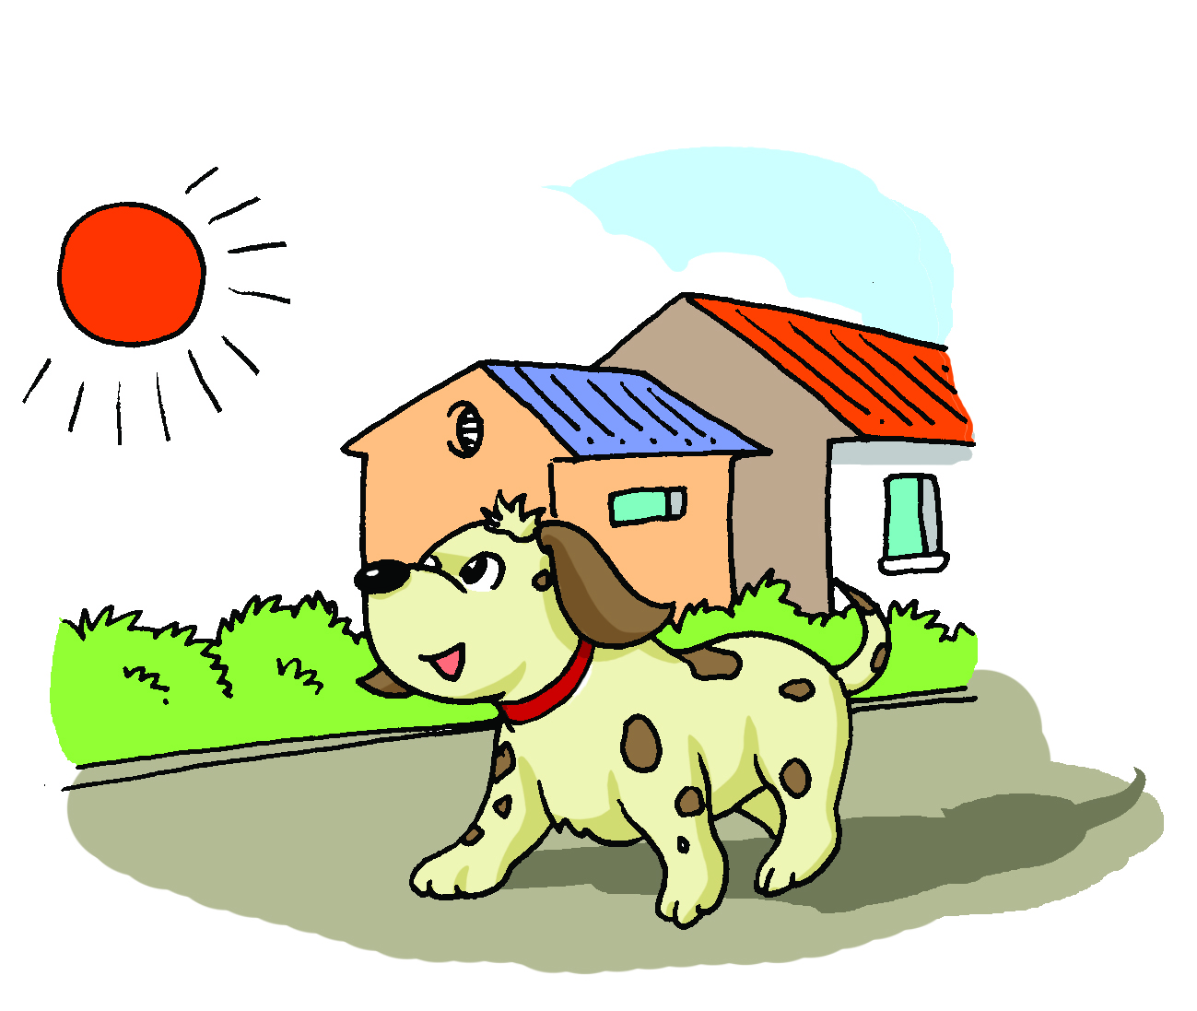
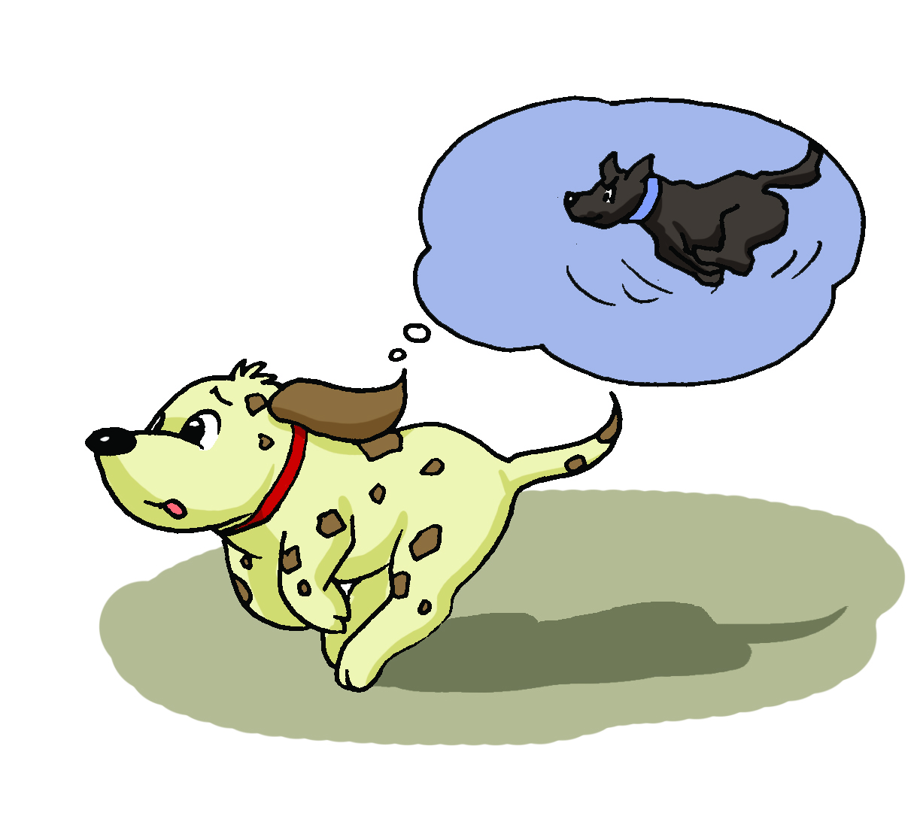
Look and order.
5
2
3
6
1
4

Slide 10
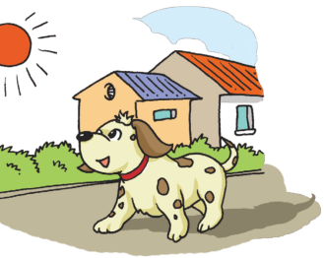
Think and answer
Where is Henry’s new friend?
Who is Henry’s new friend?

Slide 11
Henry the dog takes a walk in the morning.

Slide 12
What’s that? Is it a big black dog?
He sees a black shape behind him.

Slide 13
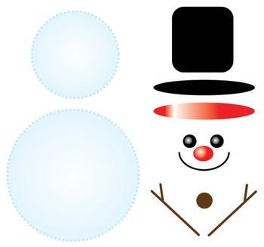
Look and learn
shapes

Slide 14
Henry is afraid.

Slide 15
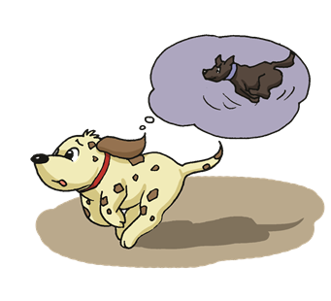
Henry runs. The black shape runs too.

Slide 16
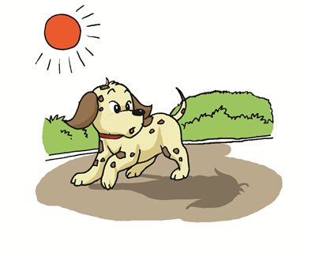
Oh,you’re my shadow!
Henry stops.
The black shape stops too.

Slide 17
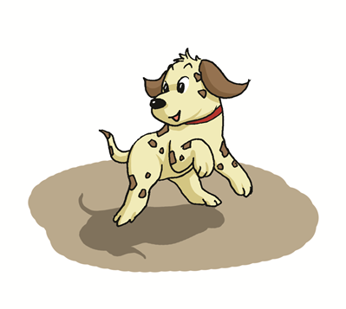
Let’s play together.
Henry likes his new friend.

Slide 18
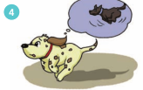
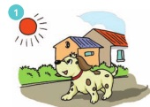
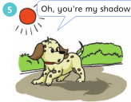
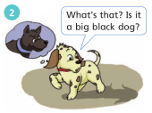
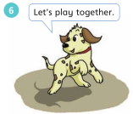
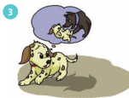
Read and match
Henry runs. The black shape runs too.
Henry is afraid.
Henry the dog takes a walk in the morning.
Henry stops. The black shape stops too.
Henry likes his new friend.
He sees a black shape behind him.

Slide 19
Read and think
What does Henry say to himself?
Henry the dog takes a walk in the morning.
He sees a black shape behind him.
Henry is afraid.
Henry runs. The black shape runs too.
Henry stops. The black shape stops too.
Henry likes his new friend.

Slide 20
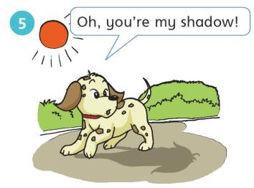
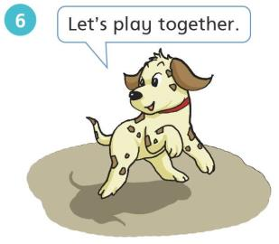
Look and match
c.
a.
b.
a. Oh, you’re my shadow.
b. Let’s play together.
c. What’s that? Is it a big black dog?

Slide 21
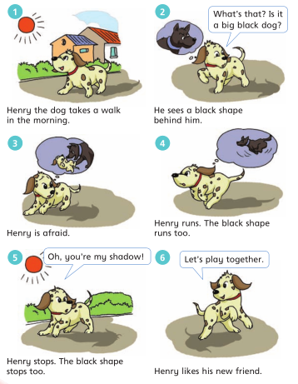
Read and think
How does Henry know the shape is his shadow?

Slide 22
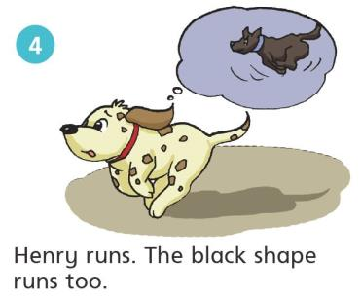
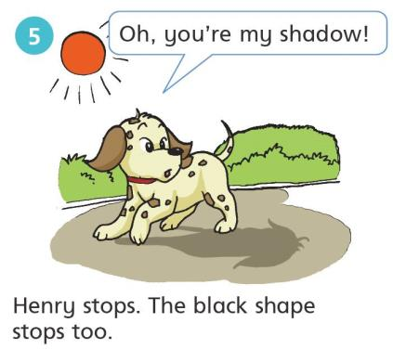
Look and say
Your shadow always follows you!

Slide 23
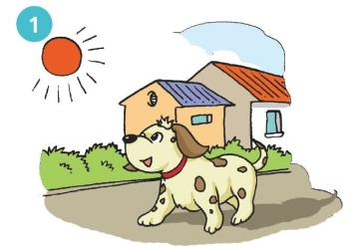
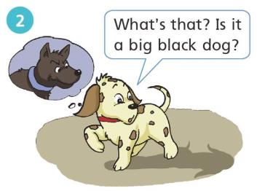
Henry the dog takes a walk in the morning.
He sees a black shape behind him.

Slide 24
Read, choose and complete
he
his
him
Henry likes to take a walk with _____ brother.
his
Henry is quite helpful. ____ friends all like _____.
His
him
him
Henry thinks the black shape wants to eat ____ , so ____ runs off.
he

Slide 25
Henry is afraid.
Henry runs.
The black shape runs too.
Henry stops.
The black shape stops too.

Slide 26
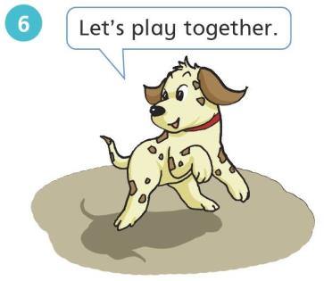
Henry likes his new friend.
Let’s … together!

Slide 27
Read and complete
Henry’s new friend
Henry the dog takes a walk in the morning. He ____ a black shape behind ____. “What’s that? Is it a big black dog?” Henry says. Henry is afraid. Henry runs. The black shape ____ too. Henry ______. The black shape stops too. “Oh, you’re my ________,” Henry says. Henry likes his new ______. “Let’s play together,” Henry says.
sees
him
runs
stops
shadow
friend

Slide 28
Retell the story

Slide 29
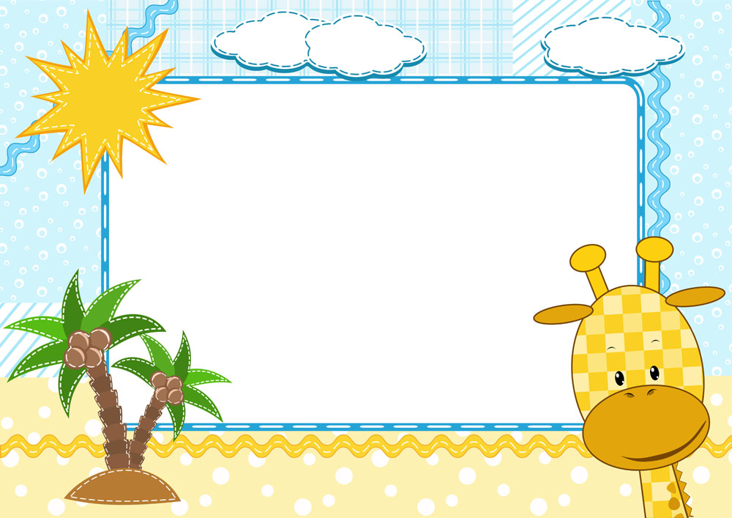
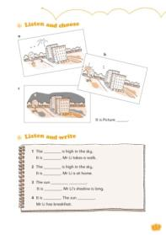
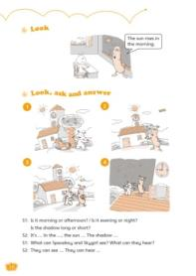
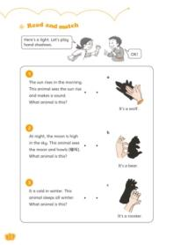
Homework
1. Read the story on page 12.
2. Tell the story “Henry’s new friend”
to your parents.
3. Complete Workbook 4B pages 15,
16 and 18.

