Slide 1
Unit 12
What did you do last weekend?
R 七年级下册
第1课时
WWW.PPT818.COM

Slide 2
Lead-in
Guessing time
What did you/she/he/they do last weekend?

Slide 3
What did they do last weekend?
They went fishing.

Slide 4
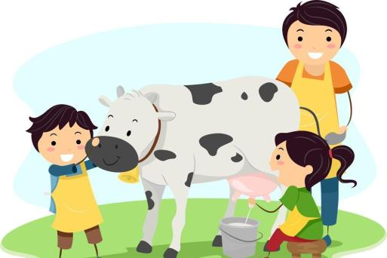
They milked a cow.

Slide 5
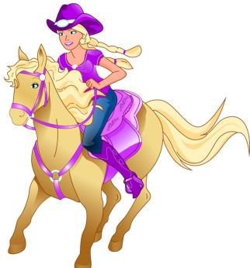
What did she do last weekend?
She rode a horse.

Slide 6
How was the trip?
It was great.

Slide 7
It was terrible.

Slide 8
It was OK.

Slide 10
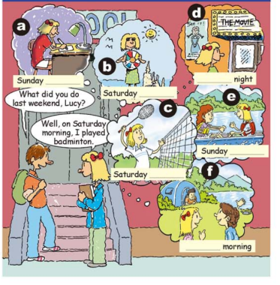
1a
Match the activities with the pictures [a-f].
1. did my homework ____
2. went to the cinema ____
3. went boating ____
4. camped by the lake ____
5. went to the beach ____
6. played badminton ____
a
d
e
f
b
c

Slide 11
Language points
1. —What did you do last weekend, Lucy?
—Well, on Saturday morning, I played badminton.
问句是一个含有一般过去时态的特殊疑问句, 其中的助动词did是do的过去式。
注意：句子中用了助动词did时, 后面的动词要用原形。

Slide 12
2. last weekend 上周末
weekend为名词, 意为“周末”, 通常指星期六和星期天两天。
对应词：weekday 工作日（即上课或上班的日子）, 通常指星期一至星期五的时间。
on weekends 在周末
on weekdays 在工作日

Slide 13
3. play
play与球类和棋类名词连用, 表示“打……球, 踢……球, 下……棋”时, 棋类和球类名词前不加任何冠词,
例如：play chess 下象棋 play volleyball 打排球
play football 踢足球 play basketball 打篮球

Slide 14
而当play与乐器名词连用时, 乐器前必须加定冠词the。
play the piano 弹钢琴
play the violin 拉小提琴

Slide 15
Listen and write the day, morning, afternoon or night below each picture.
1b
night
a. Sunday ____________
b. Saturday ____________
c. Saturday ____________
d. ____________ night
e. Sunday ____________
f. ____________ morning
afternoon
morning
Saturday
afternoon
Sunday

Slide 16
Role-play. Student A is Lucy. Student B asks Lucy about her weekend.
1c
Well, on Saturday morning, I played
badminton.
What did you do last weekend, Lucy?

Slide 17
I went to the beach.
What did you do on Saturday afternoon?

Slide 18
well, on Sunday morning, I camped by the lake.
What did you do on Sunday?

Slide 19
2a
Listen and underline the words you hear.
1. I visited my (aunt / grandma).
2. I did my (homework / sports).
3. I studied for the (English / math) test.
4. I went to a (farm / beach).
5. I fed some (sheep / cows).
_________
_______
_____
_____

Slide 20
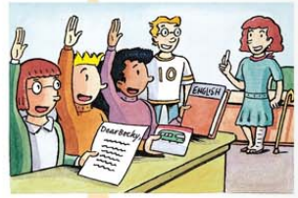
Listen again. Write C for Carol, J for Jack or B for Becky next to the statements in 2a.
2b
1. ___ I visited my grandma.
2. ___ I did my homework.
3. ___ I studied for the English test.
4. ___ I went to a farm.
5. ___ I fed some cows.
B
B
C
J
J

Slide 21
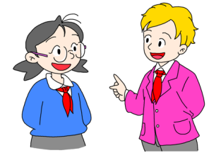
Student A asks questions with who, what or where and Student B answers. Then change roles.
2c
Who visited her grandma?
Becky did.

Slide 22
She studied for the English test.
What did Carol do?

Slide 23
Where did Jack go?
Jack went to a farm.

Slide 24
2d
Role-play the conversation.
Listen and answer the questions.
How was Lisa’s weekend?
2. Where did Lisa work as a guide?
It was great.
At the Natural History Museum.

Slide 25
3. What did she do there?
4. Why is Paul tired now?
She told the visitors about the butterflies and their living habits.
Because he stayed up late to watch the soccer game.

Slide 26
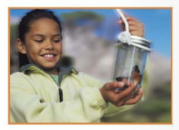
Paul：Hi, Lisa. How was your weekend?
Lisa：Great, thanks.
Paul：What did you do?
Lisa: I worked as a guide at the Natural History Museum.
Paul：Really? How interesting!

Slide 27
蝴蝶
Lisa：Yeah, it was fun. They have a butterfly house
with over 200 kinds of butterflies! I told the
visitors about them and their living habits. Did
you have a good weekend?
Paul：Yeah, it was good, but I’m kind of tired now. I
stayed up late to watch the soccer game.
介词,
超过, 多余

Slide 28
Language points
1. How interesting! 多么有趣啊！
本句为how引导的感叹句, 后面省略it was。
句型结构：How + adj./adv.(+主语+谓语）！
感叹句表示喜、怒、哀、乐等强烈情感。
例句：她唱得多好呀！
How well she sings!

Slide 29
拓展：感叹句还可以使用“What + a(an)+形容词+
名词+主语+谓语！”对名词进行感叹。
例句：哇！多动听的音乐啊！我很喜欢。
Wow! What beautiful music! I like it very much.

Slide 30
2. They have a butterfly house with over 200 kinds
of butterflies！
kind在此作名词, 意为“种类, 同类”。
常用短语：
a different kind of 一种不同的
all kinds of 各种各样的

Slide 31
3. I told the visitors about them and their living habits.
tell sb. about sth. 告诉某人关于某事
told 是 tell的过去式。意为“告诉, 说；辨别；吩咐；讲述”。
例句：马玲告诉我关于她的假期的事情。
Ma Ling told me about her holiday.

Slide 32
tell sb.to do sth. 叫某人做某事
例句： 妈妈让我打扫自己的房间。
Mother tells me to clean my room.
类似句型：
invite sb. to do sth. 邀请某人去做某事 ...
ask sb. to do sth 叫某人去做某事
teach sb. to do sth. 教某人做某事

Slide 33
4. living habits 生活习惯/习性
living 此处为动词 live 的动名词形式。
living作形容词, 意为“活着的”。
例句：他们在月球上没有发现任何活着的东西。
They didn’t find any living things on the moon.

Slide 34
5. Did you have a good weekend? 你周末过得愉快吗?
have a good weekend 周末过得愉快
have a good rest 好好休息
have a good time/have fun 玩得高兴
have a good trip 旅途愉快

Slide 35
6. I stayed up late to watch the soccer game.
stay up late意为“深夜不睡；熬夜”。stay作不及物动词, 意为“停留；待”。
例句：我熬夜一直到凌晨两点。
I stayed up late until two o’clock in the morning.

Slide 36
拓展：与stay相关的常见短语
stay in 待在室内；不外出
stay at home 待在家里
stay out 待在户外
stay away from 离开, 不接近
stay up 熬夜

Slide 37
Exercise
单项选择。
1. — ________?
— He did some reading at home.
A. What does your father do yesterday evening
B. What does your brother do in the school
C. What did your brother do last weekend
D. Where did your brother go last Sunday
C

Slide 38
2. My mum _______ sports yesterday morning.
A. didn’t B. no did
C. doesn’t D. didn’t do
D
3. ______ exciting the movie is! It’s worth watching
（值得观看）again.
A. How an B. What an C. How
C

Slide 39
4. —Who spent the weekend with you?
— Mary _______.
A. do B. did C. does D. doing
5. I didn’t get up on time this morning, because I
_______ too late last night.
A. stayed at B. stay up
C. stayed up D. wake up
B
C

Slide 40
6. She flew a kite last Saturday. (对画线部分提问）
______ _______ ______ _______ last Saturday?
What did she do
7. 我的书包里有各种各样的书。
My schoolbag has _______ _______ _______ books.
all kinds of

