Slide 1
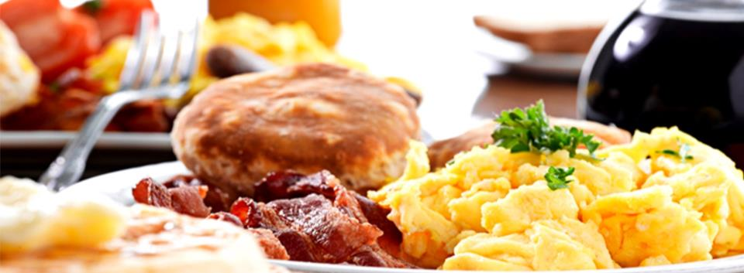
Module 6 Eating together
Unit 2
Knives and forks are used for most Western food
WWW.PPT818.COM

Slide 2
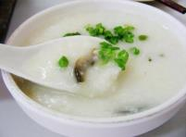
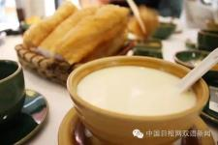
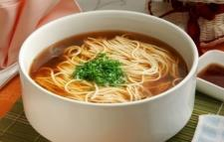
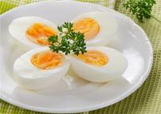
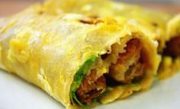
What do you eat for breakfast?
Traditional Chinese breakfast

Slide 3
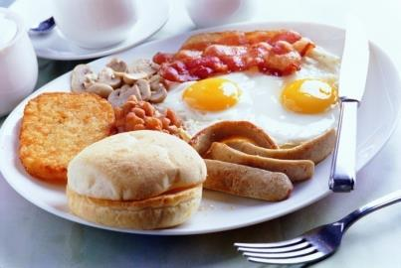
eggs, bacon, bread, beans, mushroom, sausages, coffee and so on.
Traditional Western breakfast

Slide 4
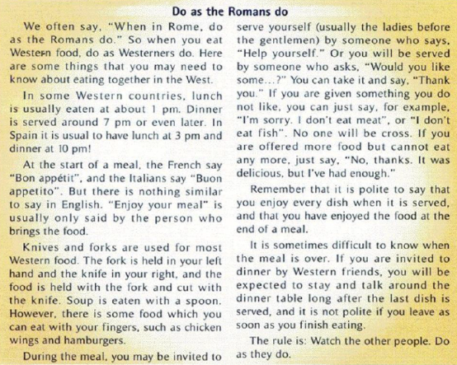
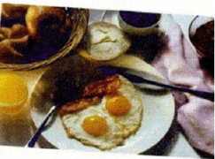
Read the title and the picture
Then predict
When in Rome, do as the Romans do.
Where is the title from?
What does it mean?
What does “do” mean here?
When you go to a place, just follow the rules there.
“do” means eat here.

Slide 5
p1
p2
p3
p4
p5
p6
p7
p8
introduction
conclusion
Skim the passage and match
what to do
utensils
what to say
mealtime

Slide 6
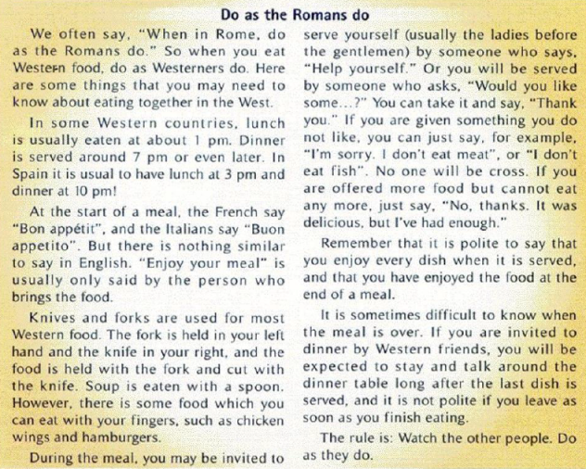
p1
introduction
p2
mealtime
p4
utensils(餐具)
Details about western eating customs
p3
p5
p6
What to say
p7
What to do
Time order
Writing order:?
p8
conclusion

Slide 7
scan &
choose
Who is the passage writer for?
A
A Westerner eating a Chinese meal.
B
A Chinese eating a Western meal.
C
A Chinese eating a Chinese meal.
D
A Westerner eating in a Chinese home.

Slide 8
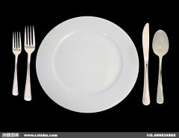
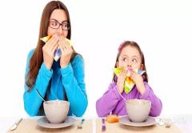
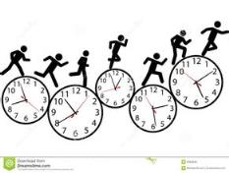
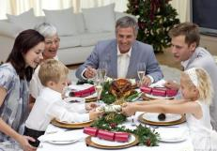
Details about Western eating customs
utensils
what to do
mealtime
what to say

Slide 9
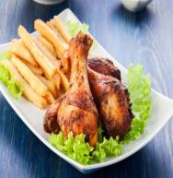
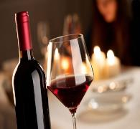
in Spain
In some Western countries
about 1 pm.
At 3 pm
lunch
so late
why?
dinner
around 7 pm or even later
At 10 pm
mealtime

Slide 10
Why so late?
1
Dinner is the most important meal in the West.
2
They go home from work very late
10

Slide 11
utensils
1.The Westerners use the fork to cut the food and the knife to hold the food.
true
false
2.Soup can be drunk with a spoon.
3.You will never see the Westerners use their fingers to eat.
11

Slide 12
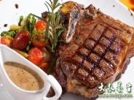
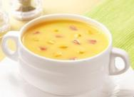
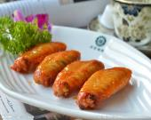
The utensils depend on
the food.
choose
utensils
for
them
Knives and forks
spoon
chopsticks
fingers
beefsteak
soup
noodles
chicken wings

Slide 13
what to say
I’ve enjoyed the food very much!
Bon appétit
at the start of a meal
at the end of a meal
Buon appetito
nothing similar
1. being served:
or
2.refusing food:
Thank you！
I enjoy it!
during a meal
I’m sorry, I don’t eat it.
No, thanks, it was delicious, but I’ve had enough.
No one will be cross / angry
13

Slide 14
p7:what to do
polite
impolite
Stay and talk around the dinner table long after the last dish is served.
Leave as soon as you finish eating.
14

Slide 15
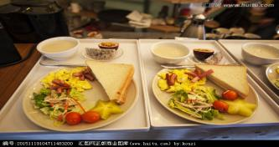
Watch the other people.
Do as they do.
Golden rule

Slide 16
Post-reading
Different from
mealtime
Which part is unusual to you?
Chinese eating customs
utensils
Western eating customs
?
what to
say
what to
do
16

Slide 17
Homework
Write a passage about Chinese eating customs for a tourist magazine with Western readers.

Slide 18
Thank you!

