Slide 1
Unit 4 A good read
Reading 1
WWW.PPT818.COM

Slide 2
Words and phrases review
against
be tired out
tie
over
stomach
until
finger
tiny
fall over
prep. 紧靠，碰，撞
筋疲力尽
vt. 捆，绑
prep. 从一边到另一边
n. 腹部；胃
conj. 直到……为止
n. 手指
adj. 极小的
摔倒

Slide 3
Words review
continue
either
manage
lift
army
must
unable
shoulder
vt. & vi. 继续
adv. 也
vt. & vi. 设法完成；管理
vt. 举起，抬高；提高
n. 大批，大群
modal v. 应该，必须；一定
adj. 不能的，不会的
n. 肩膀

Slide 4



Have you read these books?
Alice in
Wonderland
Cinderella
Snow White
Are you interested in reading stories?
Why do you like them?

Slide 5
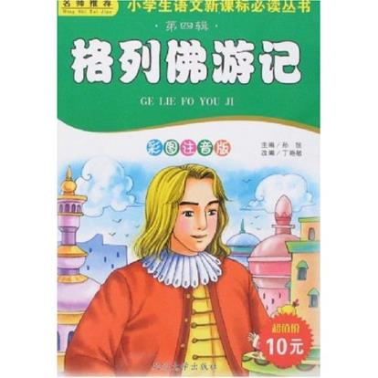
Background information
Gulliver's Travels is a novel by Irish writer and clergyman Jonathan Swift. It is Swift's best known full-length work, and a classic of English literature.
This novel tells us Gulliver’s amazing adventures in some countries.

Slide 6
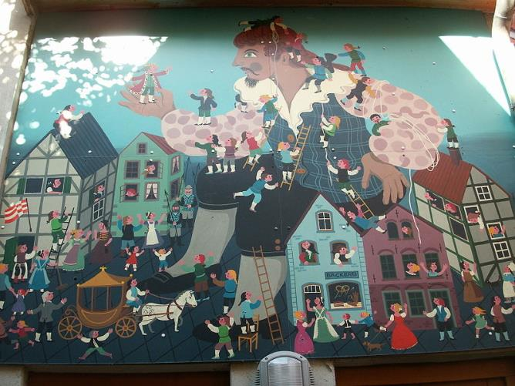
Lilliput (小入国)

Slide 7
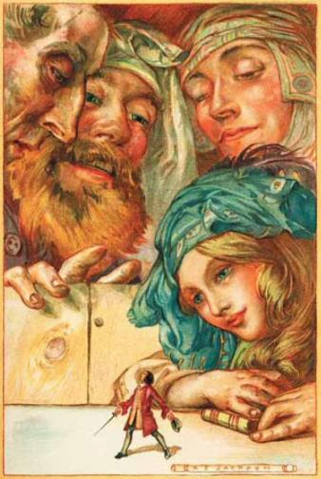
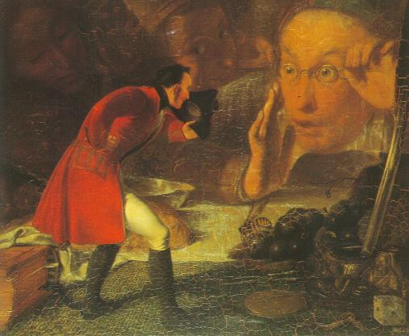
Brobdingnag (大人国)

Slide 8
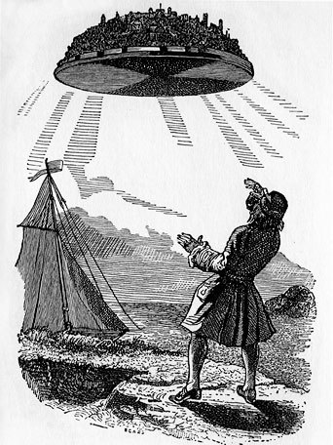
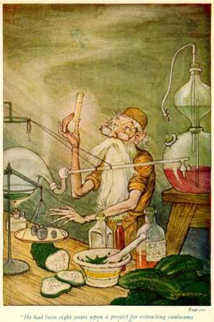
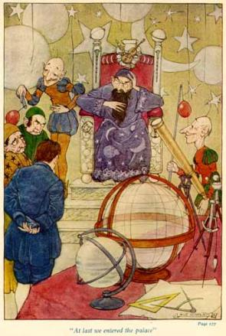
Laputa (飞岛国)

Slide 9
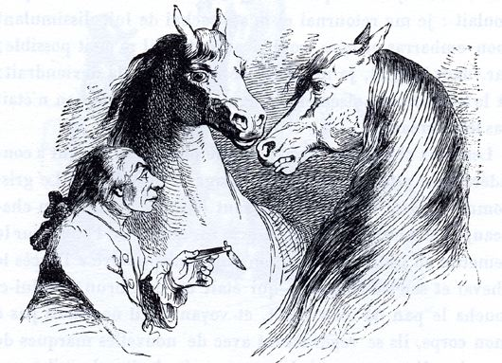
Houyhnhnms(智马国)

Slide 10

Listen and choose
(1)Which adventure does this extract belong to?
A. Lilliput B. Brobdingnag
C. Laputa D. Houyhnhnms
(2)In this extract, who am “I”?
A. Jonathan Swift B. Gulliver
C. Sandy D. A small man
(3)How many tiny people did “I” meet in the end?
A. One. B. A few.
C. A large number. D. Two.

Slide 11
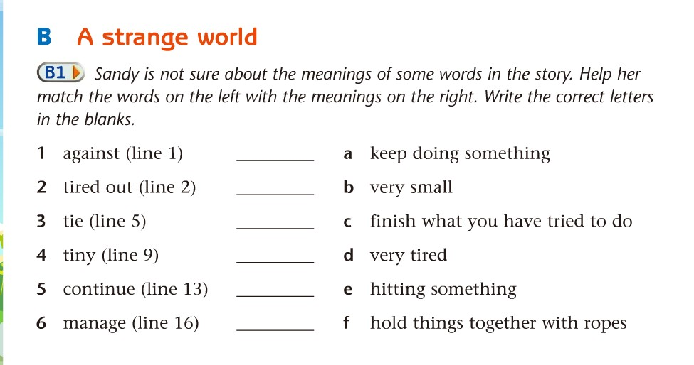
e
d
f
b
a
c

Slide 12
Read and answer.
(1)Did Gulliver know where he was when he
woke up?
No, he did not.
(2)Why did the tiny people tie Gulliver to the
ground?
They didn’t want Gulliver to run away.
(3)Did Gulliver do anything to help himself out?
What did he do?
Yes. At first he shouted at the tiny people,
and then he tried to pull his hand free.
Finally, he managed to break the ropes.

Slide 13
(4)What were those tiny people’s reactions to Gulliver when he tried to help himself out?
At first, they were shocked by the loud noise that Gulliver made and they all fell over, but they soon got up again and continued moving across Gulliver’s body. Then they began talking to Gulliver. When Gulliver lifted his 1eft hand into the air, they began to shout and a huge army of tiny people came straight towards Gulliver.

Slide 14
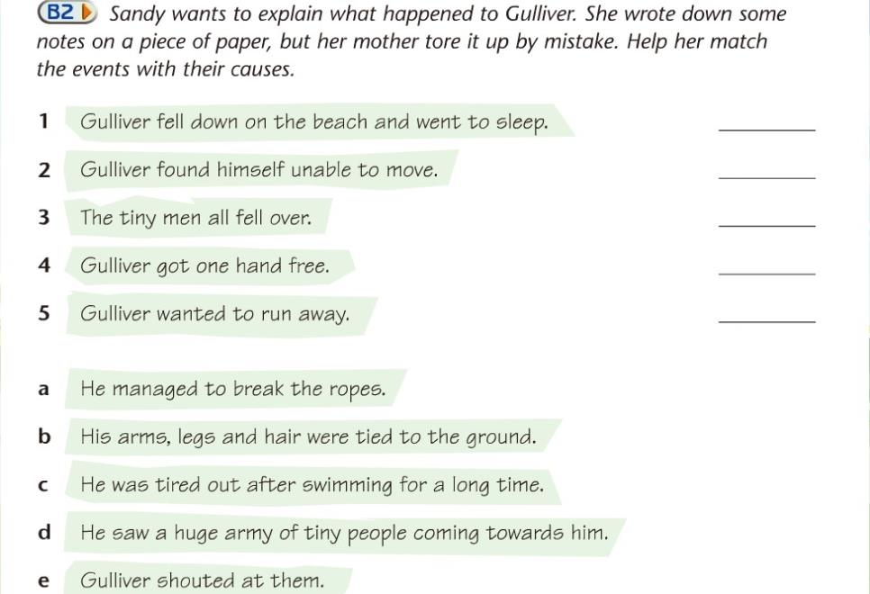
c
b
e
a
d

Slide 15
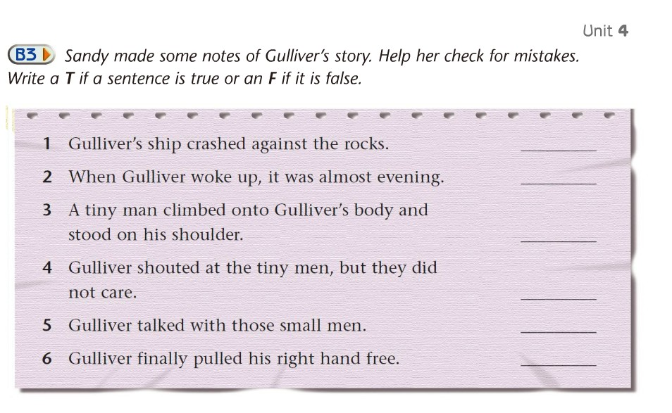
T
F
F
T
F
F

Slide 16
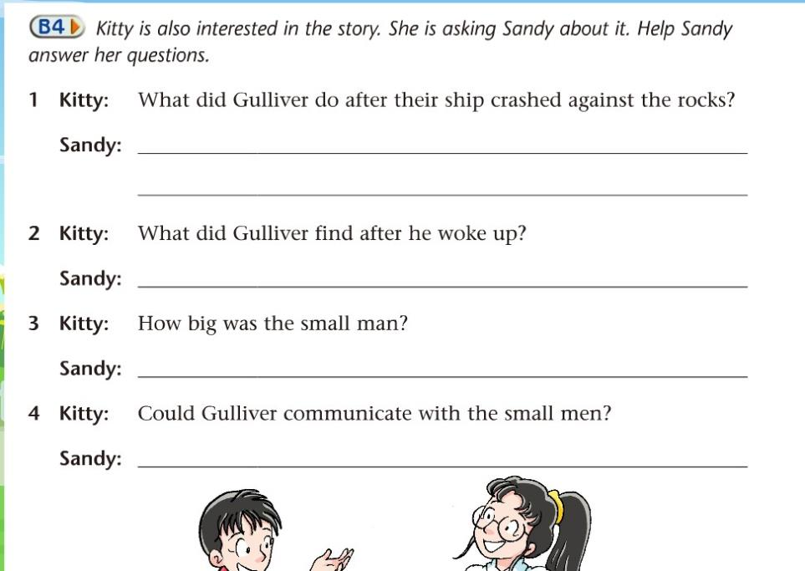

Slide 17
B4 Kitty is also interested in the story. She is asking Sandy about it Help Sandy answer her questions.
1 Kitty：What did Gulliver do after their ship crashed against the rocks?
Sandy：_______________________________
_________________________________
_________________________________
_________________________________
2 Kitty：What did Gulliver find after he woke up?
Sandy：_______________________________
________________________________
He swam as far as he could. By the time
he felt the land under his feet, he was
tired out. He felt down the beach and
went to sleep.
He found he could not to move. His arms,
legs and hair were tied to the ground.

Slide 18
B4 Kitty is also interested in the story. She is asking Sandy about it Help Sandy answer her questions.
3 Kitty：How big was the small man?
Sandy：_________________________
_________________________
4 Kitty： Could Gulliver communicate with the small men?
Sandy：___________________________
He was the same size as
Gulliver’s finger.
No, he could not.

Slide 19


Interview
Reporter: Good morning, our hero. You were the first to find the huge man. How did you find him? Tiny man: On that evening, I … on the beach. Suddenly I saw… It was the same size as… (It looked like… )
Reporter: What did you do after finding the huge man? Tiny man: I … I felt…
Reporter: … Tiny man: …
Reporter: It is said that he tried to run away. How did you stop him? Tiny man: We ... We wouldn’t let him get away because…
Reporter: You are so brave. Nice talking with you. Thank you for your time.

Slide 20
Homework
1 熟读课文, 能力较强的学生背诵。
2 完成教师布置的相关练习。

