Slide 1
Unit3 Spring Begins from March?
WWW.PPT818.COM

Slide 2
>>Lead-in
Listen and enjoy
（单击图片播放动画）

Slide 3
>>Lead-in
Let’s sing
January, February, one and two.
March, April, three and four.
May, June, five and six.
July, August, seven and eight.
September, October, nine and ten.
November, December, the year is done.

Slide 4
>>Presentation
Read and answer
1. Which is Li Shan’s favourite season?
Autumn.
2. When does autumn begin?
Autumn begins from September.
3. Is it cool in autumn?
Yes, it is.

Slide 5
>>Presentation
Read and answer
4. Does Alice like winter? Why?
Yes, she does. Because we have Christmas on December 25th and New Year on January 1st. We can have much good time together with our family and friends.
5. When are Christmas and New Year?
Christmas on December 25th and New Year on January 1st.

Slide 6
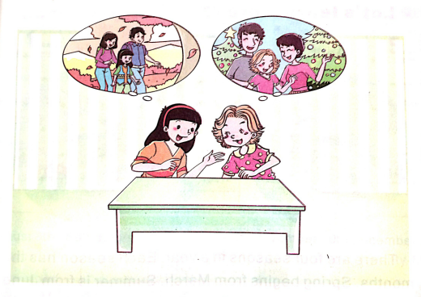
>>Presentation
Let’s talk

Slide 7
>>Presentation
Read and answer
Alice: Which is your favourite season, Li Shan?
Li Shan: Autumn.
Alice: Why?
Li Shan: Because autumn begins from September here. In September and October,
it is cool and the mountains become very beautiful.

Slide 8
>>Presentation
Read and answer
Alice: Oh, really?
Li Shan: Yes. The sky is blue. And the trees become red and yellow.
Alice: But I like winter better. Because we have Christmas on December 25th and New Year on January 1st. We can have much good time together with our family and friends.

Slide 9
>>Presentation
Let’s learn
Which is your favourite season?
My favourite season is … Because … It is … The trees … The flowers … The mountains … I can …

Slide 10
>>Presentation
序数词
first second third
fourth fifth sixth
seventh eighth ninth
tenth eleventh twelfth

Slide 11
>>Presentation
Learn to say
February 2nd
March 3rd
(second)
(third)
May 4th
July 5th
(fourth)
(fifth)
August 8th
(eighth)

Slide 12
>>Presentation
Learn to say
September 9th
October 12th
(ninth)
(twelfth)
November 20th
December 25th
(twentieth)
(twenty-fifth)

Slide 13
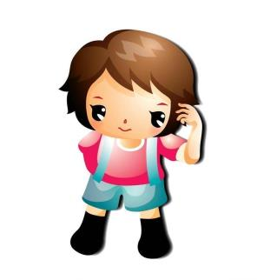
>>Practice
Group work
My favourite season is …
Which is your favourite season?

Slide 14
>>Homework
1.观看课文动画，按照正确的语音、语调朗读课文对话。
2.运用本课所学主要句型：Which is your
favourite season? My favourite season is
…做对话练习。
3.预习“Learn to say”。
close

