Slide 1
Module 9
WY 六年级下册
Unit 2 Wishing you happiness every day.
WWW.PPT818.COM

Slide 2
Have you ever received a postcard from your friend?

Slide 3
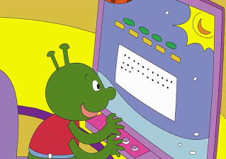
1. Look, listen and say.
I’m writing an email to my friends from the earth. I miss them.
Dear friends,
I miss you. Best wishes to you.
Love, Bobo.

Slide 4
2. Listen and read.
Dad: What are you doing，Lingling?
Lingling: I’ m writing goodbye letters to all my friends at school.
Dad: That’s a good idea. What are you writing in your letters?
Lingling: Well，first I write the name of a friend. Look ！ This one is for Amy.
Lingling: And then I write “Wishing you happiness every day” in every letter.
Dad: Wow！There are about forty letters here. What a lot of good wishes!

Slide 5
Wishing you happiness every day...
祝你每天都快乐……
知识点 1
用法：
这是常见的祝福语，用于表达祝愿。

Slide 6
happiness / hæpɪnɪs/ n. ( 名词 ) 幸福，愉快
Her face is full of happiness. 她的脸上满是幸福。
例句：
happy adj. 幸福的，快乐的
happily adv. 幸福地，快乐地
词形变化：
sadness 悲哀
反义词：

Slide 7
知识点 2
What a lot of good wishes!
多么多的美好祝愿啊！
what / wɒt/ pron. （代词）多么
例句：
What a fine day it is! 多么晴朗的一天啊！
形近词：
hat
一词多义：
what 什么

Slide 8
What a lot of good wishes!
这是由what 引导的感叹句，用以表示赞美、惊叹、喜悦等情感。
用法：
What（+ a / an）+ 形容词+ 名词（主语+ 谓语）！
句型结构：
What beautiful flowers!多么漂亮的花啊！
例句：

Slide 9
拓展
由how 引导的感叹句： （1）How + 形容词+ 主语+ 谓语（+ 其他）！例句：How hot it is today! 今天多么热呀！ （2）How + 副词+ 主语+ 谓语！ 例句：How fast he runs! 他跑得多么快呀！（3）How+ 主语+ 谓语！ 例句：How time flies! 光阴似箭！

Slide 10
3. Now read and write.
Then ask and answer.
1．What is Lingling doing? 2．What does she write first?
_____________________________ _____________________________
_____________________________ _____________________________
3．Then what does she write? 4．How many letters are there?
_____________________________ _____________________________
_____________________________ _____________________________
Lingling is writing goodbye letters to all her friends at school.
First she writes the name of a friend.
Then she writes “Wishing you happiness every day” in every letter.
There are about forty letters.
She’s writing goodbye
letters to all her friends at school.
What is Lingling doing?

Slide 11
4. Listen and say. Then sing.
GOODBYE，MY FRIEND
Goodbye, goodbye, my friend.
It’s nearly the end, the end.
Good luck, good luck to you!
Good luck, good luck to you!
Goodbye, goodbye, my friend.
It’s nearly the end, the end.
Wishing you happiness every day.
Wishing you happiness every day.

Slide 12
5. Do and say.
Give good wishes to your friends.
Good luck for the future.
From Xiaoyong.
Thank you，Xiaoyong.

Slide 13
趣味活动：最温馨的祝福。
马上就要毕业了，你有什么祝福要对你的好朋友说呢？设计一个精美的贺卡，在上面写下最温馨的祝福，送给你的好朋友吧！

Slide 14
6. Write and say.
Write good wishes to your friends in their notebooks.
Good luck for the future! I’ll miss you.
Thank you. I’ll miss you too.

Slide 15
一、单项选择。
I am growing up ______ in a ______ family.
A. happy；happiness
B. happy；happily
C. happily；happy
C
点拨：
第一个空格用副词形式happily修饰动词，第二个空格用形容词形式happy修饰名词family，故选C。

Slide 16
二、情景选择。
当你想祝福别人每天都快乐时，你可以说：（ ）
A. Good luck to you!
B. Wishing you happiness every day!
C. I will miss you.
B

Slide 17
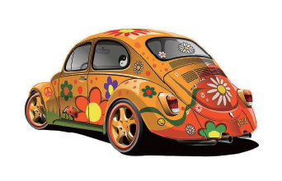
三、根据图片提示补全句子。
____________cool your new car is!
How

Slide 18
四、连词成句。
a, what, clever, is, she, girl （!）
________________________
What a clever girl she is!

Slide 19
本节课我们学习了以下知识，请同学们一定加强巩固，以便能和同学们进行灵活交流哦！
重点词汇：what, happiness
重点句式：Wishing you happiness every day.
What a lot of good wishes!

Slide 20
1 熟记本节课所学的句型、短语和单词，必须会听、说、读、写。
2 将Listen and read的对话朗读流利。
3 完成配套的课后作业。

Slide 21
Thank you!

