Slide 1
Starter Module3 My English book
Unit 3 What colour is it?
WWW.PPT818.COM

Slide 2
学习目标
1. 学习red, yellow, green, blue, black, white, orange, brown表颜色的名词。
2.能够用英语询问颜色，并能够做出相应的回答：
—What color is it? ——It’s black.
—What color is the…? ——It’s …
3.培养学生听说读写能力，增强学生跨文化意识和学科素养。

Slide 3
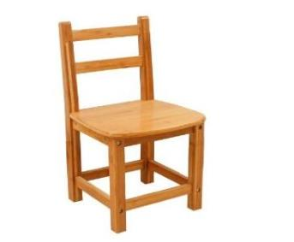
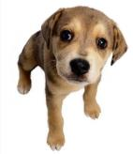
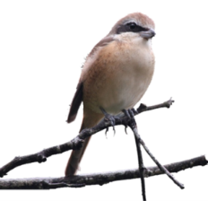
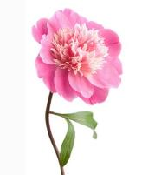
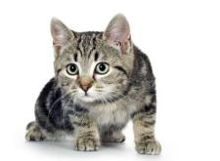
Review
What’s this in English? It’s…
How do you spell it? …

Slide 4
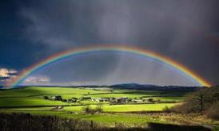
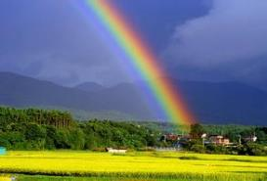
rainbow
彩虹

Slide 5
Presentation
Look and say
How many colors are there in the picture?
orange
red
blue
yellow
black
green

Slide 6
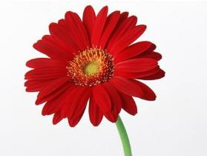
Ask and answer
What’s this?
It’s a flower.
What colour is it?
It’s red.
对颜色进行询问，用What color is it?

Slide 7
What’s this?
What colour is it?
What colour is the pen?

Slide 8
What’s this?
What colour is it?
What colour is the pencil?

Slide 9
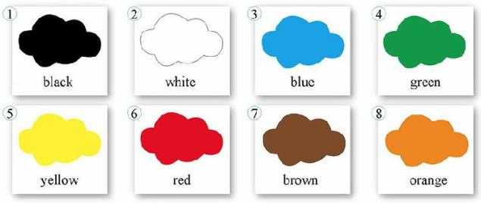
Listen and point
black
white
blue
green
yellow
red
brown
orange
What colour is it?
It’s black, B-L-A-C-K, black.

Slide 10
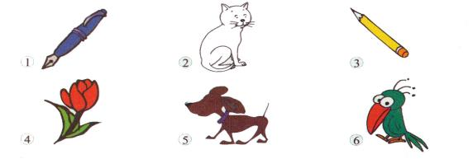
Read, match, listen and imitate
1. What colour is the pen?
2. What colour is the cat?
3. What colour is the pencil?
4. What colour is the flower?
5. What colour is the dog?
6. What colour is the bird?
It’s blue.
It’s white.
It’s yellow.
It’s red.
It’s brown.
It’s red, green and orange.

Slide 11
Practice
Work in pairs, ask and answer.
A: What’s this English?
B: It’s…
A: What colour is the…
B: It’s…

Slide 12
查资料，比一比：了解的颜色的谚语或习语
利用手机查资料发家校合作群分享
读一读你找到的资料
看看老师在班级微信群里发的的丰富资料

Slide 13
Talk and guess in groups
black tea
green hand
feel blue
see red
The grass is greener on the other side
红茶
新手
忧郁
发怒，冒火
邻家芳草绿，隔家风景好

Slide 14
Look at the family names
Cultural links
It's fun .
Talk and guess in groups
Mr. Black
Mrs. Green
Mr. White
Mrs. Brown
Mr. Red

Slide 15
Test: Listen,write and check
1. — What colour is the dog?
— It’s .
2. — What is the flower?
— It’s .
3. — is the bird?
— It’s red, green and .
brown
colour
red
What colour
orange

Slide 16
4.—What ?
—It’s yellow.
5. — the pen?
—It’s .
6. — the cat?
— It’s .
colour is the pencil
What colour is
blue
What colour is
white

Slide 17
Summary
black, white, blue, green, yellow, red, brown, orange, colour, and
words
structures
What colour is it/ the…?
It’s…

Slide 18
Write and check
bag bird black blue book brown cat desk dog flower green orange pen pencil red white yellow
In the classroom | Animals and plants | Colours
bag | bird | black
book
desk
pen
pencil
cat
dog
flower
blue brown
green orange
red white
yellow

Slide 19
Homework
1. Find out the other words about colour and write them.
2. Make a new dialogue with your partner using the sentence patterns.
3.Finish the rest of the activity.

