Slide 1
Module 9 People and places
Unit 3 Language in use
WWW.PPT818.COM

Slide 2
Monday
(day)
Dear
Lucy
(收name)
How are you?/ Greetings from Changshan. I’m having an English class now. I’m enjoying my…
(收name)
Lucy
No.4 Middle School, Beijing, China(10089)
See you soon. Love,
(收address)
Sally
(寄name)

Slide 3
等公交车
吃冰激凌
喝桔汁
吃午餐
照相
写明信片
买礼物
wait for a bus…
eat an ice cream
drink juice
have lunch
take a photo/ some photos
write a postcard
buy presents/ shop for presents

Slide 4
享受学校的郊游
躺在太阳下
打电话给妈妈
告诉她关于购物
玩的很开心
enjoy the school trip
lie in the sun
call mother/ give mother a call
tell her about shopping
have a good/ great time

Slide 5
你能听到我吗?
我正站在中国长城上.
听,鸟儿在树上歌唱.
看,小狗在躺在太阳下睡觉.
Can you hear me?
I’m standing on the Great Wall of China.
Listen, the bird is singing in the tree.
Look, the dog is lying in the sun and sleeping.

Slide 6
It is walking.
It is doing sports.

Slide 7
It is riding a bike.
It is running.

Slide 8
It is playing basketball.
It is playing the guitar.

Slide 9
It is playing football.
It is driving a car.

Slide 10
She is drinking juice.
It is dancing.

Slide 11
They are talking.
He is using a computer.

Slide 12
He is cooking.
He is doing homework.

Slide 13
读单词，把单词变成现在分词的形式 buy_____ lie______ stand _____ read _______ talk______ walk_______ sing_______ dance_______ have______ take______ write_______ shop_______
eat ______ drive_______ call_______ enjoy_______ tell_____ swim_______ wait______ drink________
buying
lying
standing
reading
talking
walking
singing
dancing
having
taking
writing
shopping
eating
driving
calling
enjoying
telling
swimming
waiting
drinking
小结：
现在分词的变化形式有多少种呢？

Slide 14
动词的现在分词形式.
一般情况,直接在动词后加ing, 如speak--speaking
以不发音的e结尾的单词,要去e加ing,如have--having
以辅+元+辅结尾的重读闭音节单词,双写最后一个字母加ing,如run—running, get--getting
特殊变化,如lie--lying
open listen

Slide 15
Grammar
现在进行时 (1)
1. 定义：表示现在正在进行的动作。
2. 构成：be + 动词的现在分词。
Be (am is are) 随着人称、数的变化而变化。

Slide 16
4. 现在进行时的否定句结构：
sb. + be not + doing
e.g. I’m not visiting my friends now.
He isn’t writing a postcard.
5. 现在进行时的一般疑问句结构：
be + sb. + doing + 其他?
e.g. Is she enjoying her visit?
Are they buying postcards?

Slide 17
句型转换：
1.The man is playing the violin.(一般疑问句）
2.She is making salad.(否定句）
3.The boy is going to school by bike.(划线提问）
4.She’s writing a letter to her friend.(划线提问）
Is the man playing the violin?
She isn’t making salad.
How is the boy going to school?
Who is she writing a letter to?

Slide 18
6. 常与现在进行时态连用的词: now,
listen, look 等。 e.g.
1. I’m reading now. 我现在正在读书。
2. Listen! She is singing.
听, 她正在唱歌。
3. Look! My parents are watering the
flowers.
看, 我的父母亲正在浇花。

Slide 19
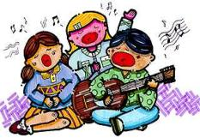
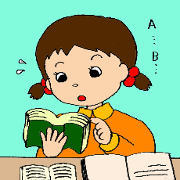
Look ! The bird is _____ in the sky.
2.Is Steve _______ in the sea?
Yes, he is.
3.My classmates are ______
on the playground.
4.Now, Mary is _______ .
flying
swimming
singing
reading

Slide 20
Language practice
1. I’m standing on the Great Wall
of China and talking to you.
2. Tony is eating a delicious
ice cream.
3. They’re working.
4. People aren’t having dinner.

Slide 21
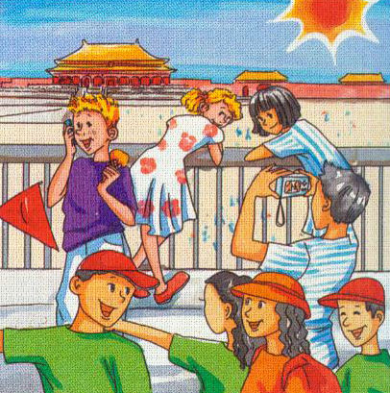
Look at the picture. Say what they are doing.
Tony is calling a friend.

Slide 22
Complete the conversation between Tony and his dad with the correct form of the words in brackets.
Tony: Hi, Dad!
Dad: Hi, Tony. What are you doing now? Tony: We (1) ___________ ( visit ) the Forbidden City. Lingling and Betty
(2) __________ ( write ) postcards.
are visiting
are writing

Slide 23
Dad: What is Daming doing? Tony: He (3) _________ ( take ) photos. There are lots of people here. They (4) ____________ ( enjoy) the sun. Some people (5) ____________ ( look ) at the buildings and some (6) ____________ ( look ) at maps.
is taking
are enjoying
are looking
are looking

Slide 24
Dad: Are you having a good time?
Tony: Yes, we (7) _____________ ( have ) a great time, Dad! See you next Monday.
are having

Slide 25
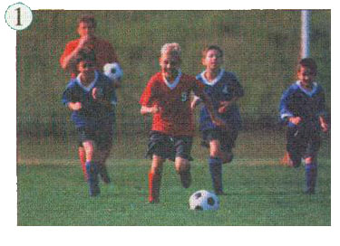
Write about the pictures.
Some boys are playing football.
They aren’t playing basketball.

Slide 26
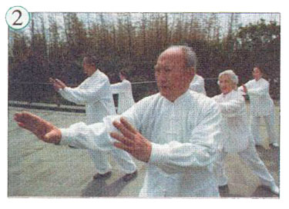
Some old people __________ Taijiquan.
They _____________ Yangge.
are playing
aren’t playing

Slide 27
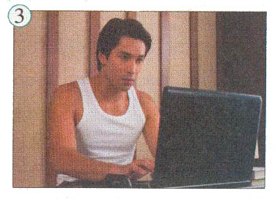
He ________________ TV. He ______________ on a computer.
isn’t watching
is working

Slide 28
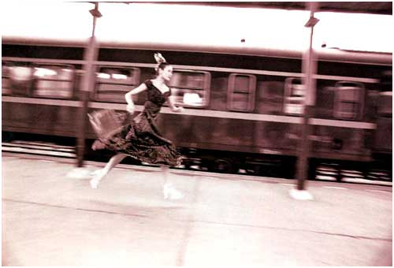
run for trains
She is running for a train.

Slide 29
Work in pairs
Mime an action for your partner to guess. Use the expressions to help you.
driving a car getting up
going to sleep lying in the sun
playing basketball running for a bus

Slide 30
studying history taking photos
watching TV writing postcards
A: You’re running for a bus!
B: No!
A: You’re playing basketball!
B: Yes!

Slide 31
Learning to learn
When you revise your vocabulary, choose words which are useful for you, and write them in sentences.
postcard: On holiday I usually send four or five postcards to my friends.

Slide 32
London 5:00p.m.
At this moment
Moscow 8:00p.m.
Beijing 1:00a.m.
Los Angeles 9:00a.m.
New York 12:00
at the moment = now
At this moment, in different places of the world people are doing different things.

Slide 33
Around the world
Time zones
In the US, from New York to Hawaii, there are several time zones.

Slide 34
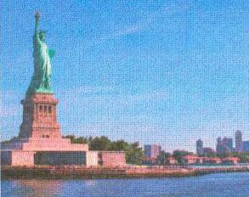
It’s midday in New York, and people are having lunch.

Slide 35
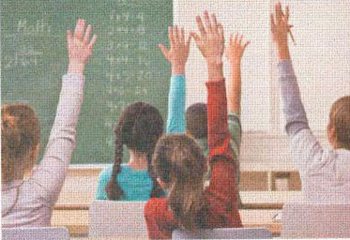
It’s 9:00 am in Los Angeles, and children are starting school.

Slide 36
In Hawaii, it’s 7:00 am, and most people are getting up.

Slide 37
Module task: Making a radio report
Work in groups of three or four. Plan a radio report.
Talk about news you would like to report.
List the activities you would like to report.
Make notes about the news.
Write what you are going to say.

Slide 38
Work in pairs
Show your report to the whole class.
Choose the best report.

Slide 39
达标练习
I. 用单词的正确形式填空。
1. Tony is ______ (take) photos.
2. They are _______ (call) their teacher.
3. Lucy is _______ (wait) for No. 8 bus.
4. We are _________ (shop) with mother.
taking
calling
waiting
shopping

Slide 40
5. Daming is _____ (lie) in the bed.
6. Lily and Tom are ______ (have) a good
time.
7. Jim is ________ (enjoy) playing football.
8. He is _______ (leave) work now.
lying
having
enjoying
leaving

Slide 41
B. 根据要求完成下列各题。
1. 他们正在吃午饭。
They are ____________ now.
2. 三班的学生正在做作业。
The students of Class Three _________ their homework.
having lunch
are doing

Slide 42
3. 孩子们正在起床。
Children _________________ now.
4. 现在是8:20。 他们在上语文课。
____ 8:20 now. They __________ Chinese.
5. 他们正在公园里拍照。
They are ____________ in the park.
are getting up
It’s are having
taking photos

Slide 43
Choose the right answer:
I’m ____ to you .
A. talk B. talking C. talkes
2. Daming is ___lunch and ___ in the sun.
A . eating, lieing B. eatting, lying C. eating,lying
3. He’s ___ the school trip a lot.
A enjoys B enjoing C. enjoying
1你在干什么? 我在等汽车.
What are you doing?
I’m waiting for the bus.

