Slide 1
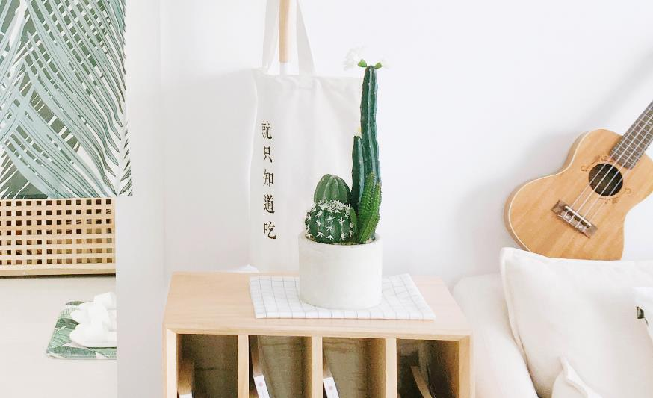
05
20
DESTINY
FREEDOM
I love you more than I've ever loved any woman. And I've waited longer for you than I've waited for any woman.
I love you more than I've ever loved any woman. And I've waited longer for you than I've waited for any woman.I love you more than I've ever loved any woman. And I've waited longer for you than I've waited for any woman.

Slide 2
Contents
01
02
03
04
I love you more than I've ever loved any woman. And I've waited longer for you than I've waited for any woman.
I love you more than I've ever loved any woman. And I've waited longer for you than I've waited for any woman.
I love you more than I've ever loved any woman. And I've waited longer for you than I've waited for any woman.
I love you more than I've ever loved any woman. And I've waited longer for you than I've waited for any woman.

Slide 3
01
Click here to add your title
I love you more than I've ever loved any woman. And I've waited longer for you than I've waited for any woman.I love you more than I've ever loved any woman. And I've waited longer for you than I've waited for any woman.
I love you more than I've ever loved any woman. And I've waited longer for you than I've waited for any woman.

Slide 4
ALL OR NOTHING
NOW OR NEVER
I love you more than I've ever loved any woman. And I've waited longer for you than I've waited for any woman.I love you more than I've ever loved any woman. And I've waited longer for you than I've waited for any woman.
I love you more than I've ever loved any woman. And I've waited longer for you than I've waited for any woman.

Slide 5
ALL OR NOTHING
NOW OR NEVER
I love you more than I've ever loved any woman. And I've waited longer for you than I've waited for any woman.
I love you more than I've ever loved any woman. And I've waited longer for you than I've waited for any woman.
Click here to add your title
I love you more than I've ever loved any woman. And I've waited longer for you than I've waited for any woman.I love you more than I've ever loved any woman. And I've waited longer for you than I've waited for any woman.I love you more than I've ever loved any woman. And I've waited longer for you than I've waited for any woman.I love you more than I've ever loved any woman. And I've waited longer for you than I've waited for any woman.

Slide 6
Click here to add your title
I love you more than I've ever loved any woman. And I've waited longer for you than I've waited for any woman.I love you more than I've ever loved any woman. And I've waited longer for you than I've waited for any woman.
I love you more than I've ever loved any woman. And I've waited longer for you than I've waited for any woman.I love you more than I've ever loved any woman. And I've waited longer for you than I've waited for any woman.I love you more than I've ever loved any woman. And I've waited longer for you than I've waited for any woman.
I love you more than I've ever loved any woman. And I've waited longer for you than I've waited for any woman.
ALL OR NOTHING
NOW OR NEVER

Slide 7
Click here to add your title
I love you more than I've ever loved any woman. And I've waited longer for you than I've waited for any woman.I love you more than I've ever loved any woman. And I've waited longer for you than I've waited for any woman.
I love you more than I've ever loved any woman. And I've waited longer for you than I've waited for any woman.I love you more than I've ever loved any woman. And I've waited longer for you than I've waited for any woman.I love you more than I've ever loved any woman. And I've waited longer for you than I've waited for any woman.

Slide 8
02
Click here to add your title
I love you more than I've ever loved any woman. And I've waited longer for you than I've waited for any woman.I love you more than I've ever loved any woman. And I've waited longer for you than I've waited for any woman.
I love you more than I've ever loved any woman. And I've waited longer for you than I've waited for any woman.

Slide 9
ALL OR NOTHING
NOW OR NEVER
I love you more than I've ever loved any woman. And I've waited longer for you than I've waited for any woman.
I love you more than I've ever loved any woman. And I've waited longer for you than I've waited for any woman.I love you more than I've ever loved any woman. And I've waited longer for you than I've waited for any woman.

Slide 10
ALL OR NOTHING
NOW OR NEVER
Add your title
Add your title
Add your title
Add your title
I love you more than I've ever loved any woman. And I've waited longer for you than I've waited for any woman.
I love you more than I've ever loved any woman. And I've waited longer for you than I've waited for any woman.
I love you more than I've ever loved any woman. And I've waited longer for you than I've waited for any woman.
I love you more than I've ever loved any woman. And I've waited longer for you than I've waited for any woman.

Slide 11
ALL OR NOTHING
NOW OR NEVER
Click here to add your title
I love you more than I've ever loved any woman. And I've waited longer for you than I've waited for any woman.I love you more than I've ever loved any woman. And I've waited longer for you than I've waited for any woman.
I love you more than I've ever loved any woman. And I've waited longer for you than I've waited for any woman.
I love you more than I've ever loved any woman. And I've waited longer for you than I've waited for any woman.

Slide 12
ALL OR NOTHING
NOW OR NEVER
I love you more than I've ever loved any woman. And I've waited longer for you than I've waited for any woman.I love you more than I've ever loved any woman. And I've waited longer for you than I've waited for any woman.
Click here to add your title
I love you more than I've ever loved any woman. And I've waited longer for you than I've waited for any woman.
I love you more than I've ever loved any woman. And I've waited longer for you than I've waited for any woman.
DESTINY FREEDOM

Slide 13
ALL OR NOTHING
NOW OR NEVER
I love you more than I've ever loved any woman. And I've waited longer for you than I've waited for any woman.I love you more than I've ever loved any woman. And I've waited longer for you than I've waited for any woman.
I love you more than I've ever loved any woman. And I've waited longer for you than I've waited for any woman.
I love you more than I've ever loved any woman. And I've waited longer for you than I've waited for any woman.

Slide 14
03
Click here to add your title
I love you more than I've ever loved any woman. And I've waited longer for you than I've waited for any woman.I love you more than I've ever loved any woman. And I've waited longer for you than I've waited for any woman.
I love you more than I've ever loved any woman. And I've waited longer for you than I've waited for any woman.

Slide 15
ALL OR NOTHING
NOW OR NEVER
Click here to add your title
I love you more than I've ever loved any woman. And I've waited longer for you than I've waited for any woman.I love you more than I've ever loved any woman. And I've waited longer for you than I've waited for any woman.
I love you more than I've ever loved any woman. And I've waited longer for you than I've waited for any woman.I love you more than I've ever loved any woman. And I've waited longer for you than I've waited for any woman.

Slide 16
Click here to add your title
I love you more than I've ever loved any woman. And I've waited longer for you than I've waited for any woman.I love you more than I've ever loved any woman. And I've waited longer for you than I've waited for any woman.I love you more than I've ever loved any woman. And I've waited longer for you than I've waited for any woman.
I love you more than I've ever loved any woman. And I've waited longer for you than I've waited for any woman.I love you more than I've ever loved any woman. And I've waited longer for you than I've waited for any woman.
DESTINY FREEDOM

Slide 17
Click here to add your title
I love you more than I've ever loved any woman. And I've waited longer for you than I've waited for any woman.
I love you more than I've ever loved any woman. And I've waited longer for you than I've waited for any woman.I love you more than I've ever loved any woman. And I've waited longer for you than I've waited for any woman.
ALL OR NOTHING
NOW OR NEVER

Slide 18
Click here to add your title
I love you more than I've ever loved any woman. And I've waited longer for you than I've waited for any woman.I love you more than I've ever loved any woman. And I've waited longer for you than I've waited for any woman.
Click here to add your title
I love you more than I've ever loved any woman. And I've waited longer for you than I've waited for any woman.I love you more than I've ever loved any woman. And I've waited longer for you than I've waited for any woman.

Slide 19
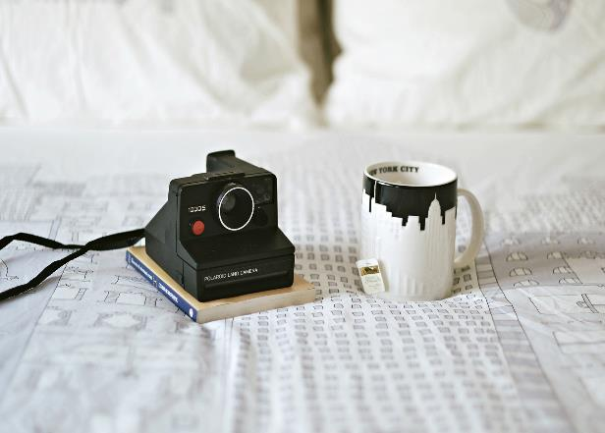
ALL OR NOTHING
NOW OR NEVER
Click here to add your title
I love you more than I've ever loved any woman. And I've waited longer for you than I've waited for any woman.I love you more than I've ever loved any woman. And I've waited longer for you than I've waited for any woman.
I love you more than I've ever loved any woman. And I've waited longer for you than I've waited for any woman.

Slide 20
04
Click here to add your title
I love you more than I've ever loved any woman. And I've waited longer for you than I've waited for any woman.I love you more than I've ever loved any woman. And I've waited longer for you than I've waited for any woman.
I love you more than I've ever loved any woman. And I've waited longer for you than I've waited for any woman.

Slide 21
ALL OR NOTHING
NOW OR NEVER
Click here to add your title
I love you more than I've ever loved any woman. And I've waited longer for you than I've waited for any woman.I love you more than I've ever loved any woman. And I've waited longer for you than I've waited for any woman.
I love you more than I've ever loved any woman. And I've waited longer for you than I've waited for any woman.I love you more than I've ever loved any woman. And I've waited longer for you than I've waited for any woman.

Slide 22
ALL OR NOTHING
NOW OR NEVER
Click here to add your title
I love you more than I've ever loved any woman. And I've waited longer for you than I've waited for any woman.I love you more than I've ever loved any woman. And I've waited longer for you than I've waited for any woman.
I love you more than I've ever loved any woman. And I've waited longer for you than I've waited for any woman.I love you more than I've ever loved any woman. And I've waited longer for you than I've waited for any woman.

Slide 23
DESTINY FREEDOM
ALL OR NOTHING
NOW OR NEVER
I love you more than I've ever loved any woman. And I've waited longer for you than I've waited for any woman.I love you more than I've ever loved any woman. And I've waited longer for you than I've waited for any woman.
I love you more than I've ever loved any woman. And I've waited longer for you than I've waited for any woman.I love you more than I've ever loved any woman. And I've waited longer for you than I've waited for any woman.

Slide 24
ALL OR NOTHING
NOW OR NEVER
I love you more than I've ever loved any woman. And I've waited longer for you than I've waited for any woman.I love you more than I've ever loved any woman. And I've waited longer for you than I've waited for any woman.
I love you more than I've ever loved any woman. And I've waited longer for you than I've waited for any woman.
Click here to add your title
I love you more than I've ever loved any woman. And I've waited longer for you than I've waited for any woman.I love you more than I've ever loved any woman. And I've waited longer for you than I've waited for any woman.
I love you more than I've ever loved any woman. And I've waited longer for you than I've waited for any woman.

Slide 25
05
20
THANK
YOU
I love you more than I've ever loved any woman. And I've waited longer for you than I've waited for any woman.
I love you more than I've ever loved any woman. And I've waited longer for you than I've waited for any woman.I love you more than I've ever loved any woman. And I've waited longer for you than I've waited for any woman.

