Slide 1
DESTINY
FREEDOM
THIS IS YOUR FUTUTE
And I've waited longer for you than I've waited for any woman.

Slide 2
Contents
1 - Click here to add your title
2 - Click here to add your title
3 - Click here to add your title
4 - Click here to add your title
5 - Click here to add your title

Slide 3
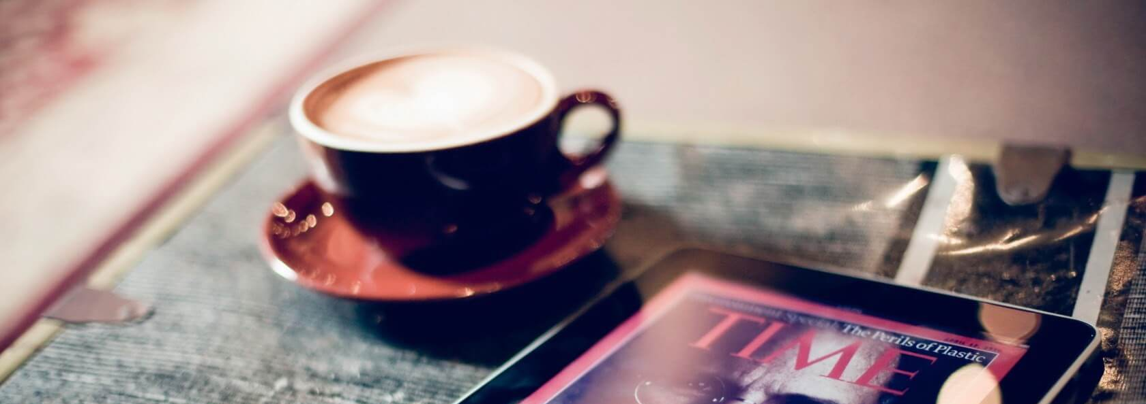
PART.01
Click here to add your title
I love you more than I've ever loved any woman. And I've waited longer for you than I've waited for any woman.
I love you more than I've ever loved any woman. And I've waited longer for you than I've waited for any woman.

Slide 4
Click here to add your title
I love you more than I've ever loved any woman. And I've waited longer for you than I've waited for any woman.
I love you more than I've ever loved any woman. And I've waited longer for you than I've waited for any woman.I love you more than I've ever loved any woman. And I've waited longer for you than I've waited for any woman.
ALL OR NOTHING
NOW OR NEVER

Slide 5
Click here to add your title
I love you more than I've ever loved any woman. And I've waited longer for you than I've waited for any woman.
I love you more than I've ever loved any woman. And I've waited longer for you than I've waited for any woman.I love you more than I've ever loved any woman. And I've waited longer for you than I've waited for any woman.
DESTINY FREEDOM

Slide 6
ALL OR NOTHING
NOW OR NEVER
DESTINY FREEDOM
I love you more than I've ever loved any woman. And I've waited longer for you than I've waited for any woman.
I love you more than I've ever loved any woman. And I've waited longer for you than I've waited for any woman.I love you more than I've ever loved any woman. And I've waited longer for you than I've waited for any woman.
I love you more than I've ever loved any woman. And I've waited longer for you than I've waited for any woman.

Slide 7
Click here to add your title
I love you more than I've ever loved any woman. And I've waited longer for you than I've waited for any woman.
I love you more than I've ever loved any woman. And I've waited longer for you than I've waited for any woman.I love you more than I've ever loved any woman. And I've waited longer for you than I've waited for any woman.
Click here to add your title
Click here to add your title
I love you more than I've ever loved any woman. And I've waited longer for you than I've waited for any woman.
I love you more than I've ever loved any woman. And I've waited longer for you than I've waited for any woman.

Slide 8
PART.02
Click here to add your title
I love you more than I've ever loved any woman. And I've waited longer for you than I've waited for any woman.
I love you more than I've ever loved any woman. And I've waited longer for you than I've waited for any woman.

Slide 9
Click here to add your title
And I've waited longer for you than I've waited for any woman.
DESTINY FREEDOM
DESTINY FREEDOM
DESTINY FREEDOM
I love you more than I've ever loved any woman. And I've waited longer for you than I've waited for any woman.
I love you more than I've ever loved any woman. And I've waited longer for you than I've waited for any woman.
I love you more than I've ever loved any woman. And I've waited longer for you than I've waited for any woman.
I love you more than I've ever loved any woman. And I've waited longer for you than I've waited for any woman.
I love you more than I've ever loved any woman. And I've waited longer for you than I've waited for any woman.
I love you more than I've ever loved any woman. And I've waited longer for you than I've waited for any woman.

Slide 10
Click here to add your title
I love you more than I've ever loved any woman. And I've waited longer for you than I've waited for any woman.
I love you more than I've ever loved any woman. And I've waited longer for you than I've waited for any woman.I love you more than I've ever loved any woman. And I've waited longer for you than I've waited for any woman.
I love you more than I've ever loved any woman. And I've waited longer for you than I've waited for any woman.

Slide 11
01
Click here to add your title
I love you more than I've ever loved any woman. And I've waited longer for you than I've waited for any woman.
02
Click here to add your title
I love you more than I've ever loved any woman. And I've waited longer for you than I've waited for any woman.
03
Click here to add your title
I love you more than I've ever loved any woman. And I've waited longer for you than I've waited for any woman.

Slide 12
Click here to add your title
I love you more than I've ever loved any woman. And I've waited longer for you than I've waited for any woman.
I love you more than I've ever loved any woman. And I've waited longer for you than I've waited for any woman.I love you more than I've ever loved any woman. And I've waited longer for you than I've waited for any woman.
I love you more than I've ever loved any woman. And I've waited longer for you than I've waited for any woman.

Slide 13
ALL OR
NOTHING
NOW OR NEVER
DESTINY FREEDOM
I love you more than I've ever loved any woman. And I've waited longer for you than I've waited for any woman.
I love you more than I've ever loved any woman. And I've waited longer for you than I've waited for any woman.
I love you more than I've ever loved any woman. And I've waited longer for you than I've waited for any woman.
I love you more than I've ever loved any woman. And I've waited longer for you than I've waited for any woman.

Slide 14
PART.03
Click here to add your title
I love you more than I've ever loved any woman. And I've waited longer for you than I've waited for any woman.
I love you more than I've ever loved any woman. And I've waited longer for you than I've waited for any woman.

Slide 15
ALL OR
NOTHING
NOW OR NEVER
I love you more than I've ever loved any woman. And I've waited longer for you than I've waited for any woman.
I love you more than I've ever loved any woman. And I've waited longer for you than I've waited for any woman.I love you more than I've ever loved any woman. And I've waited longer for you than I've waited for any woman.
Click here to add your title
I love you more than I've ever loved any woman. And I've waited longer for you than I've waited for any woman.

Slide 16
S
Click here to add
your title
I love you more than I've ever loved any woman. And I've waited longer for you than I've waited for any woman.I love you more than I've ever loved any woman.
I love you more than I've ever loved any woman. And I've waited longer for you than I've waited for any woman.I love you more than I've ever loved any woman.
I love you more than I've ever loved any woman. And I've waited longer for you than I've waited for any woman.I love you more than I've ever loved any woman.

Slide 17
W
Click here to add
your title
I love you more than I've ever loved any woman. And I've waited longer for you than I've waited for any woman.I love you more than I've ever loved any woman.
I love you more than I've ever loved any woman. And I've waited longer for you than I've waited for any woman.I love you more than I've ever loved any woman.
I love you more than I've ever loved any woman. And I've waited longer for you than I've waited for any woman.I love you more than I've ever loved any woman.

Slide 18
O
Click here to add
your title
I love you more than I've ever loved any woman. And I've waited longer for you than I've waited for any woman.I love you more than I've ever loved any woman.
I love you more than I've ever loved any woman. And I've waited longer for you than I've waited for any woman.I love you more than I've ever loved any woman.
I love you more than I've ever loved any woman. And I've waited longer for you than I've waited for any woman.I love you more than I've ever loved any woman.

Slide 19
T
Click here to add
your title
I love you more than I've ever loved any woman. And I've waited longer for you than I've waited for any woman.I love you more than I've ever loved any woman.
I love you more than I've ever loved any woman. And I've waited longer for you than I've waited for any woman.I love you more than I've ever loved any woman.
I love you more than I've ever loved any woman. And I've waited longer for you than I've waited for any woman.I love you more than I've ever loved any woman.

Slide 20
PART.04
Click here to add your title
I love you more than I've ever loved any woman. And I've waited longer for you than I've waited for any woman.
I love you more than I've ever loved any woman. And I've waited longer for you than I've waited for any woman.

Slide 21
Click here to add your title
I love you more than I've ever loved any woman. And I've waited longer for you than I've waited for any woman.I love you more than I've ever loved any woman. And I've waited longer for you than I've waited for any woman.
I love you more than I've ever loved any woman. And I've waited longer for you than I've waited for any woman.

Slide 22
Click here to add your title
I love you more than I've ever loved any woman. And I've waited longer for you than I've waited for any woman.
I love you more than I've ever loved any woman. And I've waited longer for you than I've waited for any woman.
Click here to add your title
I love you more than I've ever loved any woman. And I've waited longer for you than I've waited for any woman.
I love you more than I've ever loved any woman. And I've waited longer for you than I've waited for any woman.

Slide 23
Click here to add your title
I love you more than I've ever loved any woman. And I've waited longer for you than I've waited for any woman.
I love you more than I've ever loved any woman. And I've waited longer for you than I've waited for any woman.I love you more than I've ever loved any woman. And I've waited longer for you than I've waited for any woman.

Slide 24
DESTINY FREEDOM
DESTINY FREEDOM
DESTINY FREEDOM
I love you more than I've ever loved any woman. And I've waited longer for you than I've waited for any woman.
I love you more than I've ever loved any woman. And I've waited longer for you than I've waited for any woman.
I love you more than I've ever loved any woman. And I've waited longer for you than I've waited for any woman.

Slide 25
THE
END
THANK YOU
And I've waited longer for you than I've waited for any woman.

