Slide 1
Module 4 Unit 2
The apples are falling down the stairs.
WWW.PPT818.COM

Slide 2
Learning goals
能够掌握单词: stairs, mess。
用现在进行事态讲述正在发生的事情。
使用“can”谈论能力和向他人提供帮助的情况。

Slide 3
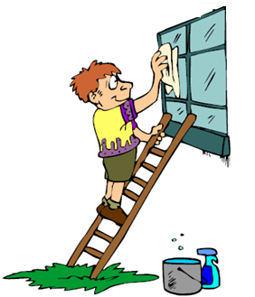
Lead-in
What is he/she doing?
He is cleaning the windows.

Slide 4
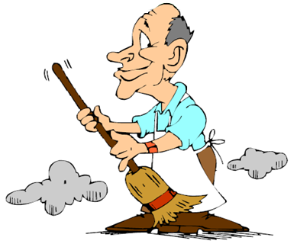
He is cleaning/sweeping the floor.

Slide 5
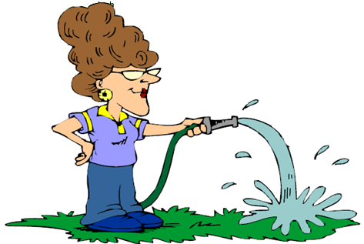
She is watering the grass.

Slide 6
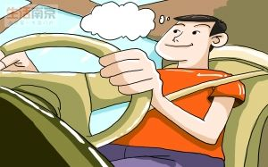
He is driving.

Slide 7
课文学习
1 Look, listen and say.
Look, a panda is falling!
What? A panda is falling?
Oh! It’s a panda kite.

Slide 8
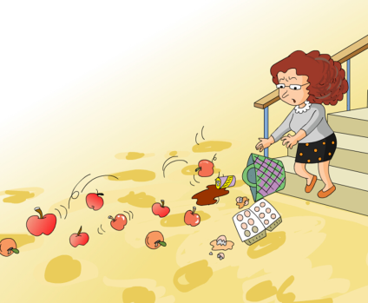
2 Listen and read.
Oh dear！I can’t carry them all.
Look at the eggs.
And the apples are falling down
the stairs.
Now, the cola is falling, too.
What a mess!
Who can help me?

Slide 9
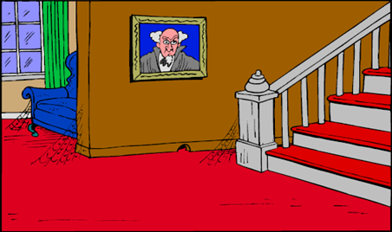
New words
stairs

Slide 10
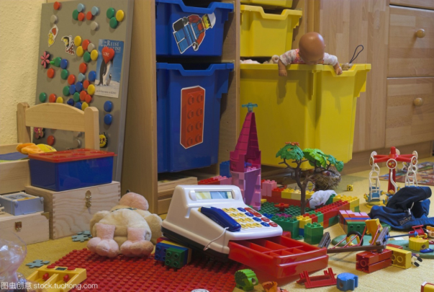
mess

Slide 11
课文理解
Listen to the tape and answer questions.
1. What’s wrong with the girl?
She can’t carry them all.
2. What happened to the apples?
They are falling down the stairs.

Slide 12
Listen again and try to fill in the blanks.
can’t
Oh dear! I ________ carry them all. Everything is ________! The eggs are __________!
And the apples are _____________ the stairs! Oh no! Now the cola is ________ too!
What a _________! Who can help me?
falling
broken
falling down
falling
mess

Slide 13
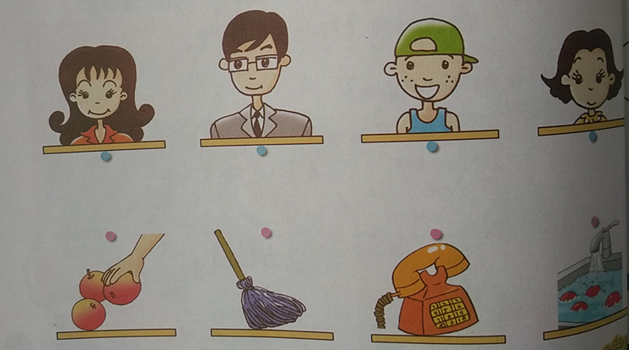
课文学习
3. Listen and match.

Slide 14
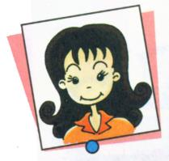
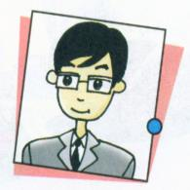
Can they help?
No, she can’t.
She’s talking on the
phone.
Yes, he can.
He will pick up the
apples.

Slide 15
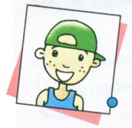
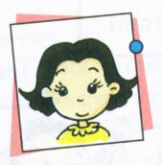
Can they help?
Yes, he can.
He will wash the apples.
Yes, she can.
She will clean the stairs.

Slide 16
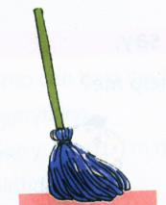
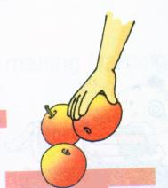
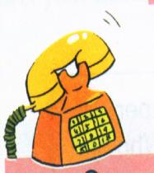
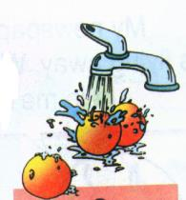

Slide 17
听力原文
Who can help the woman?
Woman: Sorry, I can’t help her. I’m on the phone.
Man: Yes, I can. I will pick up the apples.
Boy: I will wash the apples.
Girl: And I will clean the floor.

Slide 18
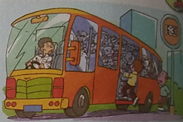
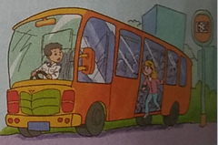
4. Listen and read. Then say the poem.
What is he doing? Look at him.
He's trying to get on the bus.
And what is she doing? Look at her.
She's trying to get off the bus.

Slide 19
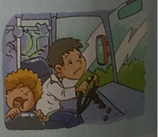
And what am I doing? Look at me.
I'm trying to drive the bus.
But I can't do it.
Can another bus come and take half of us?

Slide 20
Exercise
( ) 1. _____ a mess.
A. Who B. What C. Where
( )2. I can't carry _______ all.
A. them B. they C. their
( )3. The apples are _______ the stairs.
A. falling down B. fall down C. falls
( )5. Who can _______ me?
A. helping B. help C. helped
B
A
A
B

Slide 21
Homework
1. Read the text twice.
2. Write a task that you can’t do alone. Ask your friend for help.

