Slide 1
I’m excited about the things that will be discovered in the future.
Unit 4 Topic 2
Section D
WWW.PPT818.COM

Slide 2
一般将来时态的被动语态
Grammar
will + be + done
Passive Voice (III)
A wonderful movie will be shown tonight.
I’m excited about the things that will be discovered in the future.

Slide 3
Exercises
B
( )1. ---These bananas look different and they are sweet.
---Right. They ____ here from Taiwan yesterday.
A. was brought B. were brought C. bring D. are brought
( )2. ---Mom, may I go out to play football this afternoon?
---You can, if your homework _____.
A. is finished B. will finish C. has finished D. will be finished
( )3. A talk on development in science _____ next week.
A. is given B. was given C. has given D. will be given
( )4. This kind of desk ____ of wood.
A. is making B. made C. is made D. makes
( )5. The doctor looked over Peter carefully after he _____
to the hospital .
A. takes B. is taken C. took D. was taken
A
D
C
D

Slide 4
Functions
We will be able to do anything that can be done on the earth.
I think you should first master some basic computer skills.
Let’s work hard. Then our dreams will be realized.

Slide 5
Words: screen, realize, storm, weigh, journey
Phrases: in space, by spaceship, in the future, one day, in order to, take part in, grow up, master some basic computer skills, prefer…to… , be excited about, name after, at a distance of, search for
Sentences:
A wonderful movie will be shown tonight.
We will be able to do anything that can be done on the earth.
What fun!
I won’t believe there are aliens until I see them with my own eyes.
Our dreams will be realized.
The gravity on the surface of Mars is about two-fifths as strong as it is on earth.
Who can speak most?

Slide 6
Match the words with their meanings in Chinese!
in space
one day
in order to
take part in
master some basic computer skills
prefer…to…
name after
at a distance of
search for
搜索
在太空
某一天
为了……
参加
掌握一些基本的电脑技术
有……的距离
喜欢…而不喜欢…
命名
Exercises

Slide 7
用所给汉语的正确形式填空。
(1)A wonderful movie will be ________(上映) tonight.
(2)We will be able to do anything that can be______(做) on the earth.
(3)I won’t believe there are aliens ______（直到）I see them with my own eyes .
(4)Our dreams will be ________(实现).
(5)The gravity on the surface of Mars is about __________(五分之二） as strong as it is on earth.
shown
done
until
realized
two-fifths
Exercises

Slide 8
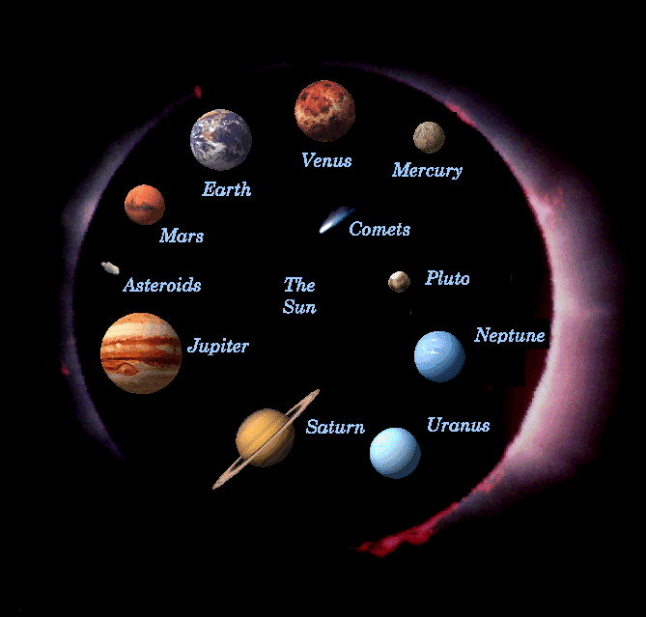
The Solar System

Slide 9
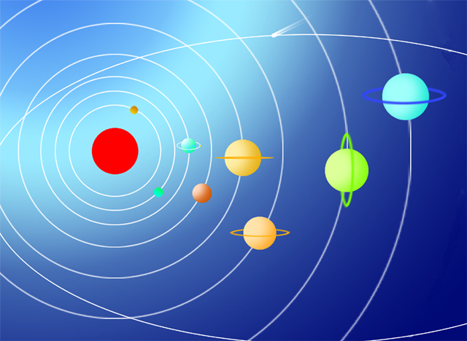
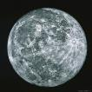
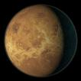
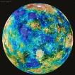
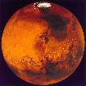
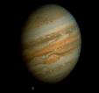
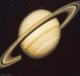
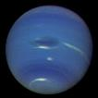
Do you know their names?
慧星（Comet）
冥王星（Pluto）
水星（Mercury）
金星（Venus）
地球（Earth）
火星（Mars）
木星（Jupiter）
土星（Saturn）
天王星（Uranus）
海王星（Neptune）

Slide 10
1a Read the passage and choose a proper title.
1. Is There Life out There?
2. Our Planet
3. The Stars at Night

Slide 11
Read 1a and answer the questions.
1. Have the scientists found life on other planets?
2. How many planets go around the sun?
3. What’s called the solar system?
4. Some spaceships have gone beyond the solar system, haven’t they?
5. Do you think there are lives on other planets in space?
No.
Eight.
The sun and its planets are called the solar system.
Yes.

Slide 12
1b Match the letters in the picture with their names according to 1a.
A
( )1. the solar system
( )2. the earth
( )3. the universe
( )4. the sun
C
C
B
B
D
D
A
A

Slide 13
Retell 1a
life on the earth---no life on other planets---go around the sun---
solar system---universe---spaceship---beyond---no one---send---alone

Slide 14
2 A spaceship will be sent out to find aliens in outer space. A letter will be put on the spaceship to introduce our earth. Discuss in groups and write a short introduction of the earth. Then present it to the class.

Slide 15
You can write it like this:
Our Earth
Do you want to know about the earth? Now, let me tell you something about it.
The earth is the third planet from the sun in our solar system and is named after old English. It goes around the sun. The moon is its only natural satellite. Its diameter is 12,742 kilometers. The surface area of the earth is 510 million square kilometers and the temperature is between -89.2℃ and 61℃. The air has 21% oxygen. So plants, all kinds of animals and human beings can live on the earth. The population of the world has reached 6.8 billion. Do you want to make friends with us?

Slide 16
3 If aliens are found in the near future , what changes will happen to people on the earth? Discuss in groups and make a list of all the possibilities.
Example :
More aliens will be found with the help of our
new friends.
Students will be sent to their planet to learn
their language.
…

Slide 17
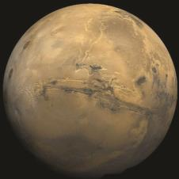
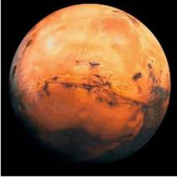
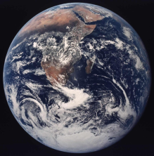
Project
Reporting on the Celestial Body You Like to Live on
1. Divide the class into three groups: Mars, the moon, the earth.
Mars
Moon
Earth

Slide 18
Project
2. Discuss the life there, such as clothing,
food and drink, transportation …
3. Choose one student in each group to
introduce the information to the class.
4. Think about which planet you would
like to live on and give a report to the
class.

Slide 19
Summary
We learn : 1.Some words: beyond, launch
2.Some phrases: millions of, go
around, send sb. sth.
3. Some sentences:
(1)Scientists have launched many
spaceships to explore other planets
in the solar system.
(2)Some spaceships have gone
beyond the solar system.
We can : 1.Talk about more about outer space.
2.Summarize the passive voice of the
simple future tense.

Slide 20
Assignment
Read 1a.
Memorize the useful expressions and key sentences that we learned in this topic.
Finish Section D in your workbook.
Preview Section A in Topic 3.

