Slide 1
Module10 A holiday journey
Unit 1 What did you do?
WWW.PPT818.COM

Slide 2
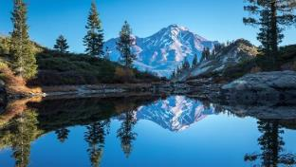
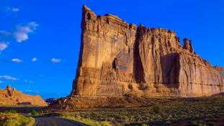
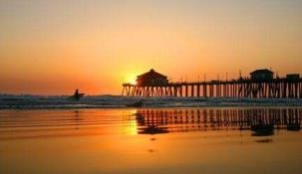
Warming-up
Look and learn
加利福尼亚州
California
California is a state of the US.
It is on the Pacific coast.

Slide 3
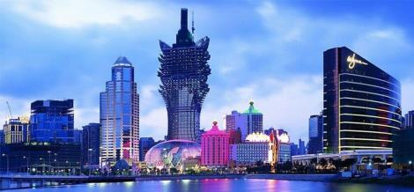
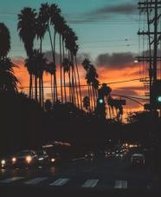
Warming-up
洛杉矶
Los Angeles is in the southwest of California.
It is the second biggest city of the US.

Slide 4
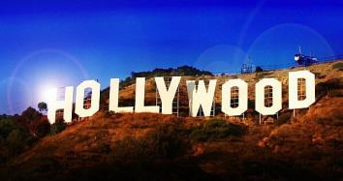
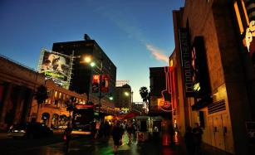
Warming-up
好莱坞
Hollywood, in northwestern LA, was the heart of the movie industry.

Slide 5
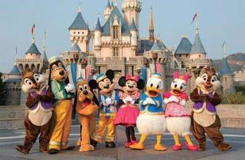
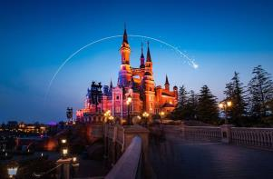
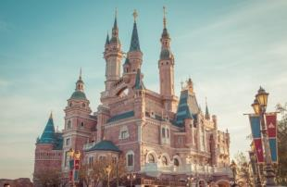
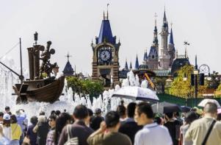
Warming-up
迪斯尼乐园
Disneyland
Disneyland is in Los Angeles, California. It is one of the most famous theme parks in the world.

Slide 6
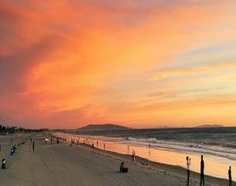
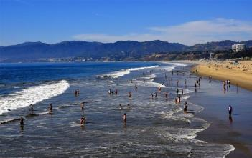
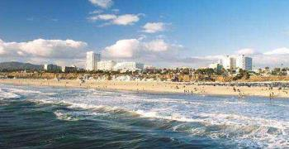
Warming-up
圣莫尼卡
Santa Monica
Santa Monica beach is one of the most famous beaches in the Los Angeles area.

Slide 7
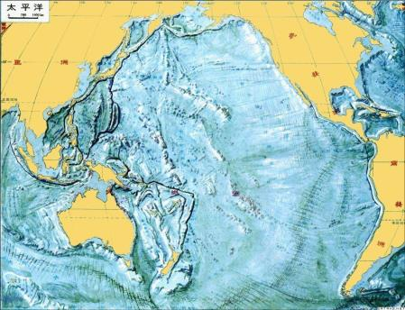
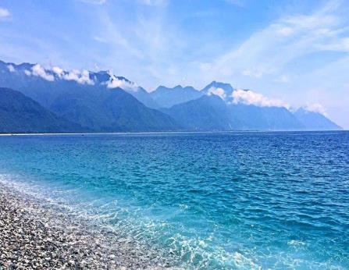
Warming-up
太平洋
Pacific Ocean

Slide 8
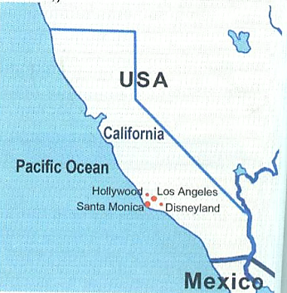
Pre-listening
1 Find the places on the map.
1
a) California
b) Hollywood
c) Los Angeles
d) Pacific Ocean
e) Santa Monica
f) Disneyland
4
2
6
5
3
Now listen and number the places as you hear them.

Slide 9
While-listening
Listen and choose the best answer.
1. Where is Tony going on holiday?
A. To London.
B. To Los Angeles.
C. To Paris.
2. Betty went to Los Angeles _______.
A. two years ago
B. four years ago
C. three years ago

Slide 10
While-listening
Listen and choose the best answer.
3. How long did it take Betty to get to Los Angeles?
A. About nine hours.
B. About five hours.
C. About ten hours.
4. Who was with Betty?
A. Her mum. B. Her dad. C. Her parents.
5. Where is Betty going on holiday this year?
A. New York. B. Paris. C. Sydney.

Slide 11
While-listening
2 Listen and answer the questions.
(1) How did Betty get to Los Angeles?
(2) How did Betty get to her friends’ home?
She flew there.
Her friends drove her.
(3) Why was Betty excited at Disneyland?
(4) How long did she stay in Disneyland?
(5) Where did she go swimming?
Because she met Snow White and Mickey Mouse.
She stayed there for two days.
She went swimming in the Pacific Ocean at Santa Monica.

Slide 12
Post-listening
Language points
1. Where are you going on holiday, Tony?
on holiday意为“在度假；在休假”，其中介词on表示“正在……；在……状态中”。
类似的短语还有：on duty（值日）, on show（展览）, on fire（着火）等。
e.g. John is on holiday in Shanghai.
约翰正在上海度假。
2. How long did it take to get there?
how long意为“多长时间”，常用于提问某一动作或状态持续了多长时间。

Slide 13
Post-listening
Language points
e.g. How long did you watch TV last weekend?
你上周末看了多长时间的电视？
how long还可以对物体的长度进行提问，意为“多长”。
e.g. How long is the bridge? 这座桥有多长？
take作动词，意为“花费”，一般用于花费时间。It takes sb. some time to do sth.句型表示“做某事花费了某人多长时间”。
e.g. It took me an hour to finish my homework last night.
昨晚完成家庭作业花了我一个小时的时间。

Slide 14
Post-listening
Language points
3. So what did you do?
so的常见用法：
(1) 副词，意为“那么（尤指用于引出新话题）；
这么，那么（用于强调质量、感觉或数量）”。
e.g. The picture is so beautiful! 这幅画是那么漂亮！
(2) 连词，意为“所以，因此”。
e.g. I like trip, so I like holidays. 我喜欢旅游，所以我就喜欢假期。
(3) 代词，意为“如此，这样”。
e.g. I think so. 我认为如此。

Slide 15
Post-listening
Language points
4. … we went to Disneyland, and guess what?
Guess what?用于向对方讲述一件自己认为会让对方感到惊讶的事情之前，字面意思是让对方猜，但通常是紧接着说出想说的事情。
e.g. Guess what? I found my lost watch.
你猜怎么着，我找到我丢的手表了。

Slide 16
Post-listening
Language points
5. I was so excited!
【辨析】excited与exciting
excited 形容词，意为“激动的，兴奋的”，修饰人。
e.g. The woman is so excited when she sees her lost boy.
当见到她丢失的孩子时，那个女人是如此激动。
exciting 形容词，意为“令人激动的，兴奋的”，修饰物。
e.g. The news is exciting.
那个消息真令人激动。

Slide 17
Post-listening
3 Complete the sentences with the correct form of the words and
expressions from the box.
have a good time on holiday see take two years ago
1. It _______________ us a long time to find his home last Saturday.
2. We had a wonderful party last night and everybody
_________________.
took
had a good time

Slide 18
Post-listening
3 Complete the sentences with the correct form of the words and
expressions from the box.
have a good time on holiday see take two years ago
3. My family went to Hainan _____________ last summer.
4. _______________ I went back to our family home and
_____________ my grandparents.
on holiday
Two years ago
saw

Slide 19
Post-listening
Fill in the blanks with the correct form of the words given.
Betty’s journey
Two years ago, Betty ______ (go) to California. It ______ (take) her nine hours. Her friends ______ (meet) her at the airport. Next, they ______ (leave) Los Angeles and ______ (spend) two days in Disneyland. Then she went to Hollywood. At last she ______ (get) to Santa Monica, and ______ (swim) in the Pacific Ocean. The journey ______ (is) great.
went
took
met
left
spent
got
swam
was

Slide 20
Post-listening
4 Listen and notice the underlined stressed words.
(1) When did Betty go to Los Angeles?
(2) How long did it take her to get there?
(3) Where did she go?
(4) Who met her at the airport?
(5) What did she see there?
Now say the sentences aloud.

Slide 21
Post-listening
Do the exercises
一、单项选择题。
1. —_____ did you get to Shanghai?
—By plane.
A. When B. How C. Why D. Who
2. —______ did it _____ him to get there?
—Five hours.
A. What time; take B. How; took
C. How long; take D. How much; took

Slide 22
Post-listening
Do the exercises
3. I _____ to Shanghai last year. My grandma _____ me
at the airport.
A. go; meet B. went; meet
C. go; met D. went; met
4. She was _____ yesterday.
A. excited B. exciting C. excite D. boring
5. —_____ did you go with?
—My friend.
A. Who B. What C. Where D. When

Slide 23
Post-listening
Do the exercises
二、补全短文。
Last summer holiday I _____ (go) to Taierzhuang Ancient Town (台儿庄古城) with my friends by train.
I _____ (see) some beautiful buildings and ____ (do) some shopping. I _____ (spend) two days there. I _____ (take) many photos. I _______ (enjoy) myself there.
went
saw
did
spent
took
enjoyed

Slide 24
Summary
so, guess,
excited,
on holiday,
get there
运用一般过去时
介绍过去
发生的事情。
How long did it take to get there?
How long did you stay there?
What did you do?
Did you…?
句子
学会运用
单词、短语

Slide 25
Homework
1. Review the new words and expressions in this period.
2. Talk about your special holiday with your partner, then write them down.
3. Surf the Internet to look for other information about
Los Angeles.

Slide 26
Goodbye!

