Slide 1
Unit 1 Countries
I'm from Britain
WWW.PPT818.COM

Slide 2
Welcome back to school!
欢迎回到学校！

Slide 3
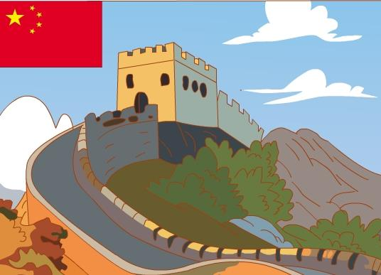
I like Chinese. （语文） I’m Chinese.（中国人）
I’m from China.

Slide 4
I’m from China.
Where are you from?
I’m from…

Slide 5
Listen and Circle
Who comes from China?

Slide 6
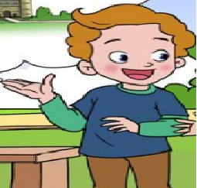
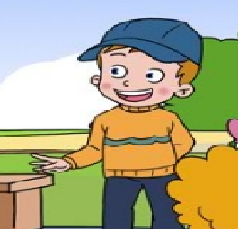
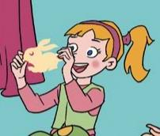
Jim
Mike
Mary

Slide 7
Find
Where are they from?
Where are you from?
I’m from...

Slide 8
Where are you from?
I’m from_______
Canada.
I’m from_______
the U.S.
I’m from_______
Britain.

Slide 9
Read and act in groups.
(小组分角色表演课文)

Slide 10
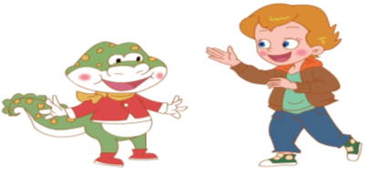
I’m from
Canada.
Let’s talk
Where are you
from?

Slide 12
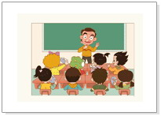
Hello!
I’m Mr. Bean.
Hello!
What’s
your
name?

Slide 13
I’m from Britain.
Where are
you from?

Slide 14
Let’s do
--- Hello!
--- Hello! What’s your name?
--- I’m...
--- Where are you from?
--- I’m from Britain.

Slide 15
Summary
--- Where are you from?
--- I’m from Britain/ China/ America/ Canada.
What have you learned?

Slide 16
Homework
1.模仿跟读。
2.制作一张自己喜欢的国家的图片，上面写上该国家的英文名称，并与朋友进行交流。

