Slide 1
Lesson 37
What's Your Hobby?
WWW.PPT818.COM

Slide 2
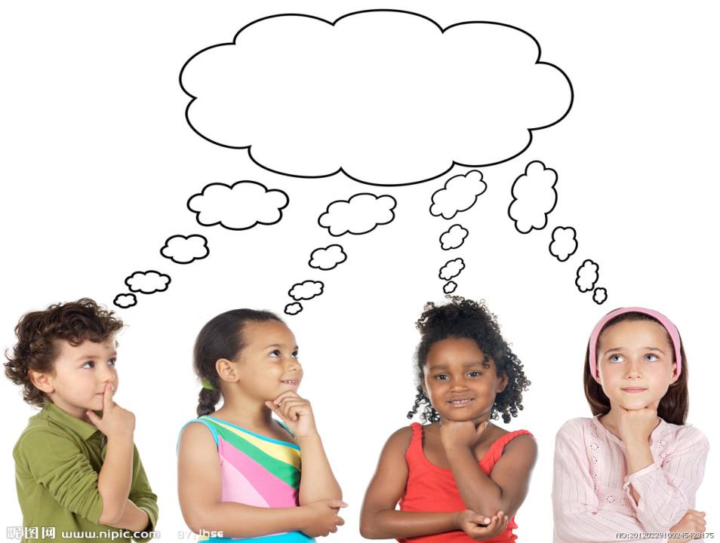
THINK ABOUT IT

Slide 3
What do you like to do in your spare time?
What hobbies do you know?

Slide 4
Ms. Liu: Hi Class! We know everyone likes to
have spare time. How do you spend your
free time? Do you have any hobbies?
Wang Mei: I like to exercise in my free time. I
often go swimming in summer. In
winter, I like to go skating.
Li Ming: Exercising is fun, and it also helps to
keep us healty. I enjoy playing ping-pong.

Slide 5
Yang Hao: My hobby is studying stars. I find it
very interesting. Did you know the
sun is a star? It’s the closest star to
Earth.
Li Lin: I collect stones. When I travel, I always
look for stones. If I find an interesting one,
I take it home and add it to my collection.

Slide 6
Yi Han: Really? I like collecting, too. I’m
interested in collecting all kinds of concert
tickets. My family often helps me. I also
trade my tickets with other people.
Wang Mei: That’s an interesting hobby. My aunt
in Shanghai loves going to concerts. I
will ask her to keep her tickets for you.

Slide 7
Ms. Liu: That would be great! How about you,
Tao Xiaolin? What do you like to do in
your spare time?
Tao Xiaolin: Well, I have many interests. I like
reading books. I also like gardening,
watching movies and surfing the
Internet.

Slide 8
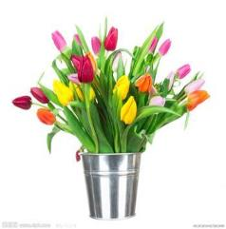
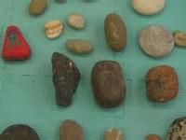
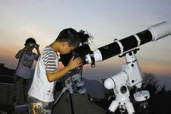
Read the lesson and write each student’s hobby
under the pictures.
Li Lin likes
collecting stones
______________________
______________________
______________________
______________________
______________________
______________________
______________________
Yang Hao’s hobby
is studying stars.
Tao Xiaolin likes
reading books and
gardening.

Slide 9
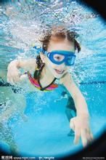
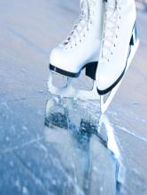
________________________
________________________
________________________
________________________
______________________
______________________
______________________
______________________
______________________
______________________
Yi Han is interested
in collecting all
kinds of concert
tickets.
Wang Mei likes
swimming in
summer and
skating in winter.
Li Ming enjoys
playing ping-pong.

Slide 10
We know everyone likes to have spare time.
我知道每个人都喜欢拥有业余时间。
1.
形容词，多余的，空闲的，备用的
There are a lot of useful things to learn in one’s
free/spare time.
一个人空闲时可以学很多有用的东西。
Every car should have a spare tire.
每辆车都应该有一个备用轮胎。

Slide 11
I like to exercise in my free time.
在业余时间我喜欢运动。
2.
in one’s free/spare time 在某人的业余时间里。
She often helps her mother do the housework
in her free time.
她经常在业余时间帮助妈妈做家务。

Slide 12
3.
go + v-ing
去做……事（与v-ing相关）
通常指户外活动
go swimming 去游泳 go skating 去滑雪
go boating 去划船 go fishing 去钓鱼
go skiing 去溜冰 go climbing 去爬山
go shopping 去购物

Slide 13
I enjoy playing ping-pong. 我喜欢玩乒乓球。
4.
enjoy doing 喜欢做某事
enjoy + doing(作宾语 )
注意：enjoy后
面不能跟to do
或者do
enjoy + to do(作宾语 )
enjoy + do(作宾语 )
具有相同用法的词：
keep, finish, mind, practice

Slide 14
My hobby is studying stars.
我的爱好是研究星星。
5.
studying是动名词作表语，
常用来表示一般性、抽象
的、经常发生的动作。
His job is painting walls.
他的工作是粉刷墙壁。
My hobby is collecting old coins.
我的爱好是收集古币。

Slide 15
It’s the closest star to Earth.
它是离地球最近的恒星。
6.
地球，也可以写作the
earth或the Earth
the closest是close的最高级，在这里用来修饰star
If I find an interesting one, I take it home and
add it to my collection.
如果我找到一块有趣的(石头)我就会把它带回
家并且把它加入我的收藏中。
7.

Slide 16
注意：add和与它相关的几个短语的用法：
① add意思是“加，增加”
If the tea is too strong, add some more hot water.
如果茶太浓了，再加点开水。
② add to 增添，增加；增进
The bad weather added to our difficulties.
恶劣的天气增加了我们的困难。

Slide 17
③ add…to… 把…加到…上，把前一项加到
后一项之后或之中
Please add some salt to the soup.
请给汤里加些盐。
Add three to seven, you will get ten. 7加3等于10.
④ add up to… 总共达……，加起来达到……
The cost of two trips added up to 900 dollars.
两次旅行的费用总计900美元。

Slide 18
be interested in doing sth.
对做某事感兴趣（指一般性的动作）
8.
be interested to do sth.
很有兴趣做某事，很想做某事（指尚未发生的动作）
He is interested in listening to stories.
他对听故事很感兴趣、
We’d be interested to hear your story.
我们很想听听你的故事。

Slide 19
kind 用作名词，表示“ 种类”
常用的一些词组有kind of , kinds of
kind of
通常用于单数可数名词
kinds of
通常用于不可数名词
通常用于复数可数名词
one of flower 一种花
kind
that of bread 那种面包
kind
this of light 这种灯
kind

Slide 20
kinds
all of plants 各种各样的植物
many of books 许多种类的书
kinds
different of animals 不同种类的动物
kinds
9.
family 集合名词，家庭；家庭成员
作主语指整体时: 谓语动词用单数
作主语指家庭成员时: 谓语动词用复数

Slide 21
His family is going to move to another city.
他家打算搬到另一个城市。
My family are very well.
我全家人很健康。
指整体，谓语用单数
指成员，谓语用复数
类似的还有：class, team, public等。在实际应
用中，有时意义区别不大，谓语用单数动词
或复数动词均可。

Slide 22
I also trade my tickets with other people.
我也会和其他人交换门票。
10.
交换；和……做生意
She traded three apples for a bunch of bananas.她用三只苹果换了一串香蕉。
I’ll trade my stamp collection for your model boat.
我想用我的邮票册换你的模型船。

Slide 23
Fill in the blanks with the correct forms of the
given verbs.
to exercise
1. Some people like __________(exercise) in the
gym, and some enjoy ___________(run) outside.
2. She likes sports very much. She often goes _____
___________(skate) in winter.
3. You’ve read many stories. I’m sure you would be
interested in ___________(write).
4. My hobby is ____________(collect) all kinds of
tickets.
running
skating
writing
collecting

Slide 24
PROJECT
WHAT’S YOUR HOBBY?
A hobby is something you enjoy doing. A hobby is not
a job or a school subject. It’s not something you need to
do. It’s just something you like to do .
Do you have a hobby?
Would you like to have a hobby?
Do you like to build model cars?
Do you collect things?

Slide 25
If you already have a hobby, talk about it! Bring
your hobby to school and show it to your classmates.
Talk about why you enjoy it.
If you don’t have a hobby, what hobby would like to
have?

