Slide 1
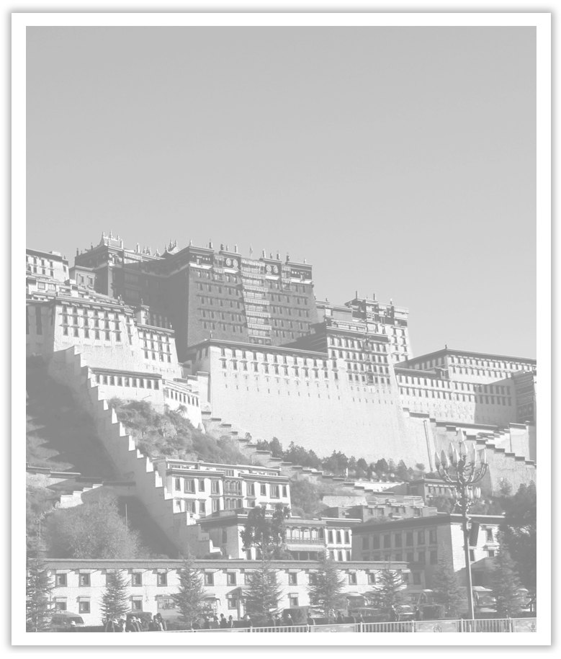
Unit 1 Cultural Heritage
Section Ⅶ Reading for Writing
WWW.PPT818.COM

Slide 2
有关文化遗产保护的新闻报道
本单元的写作任务是先读一篇关于文化遗产保护的新闻报道后，再写一篇同样话题的新闻报道。

Slide 3
Ⅰ.Pre-writing
(Ⅰ)Learning to write after the model
PROMOTING CULTURE THROUGH DIGITAL IMAGES
Lanzhou, 9 August 2017.A group of researchers and scientists from China and other countries are working together to help increase knowledge and appreciation of China’s ancient cultural heritage.They are recording and collecting digital images of cultural relics from the Mogao Caves, which were a key stop along the Silk Road throughout China’s ancient history.Nearly 500，000 high-quality digital photographs have been produced since the international project started in 1994.,

Slide 4
篇章结构
Beginning：
A group of researchers and scientists...by digital images.

Slide 5
The Mogao Caves have long been a meeting point for different cultures and are part of the history of many countries.Today, the caves are just as international as they were at the time when people travelled the Silk Road.Tourists from all over the world visit Dunhuang to see the caves, and the Getty Museum in Los Angeles has even reproduced a copy of the caves and paintings for people to admire in America.

Slide 6
Body：
The brief introduction of the Mogao Caves.

Slide 7
By sharing so many digital photos over the Internet, the group hopes to promote even wider interest around the world in China’s ancient history, culture and traditions.They also hope to further educate people about the importance of safeguarding historic and cultural relics for future generations to understand and appreciate.As one researcher who is working on the project explains, “Appreciating one’s own cultural heritage is very important for understanding oneself.Appreciating the cultural heritage of other countries is very important for international communication and understanding.”

Slide 8
Ending：
Appreciating cultural heritage is important for understanding oneself and international communication and understanding.

Slide 10
(Ⅱ)Preparation for writing—words and phrases
①____________ v. 保存，保护 ②____________ n. 存在
③____________ adj. 非物质的 ④____________ n. 文明
⑤____________ n. 多样性 ⑥____________ n. 破坏
⑦____________ v. 促进 ⑧_____________ 把……和……联系起来
⑨______________ 历史认同 ⑩____________ 有助于；贡献
⑪____________ 关于 ⑫____________ 与……有关
preserve
existence
intangible
civilization
diversity
destruction
promote
connect...with...
historical identity
contribute to
with regard to
be related to

Slide 11
Ⅱ.While-writing
下面是一个对陈磊的简单采访记录：
陈磊， 武汉高中教师； 给老建筑拍照；想保护文化遗产；采访老人；写关于遗产的故事；访问学校并给学生讲述保护遗产的意义……
请根据以上信息，以A picture is worth a thousand words”为题写一篇介绍陈磊保护文化遗产的事迹的新闻报道。
注意：1.词数100左右。可适当增加细节。
2.文章的开头与结尾部分已经给出，不计入总词数。

Slide 13
Step 1 List the outline of the passage.
Paragraph 1：____________________________________________________________
Paragraph 2：____________________________________________________________
Paragraph 3：____________________________________________________________
The brief introduction to Chen Lei.
What Chen Lei did to protect cultural heritage.
The significance of Chen Lei’s taking photos of old buildings.

Slide 14
Step 2 List the words, phrases and sentences.
1.Words and phrases
①________________ 拍……的照片
②____________________ 保护文物
③________________ 多亏，由于
④________________ v. 采访
⑤____________________ 意义重大，对……起作用
take photos of
protect cultural relics
thanks to
interview
make a big difference

Slide 15
2.Sentences
①一张照片胜过千言万语，所以拍照是保护文物的好方法。(不定式作定语)
A picture _______________________, so taking photos ________________________
____________.
②此外，为了写关于这些建筑的故事，他经常采访一些老人。(不定式作目的状语)
Besides, he often _______________________________________ about the buildings.
③另一方面，他走访学校并告诉学生保护文化遗产的方法。 (preserve)
On the other hand, he visits schools to tell students about ________________________
_________________.
is a good way to protect cultural relics
is worth a thousand words
interviews some old people to write stories
the ways of preserving the cultural heritage

Slide 16
常用词汇
old, ancient, cultural, heritage, relics, appreciate, appreciation, record, image, painting, photo, site, temple, mountain, tower, history, date back to, protect, valuable

Slide 17
亮点表达
1.Cultural heritage is of great value and protecting it can make us feel proud of our nation.
文化遗产具有极大的价值，保护它能让我们为祖国感到自豪。
2.Nowadays, many cultural relics have already been destroyed and hundreds of others are facing the danger of disappearing.
今天，很多文物已经遭到了破坏，还有成百上千的其他文物正面临消失的危险。
3.The government and schools should teach people more about the protection of cultural relics and the people should mind their behavior when travelling.
政府和学校应该教育人们更多有关文物保护的知识，人们在旅游时应该注意自己的行为。

Slide 18
4.In my opinion, some measures should be taken to protect traditional culture effectively.
在我看来，应该采取一些措施来有效地保护传统文化。
5.As the world gets globalization, it is in need of building people’s sense of local cultural heritage.
随着世界的全球化，需要培养人们对当地文化继承的意识。
6.The intangible culture heritage plays an important role in the nation’s civilization and sustainable development.
非物质文化遗产在国家的文明和可持续发展中起重要的作用。

Slide 19
A picture is worth a thousand words
Chen__Lei__is__a__senior__teacher__who__takes__photos__of__old__buildings__in__Wuhan__in__order__to__preserve__the__city’s__cultural__heritage.

Slide 20
Every day, Chen Lei takes his camera and takes photos of old buildings.When asked the reason why he does so, he usually says，“A picture is worth a thousand words，so taking photos is a good way to protect cultural relics.”Thanks to his thousands of photos, more than ten old buildings have been preserved by the government and even more people begin to protect the cultural heritage.Besides, he interviewed over 30 old people to write stories about the old buildings last year.On the other hand, he visits schools to tell students about the ways of preserving the cultural heritage.What a big difference Chen Lei makes!
Neither__people__nor__buildings__last__forever,__but__Chen__Lei’s__photos__can__help__us__remember__them.

Slide 21
Ⅲ.Post-writing—polishing the passage
Exchange your passage with your partner and pay attention to the following points.
□1.Is there a title?
□2.Does the lead sentence tell the reader about the situation?
□3.Has the writer included details and explanations?
□4.Are there quotes and paraphrases?
□5.Does the writer use relative clauses to identify people, places, things, times, etc?
□6.Does the writer end with a short summary?
□7.Are there grammar or spelling mistakes？

Slide 22
写作技巧
写新闻报道时，首先要有一个吸引人的标题。标题最好幽默风趣，简洁且能概括中心大意。
新闻报道的正文要尽可能地引例子，举事实，列数字等，以使新闻真实可信，并引起读者的兴趣。
新闻报道的结尾最好能照应标题或文章的中心。语言力求简洁，引人深思。

