Slide 1
Module 5 Look after yourself
Unit 3 Language in use
WWW.PPT818.COM
Notes:
1
www.enteacher.cn

Slide 2
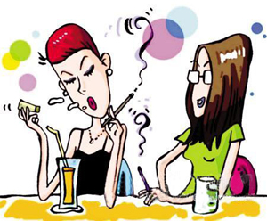
Free Talk
What’re they doing？
They are __________.
smoking
smoke
What do you think of smoking？

Slide 3
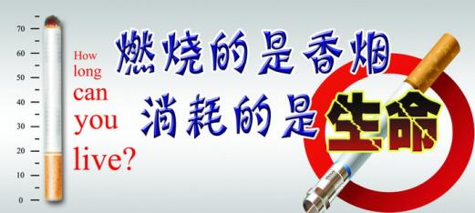
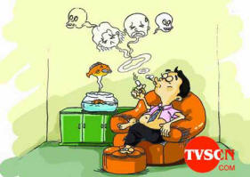
Is smoking good or bad for our health?
It’s bad for our health.

Slide 4
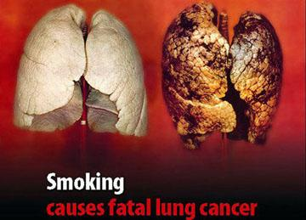
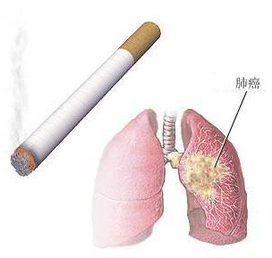
Smoking is bad for our lungs.
It can even cause cancer.

Slide 5
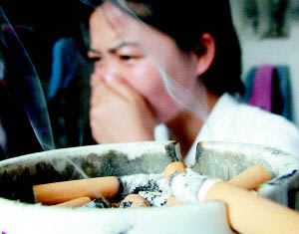
Smoking is bad for people around.

Slide 6
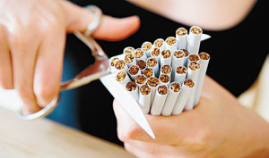
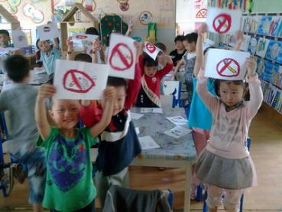
So everyone should give up smoking.

Slide 7
Read these sentences and pay attention to the tense in each.
I think it’s going to rain.
He fell over when he was running down the steps.
He’s hit his head and his leg hurts. I think he’s broken his leg.
Who’s missing?
Will I live?
Notes:
7

Slide 8
Review of tenses
一般现在时
用法：表示经常性的和习惯性的动作
常用时间状语： usually, sometimes, in
spring, every day, in the morning
结构：do / does
否定构成： don’t+动原 / doesn’t+动原
一般疑问构成及简答：
Do+主语+动原+其它？Yes, I do. Does+主语+动原+其它？No, he doesn’t.

Slide 9
特殊疑问句举例：
What do you often do on Sundays? Where does he live?
注意：
start, leave, go, come等动词的一般现在时可表示按规定、计划或安排预计要发生的事情，如The plane takes off at six past five.。客观真理在从句中也用一般现在时。

Slide 10
现在进行时
用法：说话时正在进行的动作或当前一段时间
正在进行的动作。
常用时间状语：now, these days
结构: am / is / are + 现在分词(--ing) am / is / are working
否定构成：am / is / are + not + 现在分词

Slide 11
一般疑问句构成及简答：
Am / Is / Are+主语+现在分词+ 其它?
Yes, 主语+ am / is / are.
No, 主语+ am / is / are not.
特殊疑问句举例:
What are you doing now?
Who is flying a kite there?
注意：
go, come, leave, arrive, return, die等动词的现在进行时可表将来, 主要表示最近按计划或安排要发生的 动作, 如I’m leaving tomorrow.。

Slide 12
一般将来时
用法：将来会出现或发生的动作。
常用时间状语：this evening, tomorrow, next month, in a few minutes, at the end of this term
结构:
1. will / shall+动原
2. am / is / are going to+动词原型
3. am / is / are (about)+动词不定式
4. am / is / are + coming等现在分词

Slide 13
以work为例: will / shall work am / is / are going to work am / is / are (about) to work am / is / are coming / leaving…
否定构成：will / shall not… am / is / are not… 特殊疑问句举例:
What will you do tomorrow? When are we going to have a class meeting? 备注：在if条件或as soon as等时间状语从句中用一般现在时代替一般将来时。

Slide 14
一般过去时
用法：过去时间发生的或过去经常性的动作。 常用时间状语：yesterday, last night, two days ago, in 2000, at that time, before liberation，when 等引导的含过去时的句子。 结构：动词过去时（--ed）
worked / used to work
否定构成：didn’t+动原
didn’t work used not (didn’t use) to work

Slide 15
一般疑问句构成及简答举例：
Did+主语+动原+其它？ 特殊疑问句举例：
What did he do yesterday?
When did he get up this morning?
备注：
He has opened the door. (表示过去“开门”的动作对现在的影响是门还开着)
He opened the door. (不能确定门现在是否开着)

Slide 16
现在完成时
用法:
1、发生在过去的动作且对现在仍有影响的动作，强调对现在的影响.
2、从过去一直延续到现在的动作 常用时间状语：already, just, never, before, recently, in the past few years, ever, so far, since+过去的点时间, for+段时间 结构：have / has+过去分词(--ed) have / has worked
否定构成：have / has not+过去分词

Slide 17
一般疑问句构成：
Have / Has+主语+过去分词…?
特殊疑问句举例：
What have you done recently?
How long has he lived in Beijing?
备注：
暂时性动词不能与for…, since…, How long …等表示段时间 的短语同时使用。

Slide 18
过去进行时
用法：过去某一时刻或某一段时间内正在发生的动作。
常用时间状语：at this time yesterday, at that time, at ten o’clock yesterday或when引导的从句。
动词构成： was / were+现在分词(--ing)
以work为例：was / were working
否定构成： was / were not + 现在分词

Slide 19
一般疑问句构成及简答举例: Was / Were+主语+现在分词+其它？ Yes, I was No, I wasn’t
特殊疑问句举例：
What were you dong at this time yesterday?
Where was he standing when the teacher came in?

Slide 20
Complete the conversation with the correct form of the words and expression in brackets.
1
Answers:
1. planning 2. went
3. got up 4. love
5. do 6. played
7. have
Notes:
20

Slide 21
Complete the passage with the correct form of the verbs.
2
A woman (1) ________ (come) home to find her husband in the kitchen. He (2) _____________ (shake) wildly from side to side. Then the woman (3) ________ (notice) that he (4) _______________ (stand) with one hand on the cooker! Naturally, she thought her husband (5) _____________ (touch) the electricity.
came
was shaking
noticed
was standing
was touching
Notes:
21

Slide 22
To pull him away from the cooker, she (6) ________ (hit) his arm with a piece of wood “What did you do that for?” he cried in pain. “I was (7) ______________ (make) some tea, and (8) ___________ (dance) to rock music on my MP3 player!”
hit
making
(was)dancing
Notes:
22

Slide 23
Practice
( ) 1.The police found that the house _____ and a lot of things _____.
A. has broken into; has been stolen
B. had broken into; had been stolen
C. has been broken into; stolen
D. had been broken into; stolen
D
( ) 2.Tom didn't go to hear the singer because he _____ him.
A. heard B. would hear
C. has heard D. had heard
D
Notes:
23

Slide 24
( ) 3.---Why didn't you come to the party?
---I ____ to come, but one of my friends came to see me just then.
A. wanted B. was wanting
C. had wanted D. had been wanted
C
( ) 4. Sorry, I've eaten up the food. I ____ that he would be back.
A. don’t think B. wasn’t thinking
C. hadn’t thought D. didn’t think
C
Notes:
24

Slide 25
( ) 5. --- I’m sorry to keep you waiting.
--- Oh, not at all. I ___ here only a few minutes.
A. have been B. had been
C. was D. will be
A
( ) 6. Shirley ___ a book about China last year but I don’t know whether she has finished it.
A. has written B. wrote
C. had written D. was writing
D
Notes:
25

Slide 26
( ) 7.---Can I join the club, Dad?
---You can when you ___ a bit older.
A. get B. will get
C. are getting D. will have got
A
( ) 8.When we got to his home, we learned he ___ for almost an hour.
A. went B. had gone
C. had been away D. has gone
C
Notes:
26

Slide 27
( ) 9. ---Do you know when she ___?
---No, but I’ll tell you as soon as she ___.
A. will come; comes
B. comes; will come
C. will come; will come
D. comes; comes
A
( ) 10. I don’t think Jim saw me; he ___ at the sky.
A. just stared B. was just staring
C. has just stared D. had just stared
B
Notes:
27

Slide 28
( ) 11.---Alice, why didn’t you come yesterday?
---I ___, but I had an unexpected visitor.
A. had B. would
C. was going to D. did
C
( ) 12.The price ___, but I doubt whether it will remain so.
A. went down B. will go down
C. has gone down D. was going down
C
Notes:
28

Slide 29
( ) 13.--- Can I help you, sir?
--- Yes. I bought this radio here yesterday, but it ___.
A. didn’t work B. won’t work
C. can’t work D. doesn’t work
D
( ) 14. ---Did you meet John here at the university?
--- No, we ___ when I started college.
A. have already met B. already met
C. would meet D. had already met
D
Notes:
29

Slide 30
( ) 15.The reporter said the UFO ____ east to west when he saw it.
A. traveled
B. was traveling
C. had been traveling
D. was to travel
B
( ) 16.We were all surprised when he made it clear that he ___ office soon.
A. leaves B. would leave
C. left D. had left
B
Notes:
30

Slide 31
( ) 17.When I got to the cinema, the film ____ for five minutes.
A. had began B. was on
C. has begun D. had been on
D
( ) 18.---Hey, look where you are going!
---Oh, I’m terribly sorry. _____.
A. I’m not noticing
B. I wasn’t noticing
C. I haven’t notice
D. I don’t notice
B
Notes:
31

Slide 32
( ) 19.Class ___ by the time I ____ there, so I took a seat in the back.
A. has begun, get
B. had begun, got
C. began, got
D. begins, get
B
( ) 20.The last time I ___ Jane, she ___ cotton in the fields.
A. had seen; was picking
B. saw; picked
C. had seen; picked
D. saw; was picking
D
Notes:
32

Slide 33
链接中考
( )1. —I called you at 4:00 yesterday afternoon, but no one answered.
—Sorry, I _____ with my friends at that time. (2011河南省)
A. swim B. swam
C. will swim D. was swimming
D
( )2. Don't make so much noise. The children _______ an English lesson. (2011黑龙江绥化市)
A. have B. are having C. were having
B
Notes:
33

Slide 34
( )3. So far this year, many new houses ________ in Wenchuan with the help of the government. (2011四川资阳)
A. build B. are built C. will build D. have been built
D
( )4. I was very angry with John — he just _____ when I spoke to him. (2011江苏徐州)
A. isn’t listening B. hasn’t listened
C. didn’t listen D. wasn’t listening
D
Notes:
34

Slide 35
( )5. — Are you going to the bank, Laura?
—No, I _____ to the bank already. (2011江苏徐州)
A. have been B. have gone
C. am going D. had been
A
( ) 6. My grandmother _____ a lot of changes in Tianjin since she came here. (2011天津)
A. sees B. can see
C. will see D. has seen
D
Notes:
35

Slide 36
( ) 7.The meeting ____ by the time I got there yesterday. (2011乌鲁木齐)
A. was on B. has been on
C. had begun D. has begun
C
( ) 8.—You have found your lost umbrella, haven’t you?
—Yes. I _____ it behind the door this afternoon. (2011广西柳州)
A. have found B. will find C. found
C
Notes:
36

Slide 37
( )9. I met a good friend of mine while I ___ on the street. (2011梧州)
A. walks B. walk
C. was walking D. am walking
C
( )10. The computer is broken. ＿＿ it＿＿ today? （2011沈阳）
A. Will; repair B. Has; repaired
C. Will; be repaired D. Has; been repaired
C
Notes:
37

Slide 38
( )11. It ____ hard outside. You have to stay at home. （2011四川德阳）
A. rain B. is raining C. rained
B
( ) 12. －I called you this morning, but nobody answered it.
－Oh, we _____ some running in the park. (2012山东日照)
A. are doing B. were doing
C. have done D. did
B
Notes:
38

Slide 39
( )13. —Jimmy isn’t here. Where is he?
—He hurt his arm on the playground just now. He ______ to the school doctor’s. (2012湖南省岳阳)
A. has gone B. has been C. goes
A
( ) 14. — What did the teacher say just now?
— Sorry, I didn’t hear it. I out of the window. (2012湖北省荆州市)
A. look B. looked
C. am looking D. was looking
D
Notes:
39

Slide 40
( ) 15. Summer holiday is coming. Li Lei with his father _____ to go to Shanghai. (2012黑龙江黑河市)
A. wan B. will want C. wants
C
( ) 16.— What did you do yesterday evening, Gina?
— I _______ Titanic 3D in the City Cinema. (2012浙江温州)
A. watch B. watched
C. am watching D. will watch
B
Notes:
40

Slide 41
( ) 17. —Ssh, be quiet! The baby ______ in the next room.
—Oh, sorry. (2012浙江衢州)
A. sleeps B. slept
C. is sleeping D. was sleeping
C
( ) 18. —Where were you last Saturday?
—I _______ in the Capital Museum. (2012北京)
A. am B. will be
C. was D. have been
C
Notes:
41

Slide 42
( ) 19. —May I speak to the headmaster?
—He ____ a meeting now. Can I take a message? (2012北京)
A. is having B. had C. has D. will have
A
( ) 20. --Let's discuss the plan, shall we?
--Not now. I _____ to an interview. (2012安徽省)
A. go B. went
C. am going D. was going
C
Notes:
42

Slide 43
( ) 21. The astronaut is so tired that he ______ for eleven hours. (2013山东青岛)
A. has been asleep B. has fallen asleep
C. has gone to bed D. has gone to sleep
A
( ) 22. Though he ____ the book three times, he hopes to read is again. (2013四川内江)
A. read B. reads
C. has read D. would read
C

Slide 44
( ) 23. —Sam, what will the weather be like tomorrow?
—Sorry, Mum. I didn’t watch the weather forecast just now. I _____ a football match. (2013 浙江衢州)
A. was watching B. am watching
C. would watch D. will watch
A
( ) 24. Look, so many passengers ____ with their smart phones on the underground.(2013 上海)
A. played B. will play
C. are playing D. have played
C

Slide 45
( ) 25. --- You look very nice in your new dress today.
--- Oh, really? I ______ it when it was on sale. (2013广东广州)
A. buy B. bought
C. have bought D. will buy
B
( ) 26. Has your friend completed his design? —Not yet. He _______ on it last night. (2014扬州)
A. worked B. has worked
C. is working D. was working
D

Slide 46
( ) 27. —What do you often do at weekends? —I often _______ my grandparents. (2014北京)
A. visit B. visited
C. have visited D. will visit
A
( ) 28.He _____ in this factory for 20 years already. (2014北京)
A. will work B. works
C. has worked D. is working
C

Slide 47
4
Complete the conversation.
bad exercise health smoke step
A: What’s that you’re wearing around your
stomach?
B: It’s a new piece of technology that records how
many _________ you walk each day.
A: Why do you want to know?
B: Because to keep fit, you need to walk at least
10,000 steps a day! It’s important, both for a
_________ heart and for you to feel good.
steps
healthy

Slide 48
A: You’re taking a sudden interest in exercise!
B: Yes. For the past couple of months, I’ve put
on a lot of weight. I should spend some time
_________.
A: But at least you’ve never taken up
__________.
B: Yes, I’m really glad about that! Smoking is
the ___________ thing you can do for your
health.
exercising
smoking
worst

Slide 49
5
Complete the sentences with the expressions in the box.
Answers:
1. keep fit
2. at least
3. thanks to
4. in the future
5. once in a while

Slide 50
6
Listen and answer the questions.
① Where does the conversation take place?
② Who is talking?
③ What’s the problem?
The conversation takes place in a doctor’s office.
Mr. Maxwell and the doctor are talking.
Mr. Maxwell wants to give up smoking.

Slide 51
7
Listen again and complete the notes.
Patient: Mr Maxwell
Problem:
He started smoking ________ years ago.
Has he tried to stop smoking before? Yes / No
General health: fit / not fit
Has a(n) _______ and often gets __________
Advice: _____________________________
25
∨
∨
cough
colds
To join a group

Slide 52
Read the passage and match the ideas with the paragraphs.
8
Kate asks her father to stop smoking.
____________
b) Kate tells her father why smoking is also
bad for non-smokers. ___________
c) Kate explains why she’s writing the email.
___________
d) Kate tells her father why smoking is bad for
him. ___________
Paragraph 4
Paragraph 3
Paragraph 1
Paragraph 2

Slide 53
9
Choose the correct answer.
① Kate is writing to her father because
_______.
a) he has stopped smoking
b) she missed her father
c) she wants him to stop smoking
d) her mum asked her to
② Kate has found out that smoking _______.
a) isn’t so bad
b) causes many illnesses
c) makes people think slowly
d) outside is dangerous
c
b

Slide 54
③ Kate’s mother doesn’t like ________.
a) smoking outside
b) the smell of Kate
c) the smell in the house
d) the smell of smoke in the house
④ Kate is afraid that ________.
a) she and her mother will fall ill
b) her clothes will smell of smoke
c) she will start to smoke
d) she can’t help her father
d
a

Slide 55
Writing
Is your father / mother / grandfather / uncle / … smoking? Try to write a letter to him / her, using Kate’s email as an example.

Slide 56
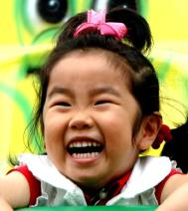
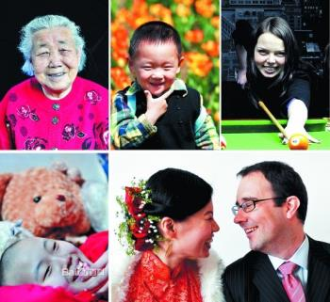
Around the world
Laughter for health
Read the passage and discuss what the benefits of laughter are.

Slide 57
World Smile Day
World Smile Day was created by Harvey Ball of Worcester, Massachusetts, who, in 1963, designed the original smiley face logo.
He thought that all of us should devote one day each year to smiles and kind acts throughout the world, regardless of politics, geography and religion.

Slide 58
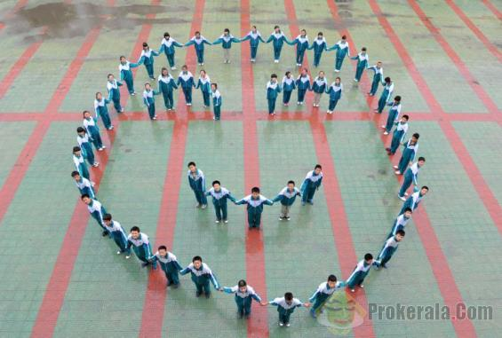
So on World Smile Day, the first Friday in October each year, people all around the planet perform acts of kindness and help others smile.

Slide 59
关于微笑的英语格言
If you don’t learn to laugh at troubles, you won’t have anything to laugh at when you grow old. ---Edward W. Howe
如果你不学会在麻烦时笑，当你变老时，你不会对任何东西笑。 ---爱徳华·豪
Laughter is the shortest distance between two people. ----Victor Borge
笑是两个人之间最短的距离。
----维克托·伯盖

Slide 60
Laughter is the privilege of human.
—— Carnegie
笑是人类的特权。 ——卡耐基
The human race has one really effective weapon, and that is laughter.
—— Mark Twain
人类确有一件有效武器，那就是笑。
——马克·吐温
When you smile, the world loved him; when he laughed, the world became afraid of him.
—— Tagore
当你微笑时，世界爱了他; 当他大笑时，世界便怕了他。 ——泰戈尔

Slide 61
Just one laugh makes the person ten years younger.
笑一笑，十年少。
A smile is the language has multiple meanings. ----- Spitler
微笑乃是具有多重意义的语言。
——施皮特勒
Smile is the best name card.
微笑是最好的名片。

Slide 62
Module task: Giving health advice to people
Work in groups. Give advice for the following problems.
First have a discussion about the problems. Then write some advice for each problem.

Slide 63
Useful expressions
You should / shouldn't …
You’d better …
It’s a good idea …
To …, try (not) to …
It’s important to …
How / What about …?
Why don't you …?

Slide 64
I’ve just moved to a new area. I’m unhappy because I don’t know anyone. It’s making me feel sad.

Slide 65
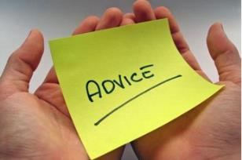
Get used and face your new life bravely.
Try to get familiar with people around you.
Smile at your neighbors when meeting on the road.
Invite your friends to your new house.
Take an active part in different activities.

Slide 66
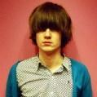
I can’t get my friend to give up smoking.

Slide 67
You should warn him that smoking is harmful to him and to the people around.
Tell him smoking could lead to lung cancer.
Tell him how painful the people who get the cancer feel.
The bad smell keeps people away from him.

Slide 68
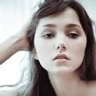
I have difficulty sleeping. I worry so much about my schoolwork.

Slide 69
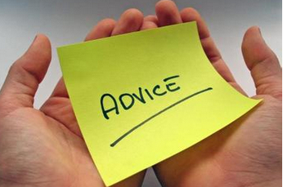
Plan time carefully.
Make full use of your free time and be efficient.
Put your heart into study, and then you will achieve a lot.
Before going to bed, have deep breathing or have a cup of milk.

