Slide 1
Unit3 How do you come to school?
陕旅版
三年级下册
第一课时
WWW.PPT818.COM

Slide 2
>>Review
Ask and answer
S1: Who is he/she?
S2: He / She is …
S1: Is he/she …?
S2: Yes, he/she is./
No, he/she isn’t.

Slide 3
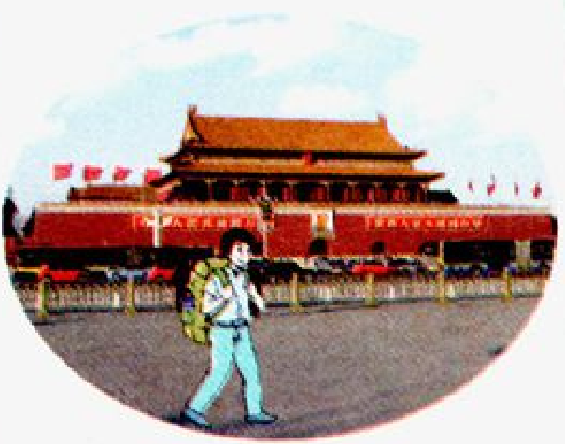
>>Warming-up
Look and think
How do you go to …?

Slide 4
>>Lead-in
Free talk
How do you come to school?

Slide 5
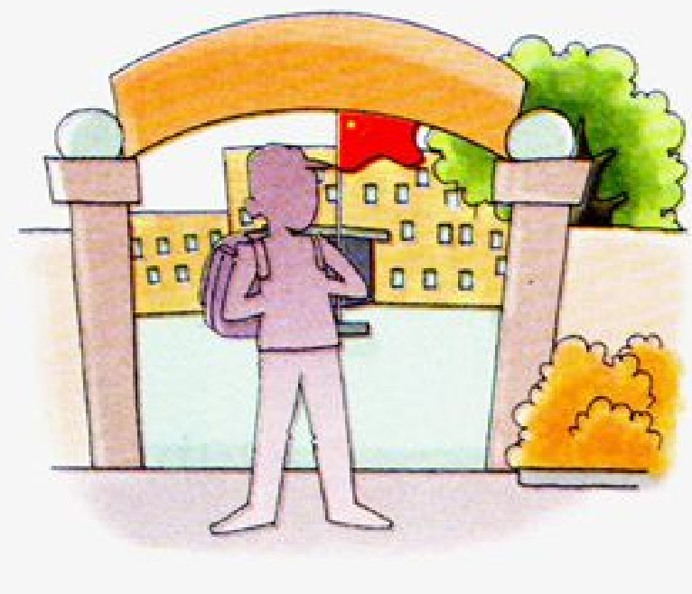
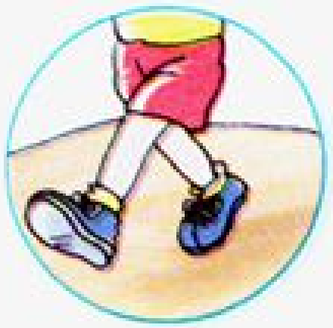
>>Lead-in
Look and tick
How do you come to school?

Slide 6
>>Lead-in
Let’s sing
How do you go to school?

Slide 7
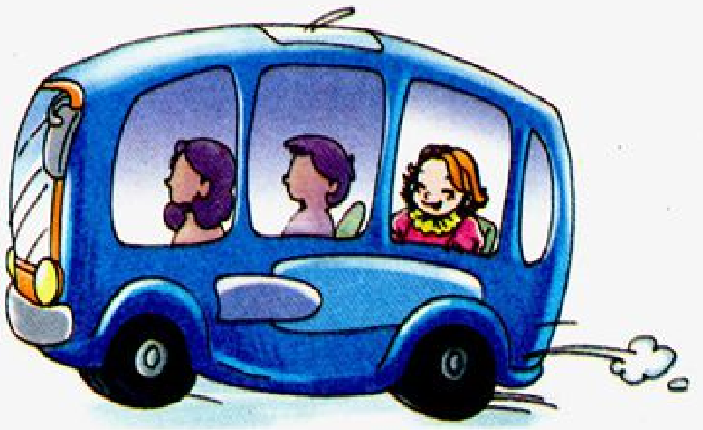
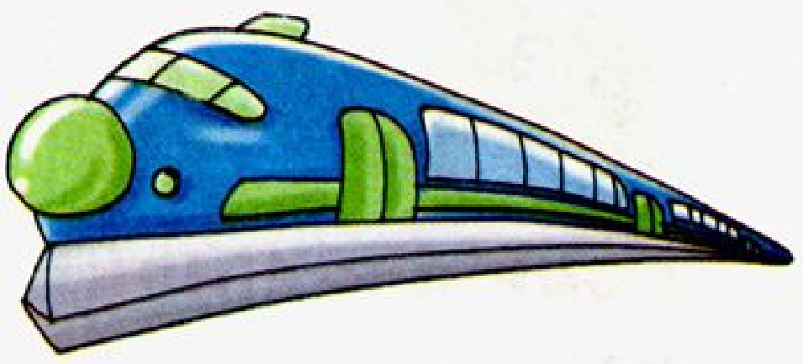
>>Presentation
Let’s learn
bus
train

Slide 8
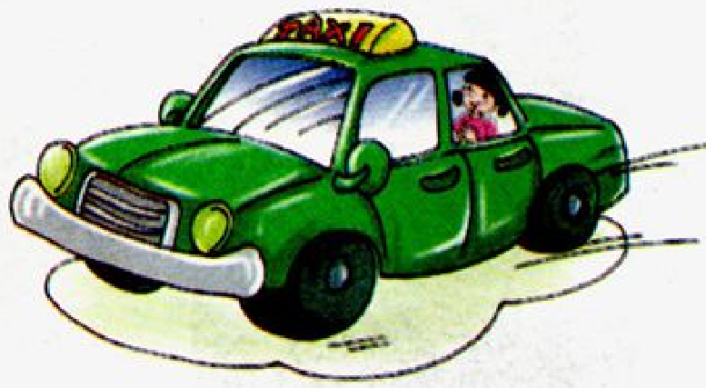
>>Presentation
Let’s learn
ship
taxi

Slide 9
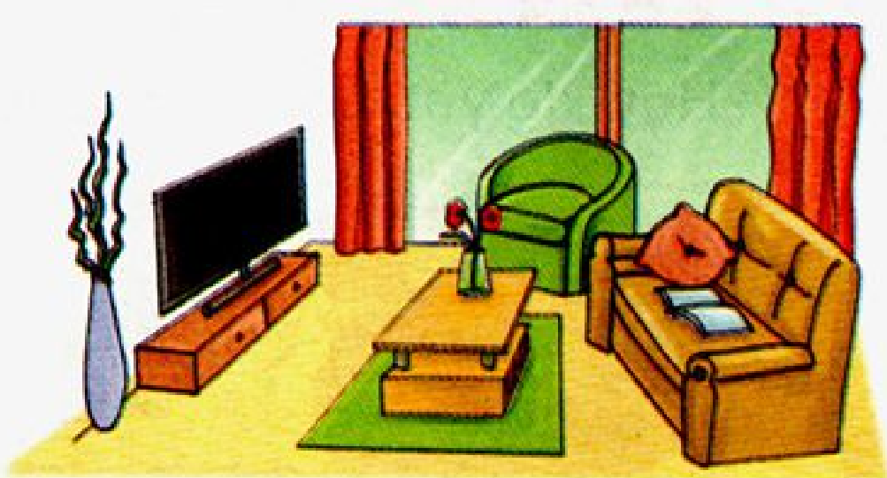
>>Presentation
Let’s learn
school
home

Slide 10
>>Practice
Game 1
Magic fingers
bus train ship
taxi school home

Slide 11
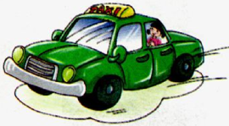
>>Practice
Game 2
Which is missing?

Slide 12
>>Practice
活动
大转盘
train
taxi
ship
bus
school

Slide 13
>>Practice
Game 3
句子接龙
How do you come to …?
I come to …
I come …

Slide 14
>>Summary
与交通工具相关的单词：
bus train ship taxi
与地点相关的单词：
school home

Slide 15
>>Homework
1.听课文录音并跟读，按照正确的语音、语调朗读并表演课文对话。 2.正确书写本课所学单词5遍，并让家长听写1遍。
3.预习A Let’s talk。
close

