Slide 1
陕旅版英语六年级上册
Unit7 I Had a Good Time
第2课时
WWW.PPT818.COM

Slide 2
教学目标：
1. 能听懂Did you go out to play last weekend?并能运用功能结构Where did you go last weekend? / What did you do there? 与他人谈论过去的假期活动，语音语调自然。
2. 能听懂Sounds interesting!等表达，并能在实际生活中正确运用。

Slide 3
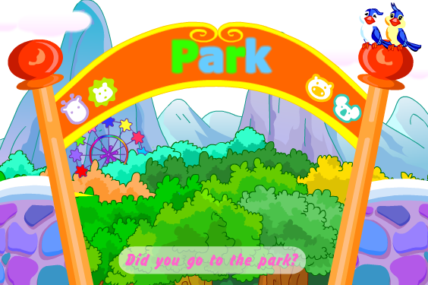
Let’s chant

Slide 4
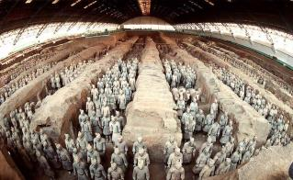
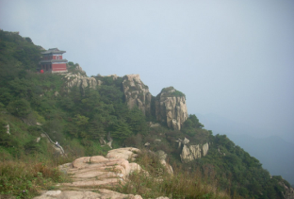
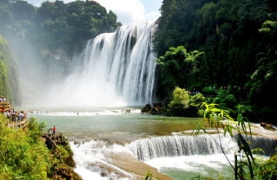
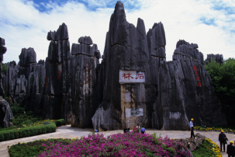
Look and say

Slide 5
Look and choose

Slide 6
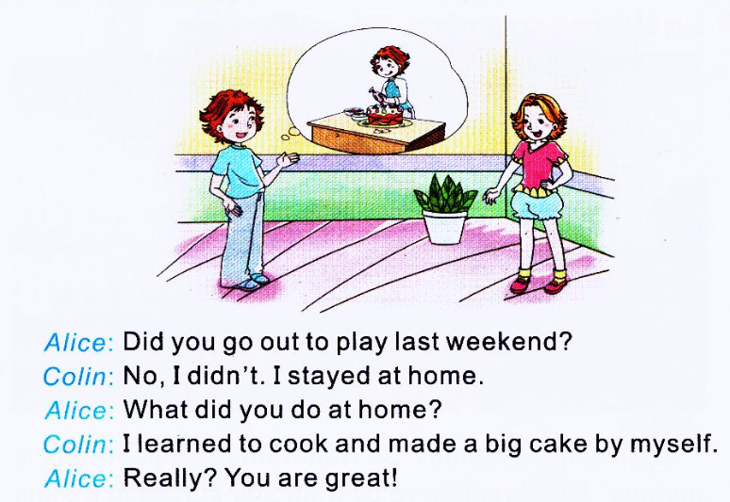
Let’s talk
Q1: Who is talking with Colin?
Q2: Did Colin go out to play last weekend?
Q3: Where was Colin last weekend?
Q4: What did Colin do at home?

Slide 7
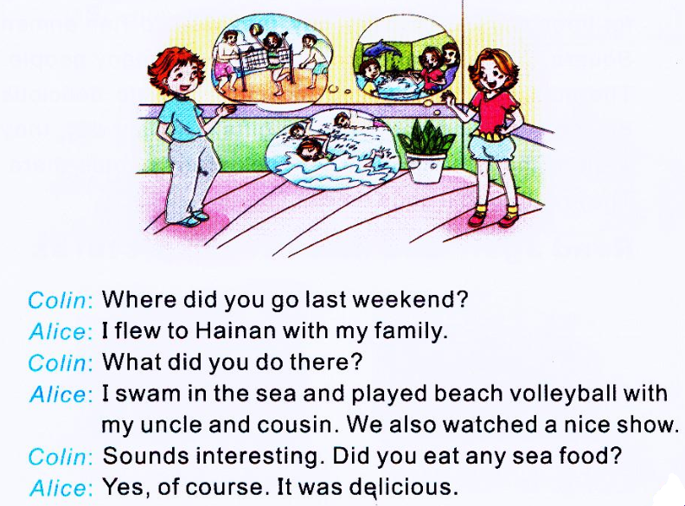
Let’s talk
Q1: Where did Alice go last weekend?
Q2: How did Alice go there?
Q3: Who did Alice go with?
Q4: What did Alice do there?

Slide 8
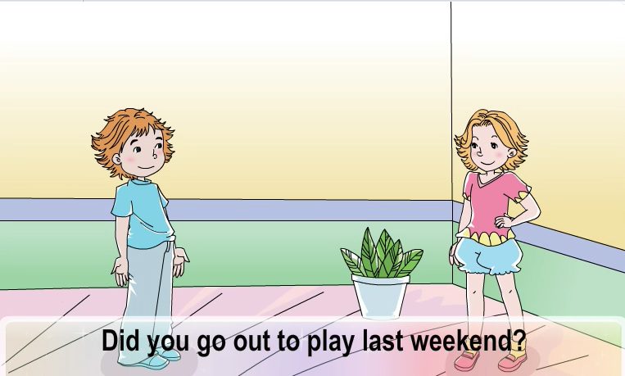
观看课文动画并大声跟读

Slide 9
Role play
A: Did you go out to play last weekend?
B: No, I didn’t. I…
A:What did you do at…?
B: I…
A: Really? You are great!

Slide 10
看图片，说一说
Ss: Where did you go on your holiday?
S1: I went to...
Ss: Who did you go with?
S1: I went with...
Ss: What did you do there?
S1: We.
Ss: Sounds great!

