Slide 1
Unit 5 A party
WWW.PPT818.COM

Slide 2
Let’s talk
Where are you going this May Day?
May Day
What are you going to do there?

Slide 3
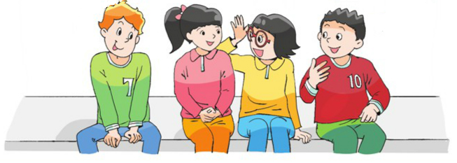
Let’s review
Where?
When?
What?
party

Slide 4
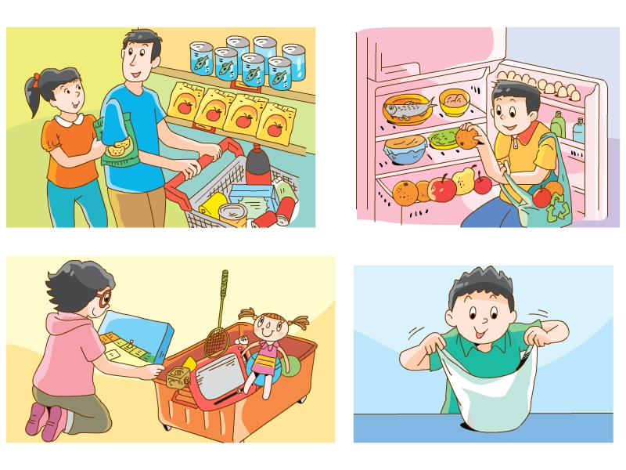
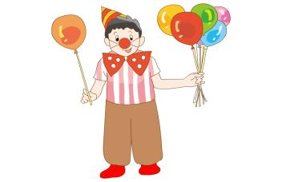
What are they going to bring to the party?

Slide 5
Let's read
They are going to have a party.
Su Hai is going to buy some snacks and drinks.
Yang Ling is going to play with some toys.
Liu Tao is going to bring some balloons.
I am going to show you Grammar time.

Slide 6
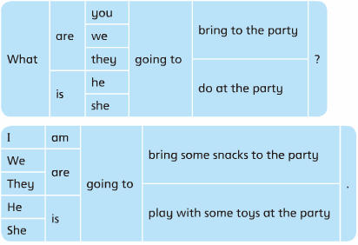
Let’s read
be
going to
do
表示“将要”、“打算”做某事。

Slide 7
一般将来时:
表示在将来某一时间将要发生的动作或存在的状态，也可表示将来某一段时间内经常发生的动作或存在的状态。
结构: be going to +动词原形
打算做某事，将要做某事

Slide 8
Think and judge
Yes or No
When can we use 'be going to ...'?
my plan for the weekend
plan
our plans for the summer holiday
plans
my diary
Mike's plan for Christmas
Mike's daily life
plan

Slide 9
Let’s guess
What?
after the party

Slide 10
Read and guess
Is she/he going to ……？
Are they going to……？
Su Hai is in the kitchen. What is she going to do?
Wang Bing is in the dinning room. What is he going to do?
Yang Ling and Liu Tao are in the sitting room. What are they going to do?

Slide 11
is in the kitchen.
What is she going to do?
Is she going to ……?
She is going to do some washing.

Slide 12
is in the dinning room.
What is he going to do?
Is he going to ……?
He is going to clean the desk.

Slide 13
are in the sitting room.
What are they going to do?
Are they going to ……?
They are going to sweep the floor.

Slide 14
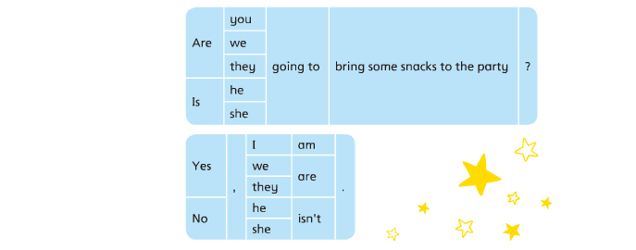
Ask and answer
be
人称
going to
do
一般疑问句
肯定回答 /否定回答

Slide 15
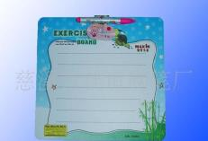
Helpful

Slide 16
用所给词的适当形式填空
We________________ ( watch) a film next week.
What_____ Mike __________(do) tomorrow?
He (visit) the zoo.
3. _______ they _______________ (make) model planes tomorrow evening? No, they ________.
are going to watch
is
going to do
is going to visit
Are
going to make
aren’t

Slide 17
Summary
一般将来时的基本结构：主语+ be going to+动词原形。
一般疑问句：be+主语+ going to+动词原形？
肯定回答：Yes,+主语+提问的助动词. 否定回答：No,+主语+提问的助动词+not.
特殊疑问句：特殊疑问词+be going to+动词原形

Slide 18
六月，大家即将告别母校，我们计划开展一个毕业party，
设计下面的邀请卡吧（小组合作讨论）。
Invitation(邀请卡)
Date:_________
Time:__________
Place:_________
With__________
Come and have fun !
Welcome to the party
Tips:1.When are we going to have the party ?
2.Where are we going to have the party ?
3.What are we going to bring to the party ?

Slide 19
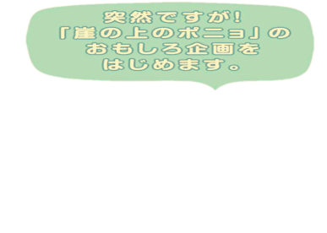
Homework
1. Review Grammar time.
2.Try to make a new invitation card.

