Slide 1
Unit 3 What animal is it ?
WWW.PPT818.COM

Slide 2
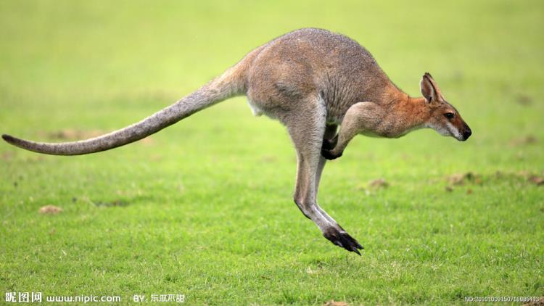
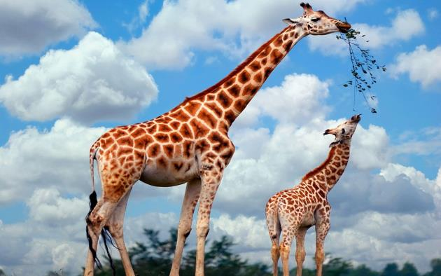
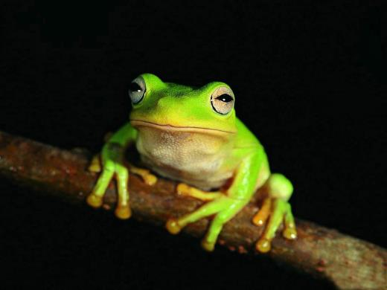
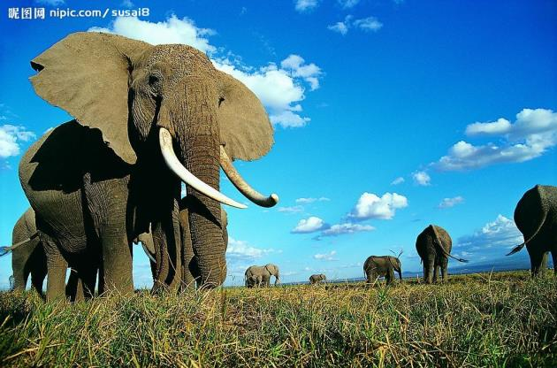
Let's play a game!

Slide 3
tiger

Slide 4
lion

Slide 5
kangaroo

Slide 6
starfish

Slide 7
panda

Slide 8
elephant

Slide 9
frog

Slide 10
giraffe

Slide 11
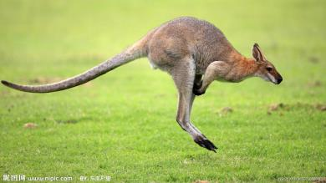
Guess ! Who am I ?
It has two strong back legs and can jump very far.
It usually has brown or grey hair and it's from Australia.
back leg : 后腿
jump far: 跳得远
hair: 毛发
Australia: 澳大利亚

Slide 13
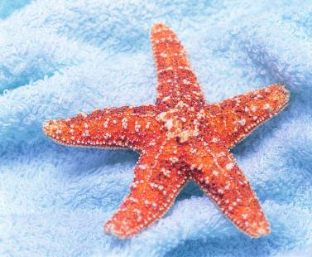
This animal looks like a star and it lives in the ocean.
look like : 看起来像
ocean : 海洋

Slide 14
She looks like her mother.
He looks like a teacher.

Slide 15
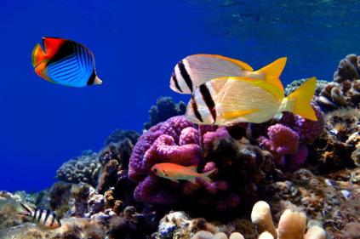
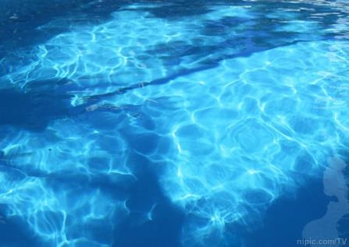
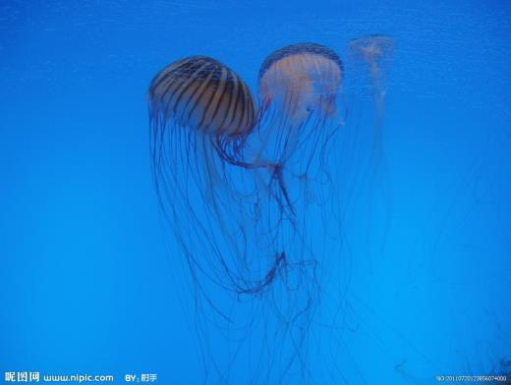

Slide 16
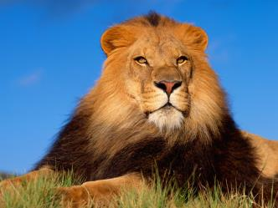
It is a large cat. It loves eating meat. It is yellow and lives in Africa.
It is also called the "King of the Animals.
love/like + V-ing : 喜欢做某事
Africa : 非洲
king : 国王

Slide 17
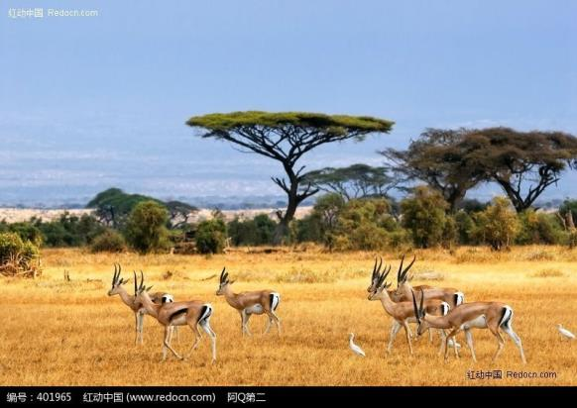
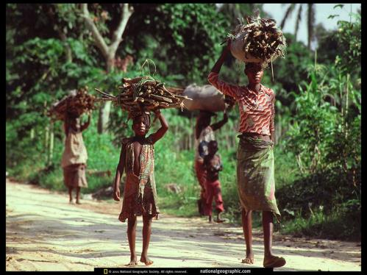
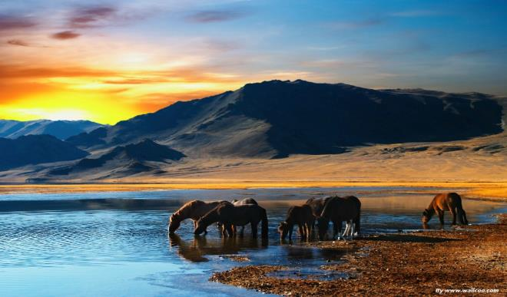

Slide 18
be called 被称为
This place is called Window of the World.
These workers are called the best team in the city.

Slide 19
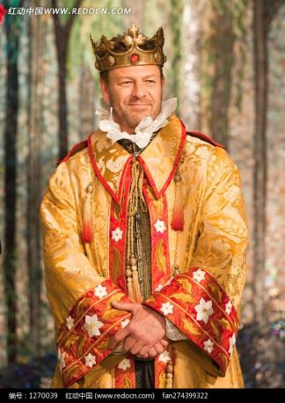
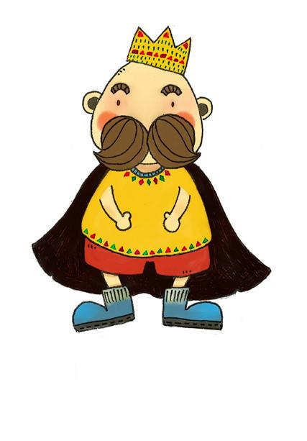

Slide 20
(1)Do kangaroos have two strong back legs ?
(2)What colour are kangaroos’ hair ?
(3)What does a starfish look like ?
(4)What do lions love eating ?
(5)Where do tigers live in ?
(6)What is called the “King of the Animals”?
Yes, they do.
It is brown or grey.
It looks like a star.
They love eating meat.
They live in Asia.
A lion.

Slide 21
Let's recite.
Jiamin: Let's play a game. Can you guess this animal's name? It has two strong back legs and can jump very far.
Janet: Hmm...that's difficult. A frog?
Jiamin: No. It usually has brown or grey hair and it’s from Australia.

Slide 22
Let's recite.
Xiaoling: That’s easy. It’s a kangaroo. My turn. This animal looks like a star and it lives in the ocean. What is it ?
Ben: Is it a starfish ?
Xiaoling: Yes, it is. You try, Janet.
Janet: It is a large cat. It loves eating meat. It is yellow and lives in Africa.

Slide 23
Let's recite.
Ben: A tiger ?
Janet: No. Tigers live in Asia, not Africa. It is also called the “King of the Animals”.
Jiamin: I know. A lion!

