Slide 1
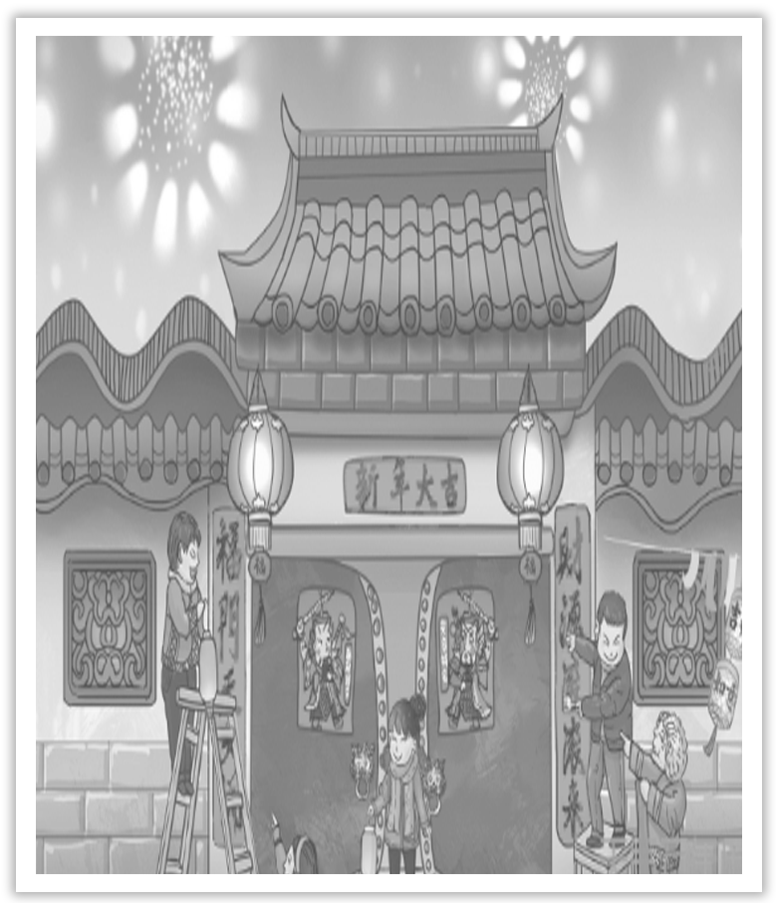
Unit 1 Festivals And Celebrations
WWW.PPT818.COM

Slide 2
主题语境——人与社会之传统节日
【语境概说】 本单元的主题语境为人与社会中的传统节日，该主题语境主要包括与传统节日相关的文化习俗、节日渊源、庆祝活动、个人经历等。本单元主要涉及节日渊源、庆祝活动和个人经历。该主题与学生生活密切相关，在此主题意义的引领下，有助于整合传统节日方面的学习内容，促进学生语言能力、文化意识、思维品质和学习能力的整合发展。

Slide 3
The ceaseless drizzle drips all the dismal day，so broken-hearted fares the traveler on the way.清明时节雨纷纷，路上行人欲断魂。
People are especially happy at happy events，especially in the Mid-Autumn Festival.人逢喜事尤其乐，月到中秋分外明。
Wish us a long life to share the beauty of this graceful moonlight，even thousands miles apart.但愿人长久，千里共婵娟。

Slide 4
Section Ⅰ Listening and Speaking
1.Translate the following words and phrases.
①lantern n. ____________
②carnival n. ________________
③dress (sb) up ________________
④march vi.& n. _____________________
灯笼；提灯
狂欢节；嘉年华
穿上盛装；装扮
行进；前进；示威游行

Slide 5
⑤congratulation n. ____________
⑥riddle n. ________________
⑦ceremony n. ____________
⑧samba n. __________________
⑨make-up n. ____________
⑩after all ____________
⑪costume n. ______________________________
⑫congratulate vt. ____________________________________
祝贺；恭喜
谜语；神秘事件
典礼；仪式
桑巴舞；桑巴舞曲
化妆品；性格
毕竟；别忘了
(某地或某历史时期的)服装；戏装
向(某人)道贺；(因某事)为自己感到自豪

Slide 6
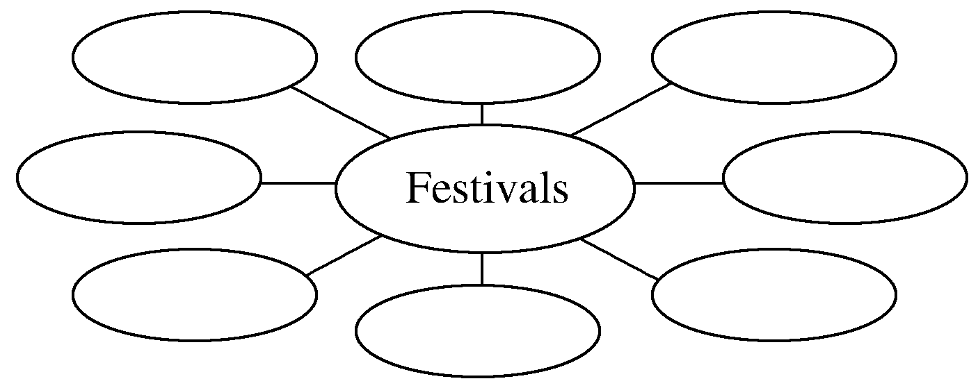
2.Brainstorming：There are many different festivals in our country.Which festivals do you like?
Spring Festival (Chinese New Year)，the Lantern Festival，Tomb-Sweeping Festival，Chinese Youth Day，the Dragon Boat Festival，Mid-Autumn (Moon) Festival，Double－Ninth Day...
________________________________________________________________________
________________________________________________________________________
________________________________________________________________________

Slide 7
3.Look at the pictures on Page 2 and tell your classmates what festivals they are.
Chinese Lantern Festival，Coming-of-age Day，Rio Carnival
________________________________________________________________________
4.Finish Ex.1 on Page 2.
5.Try to translate the sentence in various ways.
我认为我们应该保护好我们的环境。
①_________________________________________________________________
②_________________________________________________________________
③_________________________________________________________________
④_________________________________________________________________
I think we should protect our environment.
I believe we should protect our environment.
In my opinion，we should protect our environment.
In my view，we should protect our environment.

Slide 8
1.Finish Ex.2 on Page 2.
2.Finish Ex.3 on Page 3.
3.Finish Ex.4 on Page 3.

Slide 9
1.Speaking—Finish Ex.5 on Page 3 by following the example.
A：I think the Rio Carnival would be the most exciting.After all，as you know，I love to dance.
B：I love dancing，too，but I’m not sure I’d enjoy it in such hot weather.
A：So which festival do you like best?
B：I like All Fools’ Day.On that day，people play all kinds of tricks on others，and the one easily taken in is called April fool.
A：April fool!
B：April the first is coming.Be careful!

Slide 10
2.Pronunciation
(1)The change in the pronunciation of the bold letters.
①duty education ②use usually ③news newspaper
④is issue ⑤last year ⑥in bed
⑦those shirts ⑧as you see

Slide 11
(2)The change in the pronunciation of the consonants in the sentences.
①Did you enjoy the holiday?
②Miss，congratulations on becoming an adult!
③It’ll be too tiring to walk or dance for a long time in those shoes.
④I was hoping to hear that you had a great time throughout.
⑤Children then take part in Easter egg hunts to find the eggs and win prizes.
⑥In Mexico，the Day of the Dead is celebrated between October 31st and November 2nd.

Slide 12
语言知识积累
表示个人看法的常用表达
1.I think...
2.As far as I am concerned...
3.Personally speaking...
4.As to me...
5.As I see it，...

Slide 13
6.It seems to me that...
7.In my view，...
8.If I may say so，I think...
9.I believe/feel...
10.In my opinion，...

Slide 14
文化知识习得
1.你知道日本的成人节吗？
日本的成人节源于中国古代的成人仪礼，而日本古代的成人仪礼受到过中国“冠礼”的影响，所谓“冠礼”，指男子成年时举行的一种加冠的礼仪。从加冠这天起，冠者便被社会承认为已经成年。2018年日本将法定成年年龄从20岁下调至18岁。
2.里约热内卢狂欢节知多少？
巴西里约热内卢狂欢节开幕当天，里约热内卢市市长在市长官邸，亲手将城门的金钥匙交给“狂欢国王”，象征着一年一度的狂欢节正式开始。自此，在长达一周的狂欢节中，整个里约热内卢城都要由“狂欢国王”“统治”，全体市民将按照自己的方式尽情狂欢。

Slide 15
学习策略形成
1.学会用不同句式表达个人观点。
2.学会英语发音中的音变现象，并能灵活掌握。
音的同化
音的同化也是一种连读的现象，两个词之间非常平滑的过渡，导致一个音受临音影响而变化。主要是以下三种方式：
1.辅音[d]与[j]相邻时，被同化为[dʒ]：Would you...?
2.辅音[t]与[j]相邻时，被同化为[t∫]: Can’t you...?
3.辅音[s]与[j]相邻时，被同化为[∫]: Miss you

Slide 16
失音
规则：辅音爆破音或摩擦音后面跟的是爆破音、破擦音和摩擦音等，前面的辅音要失去爆破。
Sit down
Contact lens
Big cake
Dad told me
Huge change
Good night

Slide 17
1.dress (sb) up 穿上盛装；装扮
dress up in carnival costumes (教材P₂)穿上狂欢节的服装
[短语记牢] 记牢下列短语
dress up as... 装扮成……；打扮成……
dress oneself 自己穿衣
be dressed in 穿着……(表示穿的状态)

Slide 18
①It is now a children’s festival，when they can dress up and go to their neighbours’ homes to ask for sweets.
如今它成了孩子们的节日，这天他们可以乔装打扮，上邻居家要糖果吃。
②We are supposed to dress up as movie characters for the party; what a good idea！我们在晚会上要装扮成电影中的角色，这是一个多么好的主意啊！
③Dressed in a red coat，she looks more beautiful.
穿着红色的外衣，她看上去更漂亮了。
④The little boy is too young to dress himself.
这个小男孩太小，不会给自己穿衣服。

Slide 19
[巩固内化]
单句语法填空/补全句子
①In my city，all children played this game，and they dressed up __________ cowboys.
②The girl next to you ____________(dress) in blue.
③I’d like you _______________ for my birthday party tonight.
今晚我希望你为我的生日派对打扮打扮。
as
is dressed
to dress up

Slide 20
2.congratulation n.祝贺；恭喜 congratulate vt.向(某人)道贺；(因某事)为自己感到自豪
receive congratulations from...(教材P₂)接受……的祝贺
[合作探究] 体会黑体部分的用法和意义
①Congratulations！We are pleased to tell you that you have won the high school speaking competition about new Tangshan.
____________！我们很高兴地告诉你，你已经赢得了以新唐山为主题的高中组演讲比赛。
恭喜你

Slide 21
②We sent our congratulations to her on passing the exam.
＝We congratulated her on/upon passing the exam.
她通过了考试，我们____________。
[自主发现]
③Congratulations! 恭喜！祝贺！(常以复数形式出现，用以向某人祝贺)
④offer/send congratulations ________ sb ________ sth向某人祝贺某事
⑤congratulate sb ____________ (doing) sth就某事向某人祝贺
向她表示祝贺
to
on
on

Slide 22
[巩固内化] 单句语法填空
①________________(congratulate) on your 50th wedding anniversary!
②I congratulate you ____________ what you have achieved.
[思考] congratulate和celebrate有什么区别？
________________________________________________________________________
________________________________________________________________________
Congratulations
on
congratulate“祝贺，道贺”，宾语是指人的名词，不是指物的名词；celebrate“庆祝，庆贺”，宾语往往是表示活动的名词。

