Slide 1
Unit8 Topic 1
How is the weather in winter?
Section C
WWW.PPT818.COM

Slide 2
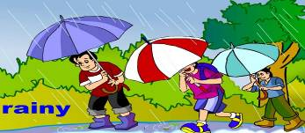
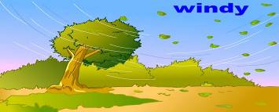
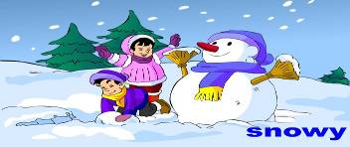
Describe the weather and activites.
sunny
It’s…
I can ... /It’s a good time to …

Slide 3
Make a weather report.
City | Beijing | Harbin | Shanghai | …
Weather | cloudy | windy | sunny | …
Temperature | 15℃-20℃ | 27℃-30 ℃ | 31℃-37℃ | …
Example:
The weather in Beijing was cloudy yesterday. The highest temperature was 20℃ and the lowest temperature was 15℃.

Slide 4
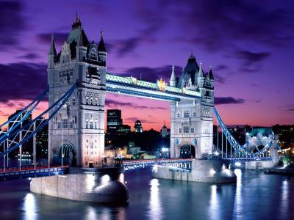
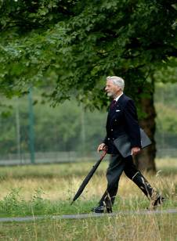
The weather in different places.
England
umbrella
In England, you had better take an umbrella when you go out.
最好

Slide 5
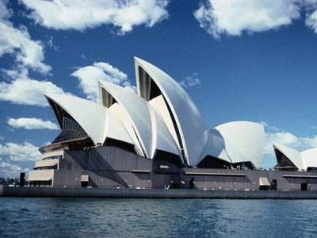
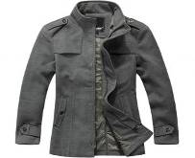
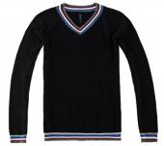
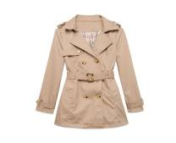
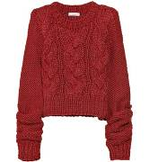
Australia
In Australia, it's winter in August, remember to wear warm clothes .

Slide 6
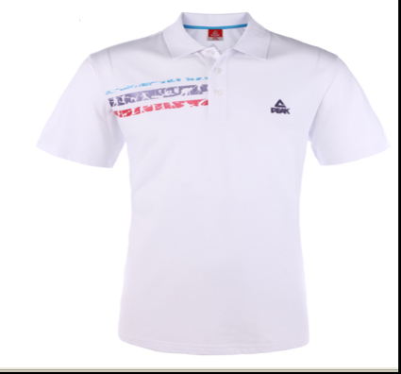
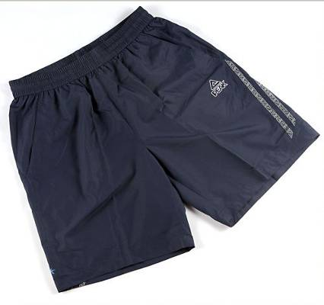
hot
You need to wear a T-shirt and shorts.
In most areas of China, it is very hot in August.
大多数

Slide 7
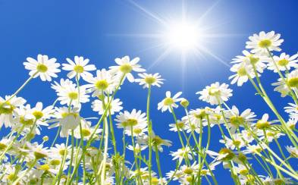
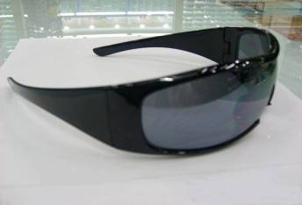
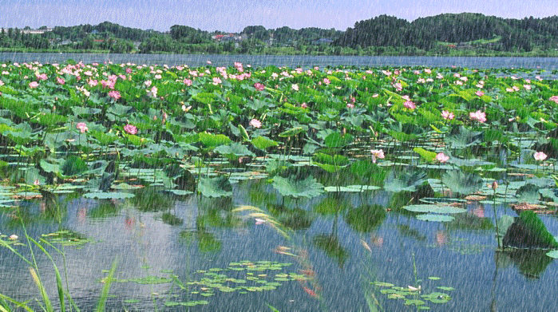
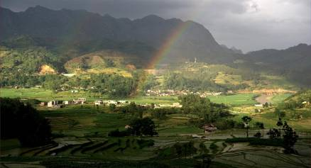
The sun shines brightly.
a pair of sunglasses
Sometimes it rains suddenly.
But later on, it may get fine again.

Slide 8
Write down the meaning of each word.
holiday _________ umbrella_______________ sunglasses _______________ shorts _______________
travel _______________ wear _______________
suddenly _______________ shine ________________
假 期
雨 伞
太阳镜
短 裤
旅 游
穿，戴
突 然
照 耀

Slide 9
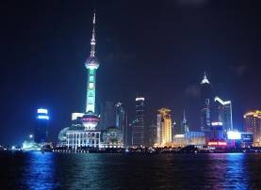
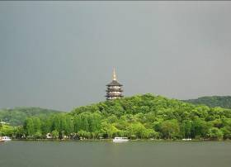
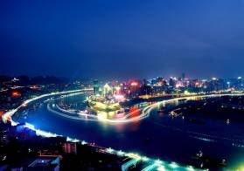
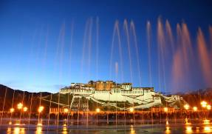
Talk about the place you are going to visit and the weather there. Then ask him or her to give you some suggestions.
Example:
It is hot/sunny...in Chongqing/Shanghai... You'd better wear sunglasses and shorts...
Beijing
Shanghai
Hangzhou
Chongqing
Dali
Tibet

Slide 10
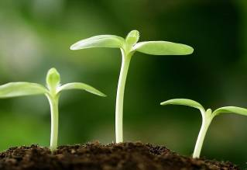
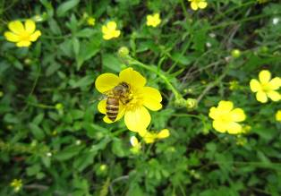
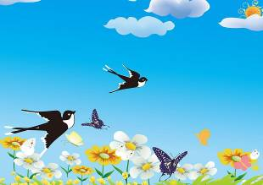
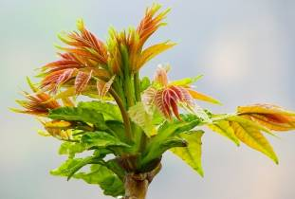
Four Seasons in China.
The flowers come out.
Everything comes back to life in spring.

Slide 11
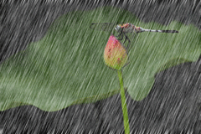
Summer
Sometimes it rains heavily in summer.
heavy

Slide 12
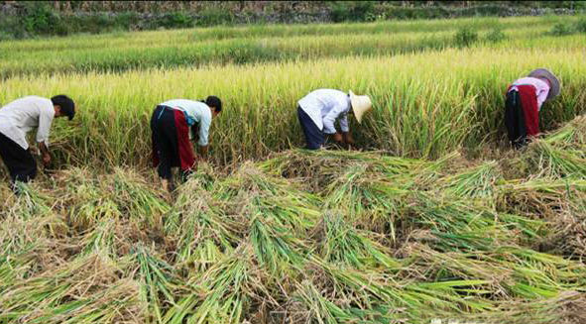
Fall
harvest
The farmers are busy harvesting in fall.
be busy doing...“忙于做...”

Slide 13
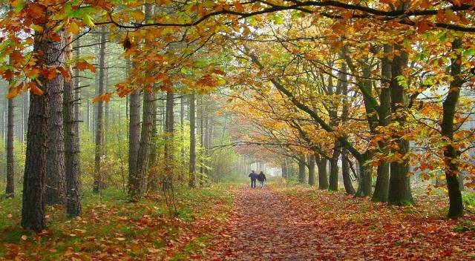
Fall
leaf
leaves
Many leaves fall from the trees in fall.

Slide 14
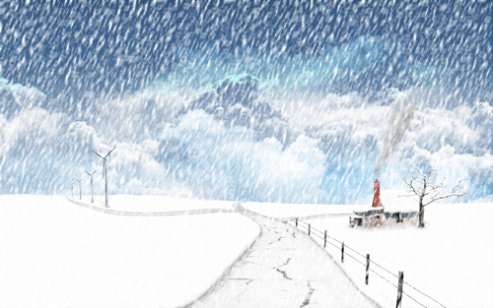
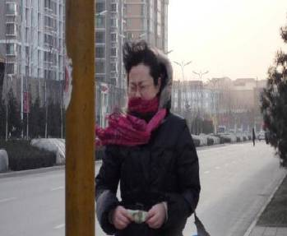
Winter
It's snowy and the wind is blowing strongly.
Sometimes there is ice on the street in winter.
冰

Slide 15
Listen and complete the passage.
In China,_________returns in March. The weather gets______. Everything comes back to life. Trees turn green and flowers come out. It is a wonderful season.
________begins in June. It is very______. It often rains and sometimes it rains heavily.
______comes after summer. It is the harvest season, and the farmers are busy harvesting. It's_____and the leaves fall from the trees. The cold weather is coming.
______lasts from December to February. It's a very_____season. We all wear warm clothes. The wind blows strongly and sometimes there is ice or snow.
spring
warm
Summer
hot
Fall
cool
Winter
cold

Slide 16
Read the passage aloud.

Slide 17
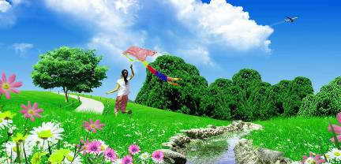
Make notes according to 2a.
Spring
return in March
get warm
come back to life
a wonderful season
fly kites ...
Summer
begin in June
hot
rain heavily
go swimming
...

Slide 18
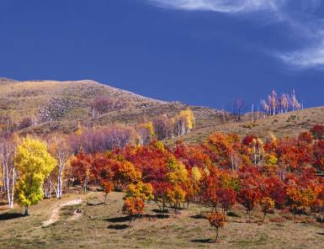
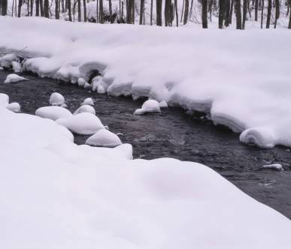
Fall
come after summer
harvest season
cool
leaves fall
Winter
last from December to February
cold
wear warm clothes
wind blows strongly
ice or snow

Slide 19
Listen and read the words aloud, paying attention to the word stress.
'February De'cember Ju'ly
'sometimes 'harvesting
'everything Au'stralia 'sunglasses
'Canada um'brella

Slide 20
Listen to the pronunciation of past form of each verb. Then read them aloud.

Slide 21
Summary
1. Learn some phrases:
had better(do sth.), go out, later on, get fine,
come back to life, come out, be busy doing sth.
2. Learn how to make suggestions for traveling.
(1)You’d better find out the weather in different places in August.
(2)You need to take an umbrella when you go out.
(3)So it's the best time to go there.

Slide 22
3.Learn some useful expressions about the seasons.
(1)Everything comes back to life.
(2)Trees turn green and flowers come out.
(3)It often rains and sometimes it rains heavily.
(4)It’s cool and the leaves fall from the trees.
(5)The wind blows strongly, and sometimes there is ice or snow.

Slide 23
Homework
Read 1a and 2a, then recite them.
2. Finish Section C in your workbook.

