Slide 1
Unit 5
Where is Ben?
WWW.PPT818.COM

Slide 2
Go to the garden,
water the flowers.
Go to the library,
read a story-book.
Go to the canteen,
eat some fruit.
Go to the teacher’s office,
hand in the homework.
Go to the playground,
play football.

Slide 3
补全单词 1. p_a_g_ou_d 2. g_ _ d_n 3. l_ br_r_ 4. c_nt_ _ n 5. t_ _ ch_ _’ _ off_ c_

Slide 4
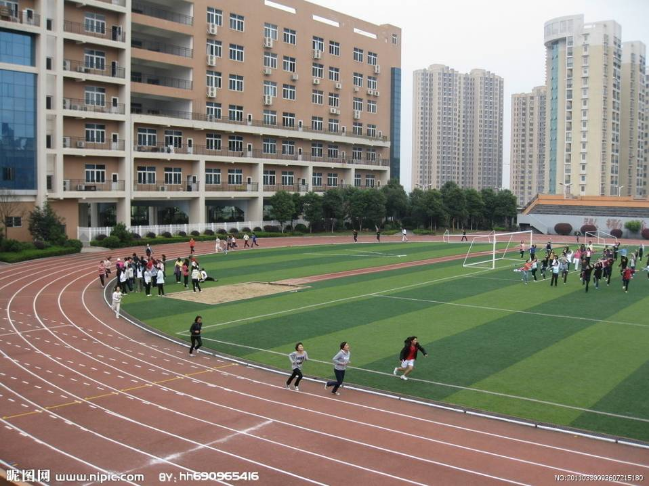
playground

Slide 5
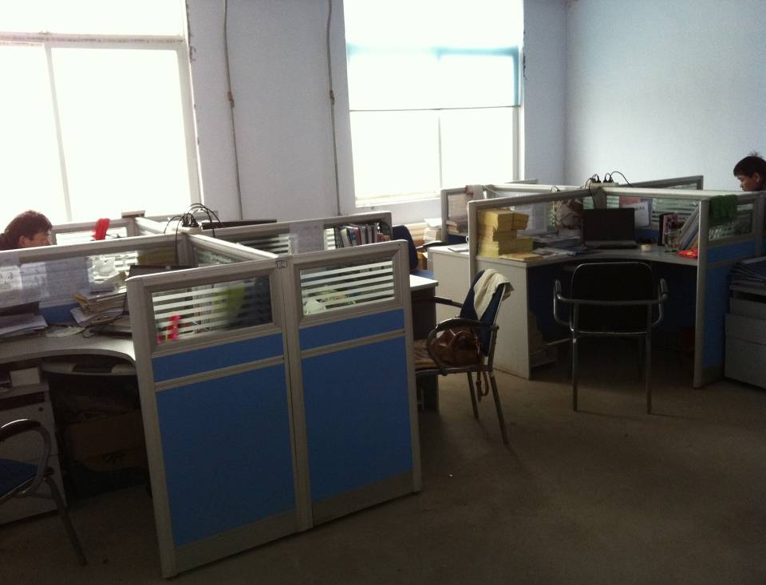
teacher's office

Slide 6
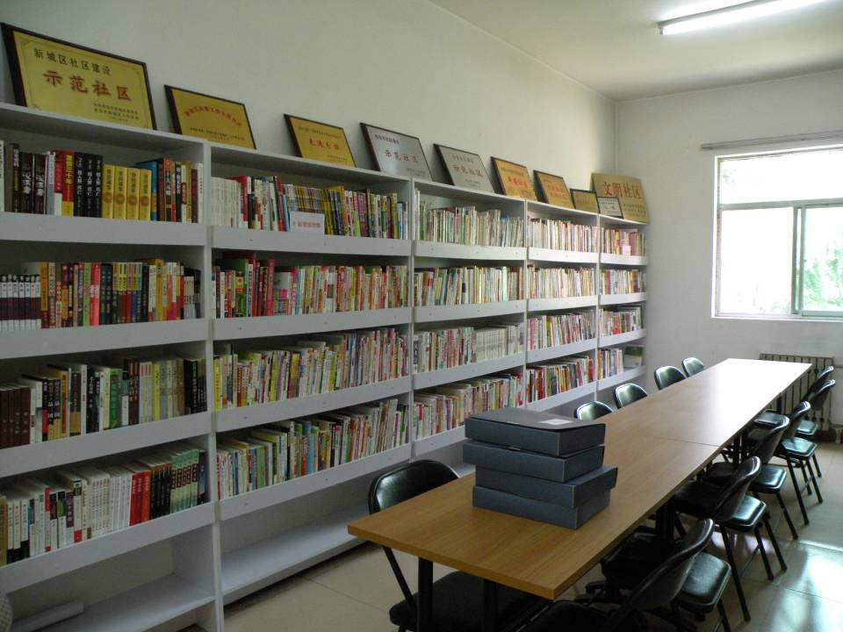
library

Slide 7
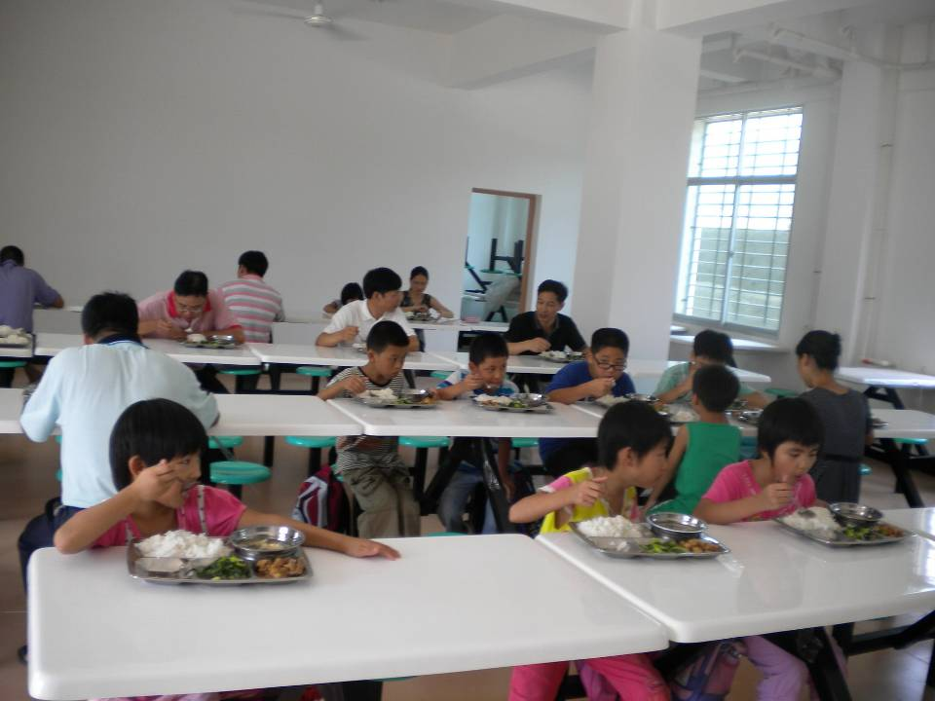
canteen

Slide 8
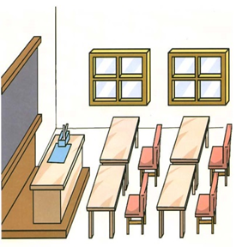
classroom

Slide 9
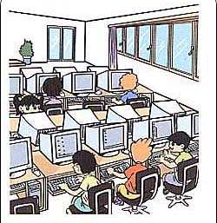
computer room

Slide 10
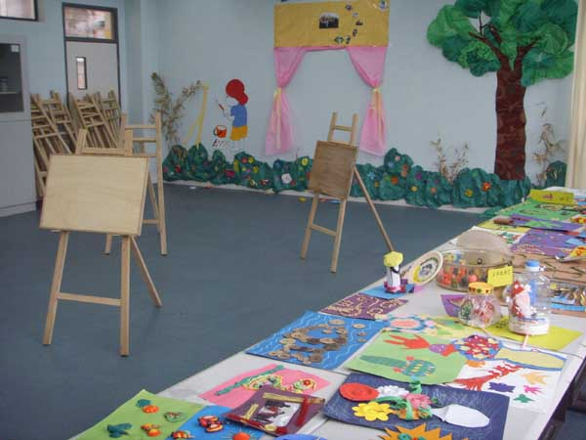
art room

Slide 11
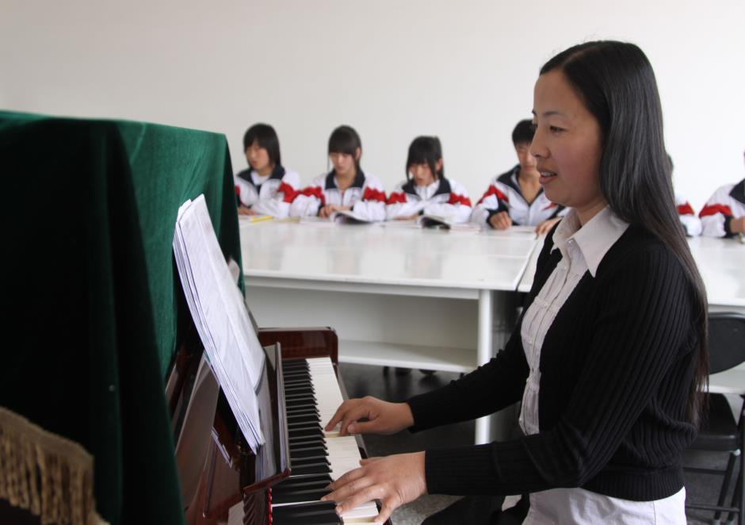
music room

Slide 12
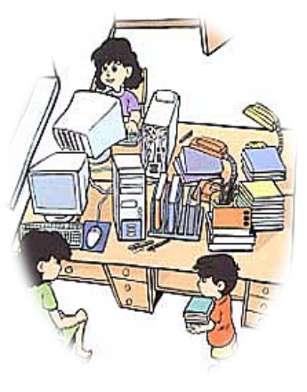
teachers’ office

Slide 13
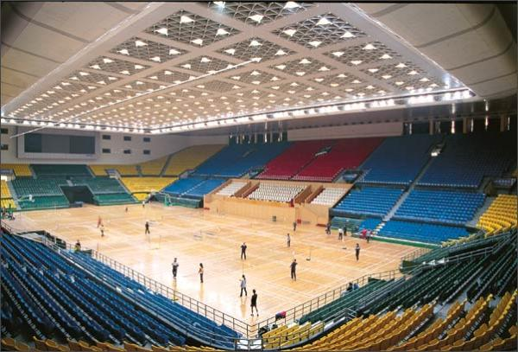
gym

Slide 14
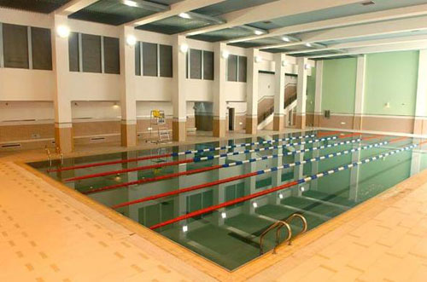
swimming pool

Slide 15
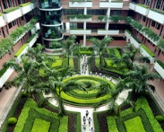
garden

Slide 16
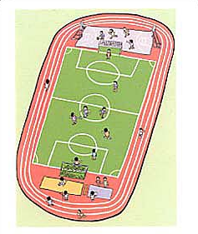
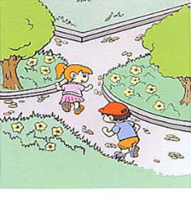
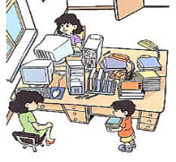
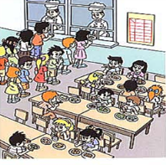
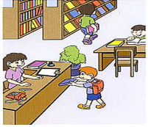
playground
garden
library
teacher’s office
canteen

Slide 17
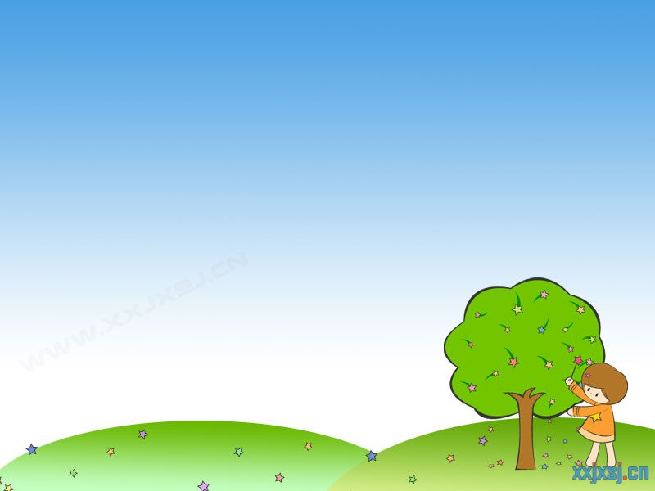
Read and answer:
Who wants to talk with Ben?
Does Ben go swimming on weekdays?
Where does Ben read books?
Can Mike and Xiaoling find Ben at the library?
Does Ben sometimes play football
with Xiaoling after school?

Slide 19
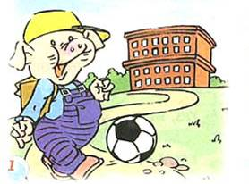
This is a beautiful school.
Let’s go and do something in the school !

Slide 20
library
Go to the library, read a story-book.

Slide 21
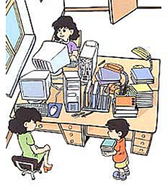
teacher’s office
Go to the teacher’s office, hand in the homework.

Slide 22
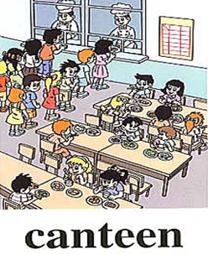
canteen
Go to the canteen, eat some fruit.

Slide 23
playground
Go to the playground, play football.

Slide 24
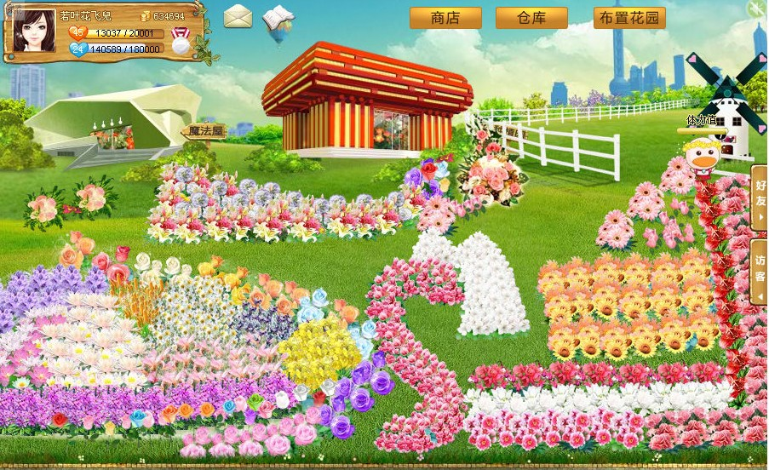
garden
Go to the garden, water the flowers.

Slide 25
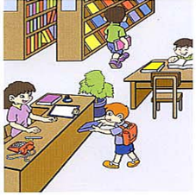
What's missing

Slide 26
What's missing

Slide 27
What's missing

Slide 28
What's missing

Slide 29
What's missing

Slide 30
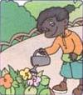
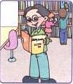
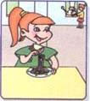
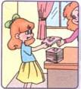
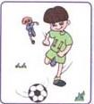
Go to the garden .
Water the flowers.
Go to the library.
Read a story-book.
Go to the canteen.
Eat some noodles
Go to the teacher’s office.
Hand in the homework.
Go to the playground.
Play football.

Slide 31
Homework:
1.Read the words and the phrases four times.
2.Introduce your school to your parents.

