Slide 1
Unit5 It’s a parrot.
人教精通版三年级下册
WWW.PPT818.COM

Slide 2
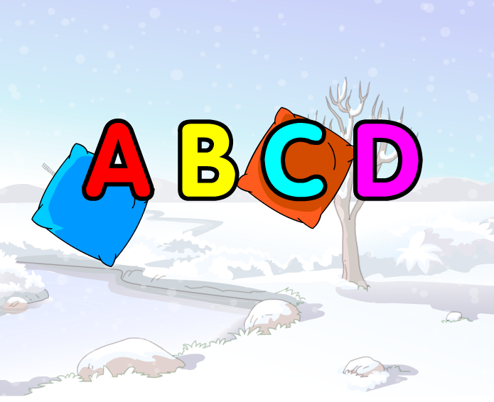
Warm-up
Let’s sing

Slide 3
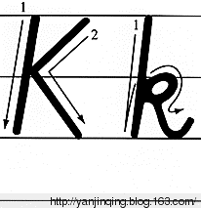
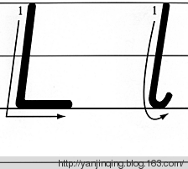
Presentation
Let’s learn

Slide 4
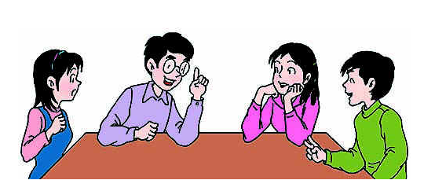
Presentation
Discussion
我们学过的哪些单词含有字母k或l呢？
desk, book, school, uncle
……

Slide 5
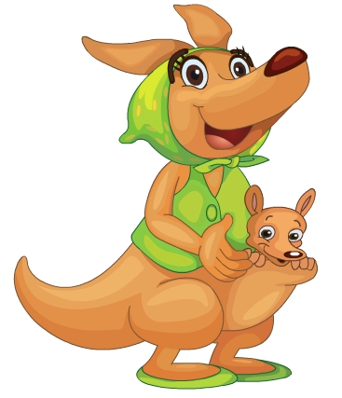
Presentation
Let’s learn
kangaroo
Do you like kangaroo?

Slide 6
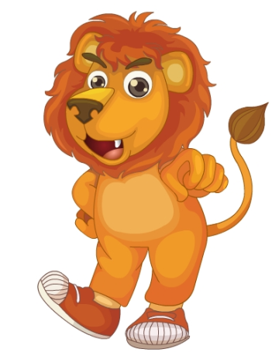
Presentation
Let’s learn
lion
Do you like lion?

Slide 7
Practice
Let’s chant
K, K, K, kangaroo;
L, L, L, lion!

Slide 8
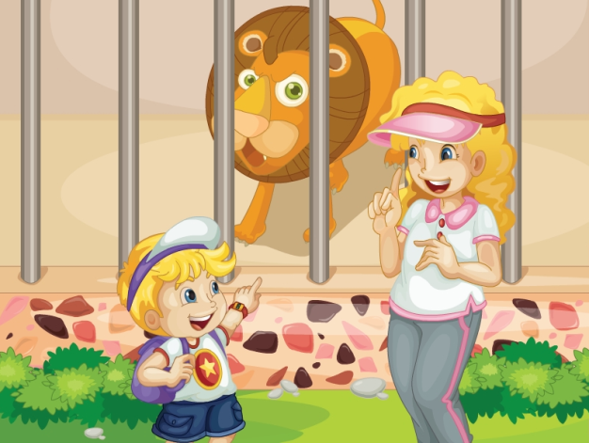
Presentation
Listen and say
What are they talking about?

Slide 9
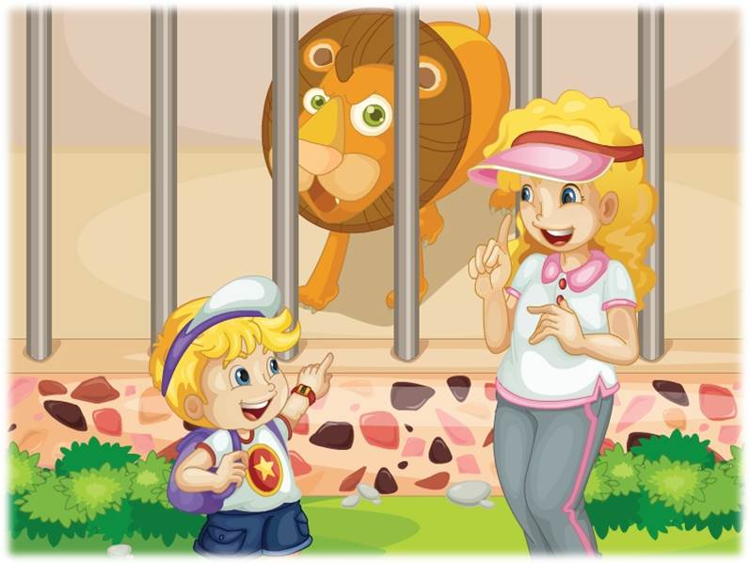
Presentation
Let’s learn
It’s a lion.
Excuse me, Mum. What’s this?
Oh, a lion. It’s big!

Slide 10
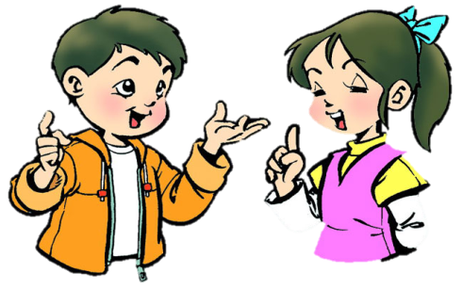
Practice
Role-play
分角色朗读对话，注意模仿语音语调。
两人一组，试着表演出来吧。

Slide 11
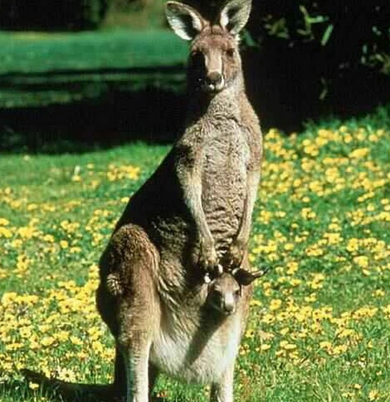
Practice
Let’s guess
What’s this?
It’s a kangaroo.

Slide 12
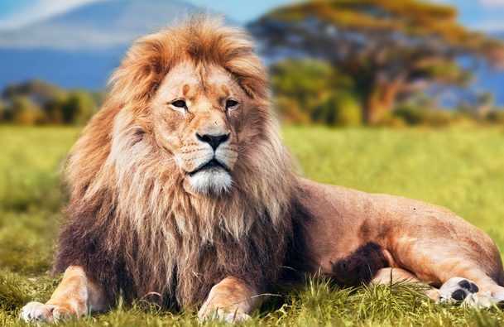
Practice
Let’s guess
What’s this?
It’s a lion.

Slide 13
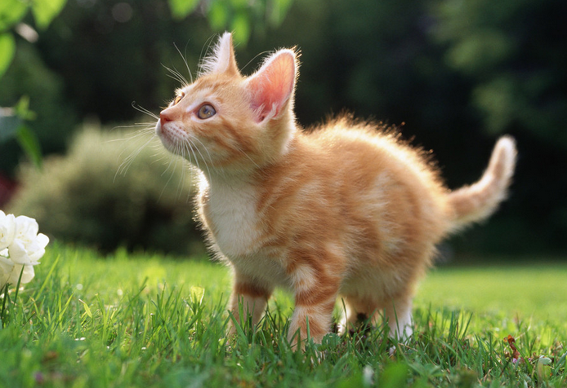
Practice
Let’s guess
What’s this?
It’s a cat.

Slide 14
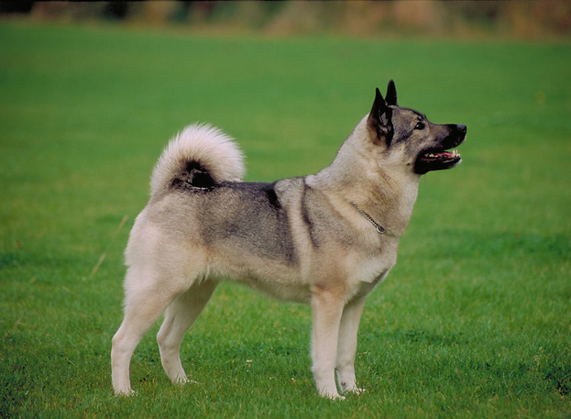
Practice
Let’s guess
What’s this?
It’s a dog.

Slide 15
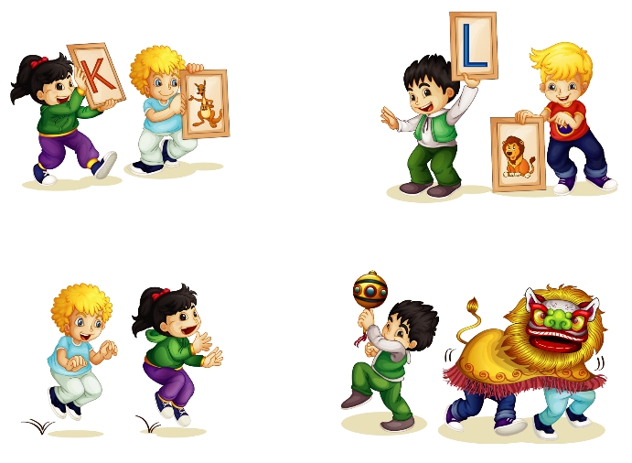
Practice
Let’s play
Show me the letter K and a kangaroo.
Show me the letter L and a lion.
Act like a kangaroo.
Act like a lion.

Slide 16
Summary
本课学到的重点单词：
kangaroo lion
本课学到的重点句型：
—What’s this?
—It’s a …

Slide 17
Homework
1. 跟读课文Just talk部分的录音，注意语音、语调。
2. 制作字母和单词卡片，并能熟练书写所学字母。
3. 预习本单元Lesson 26的内容。
Close

