Slide 1
陕旅版小学英语三年级下册
Unit7 There Is a TV in the Classroom
第2课时
WWW.PPT818.COM

Slide 2
学习目标
学生能熟练听说单词：
student, teacher, fan, TV, blackboard, light, sofa
2. 学生能熟练运用句型：
There is …
There are …

Slide 3
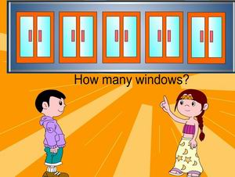
对话问答How many

Slide 4
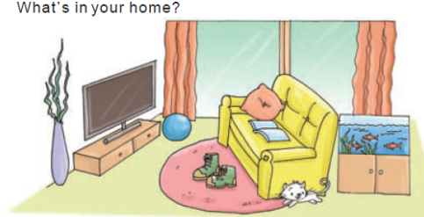
Part A Look and tick
Boys and girls, Miss Wang has a big and cozy home. In my home, there is a TV, a sofa and a computer. What’s in your home?

Slide 5
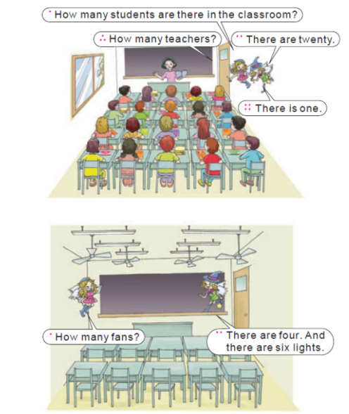
Part B Let’s learn more

Slide 6
How many 提问数量，后+可数名词的复数形式。一般情况下名词的复数在其后加s。例：How many books do you have?
How many students are there in your class?

Slide 7
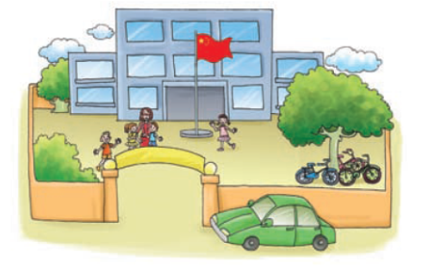
Part C Look and say
What can you see in the school?

Slide 8
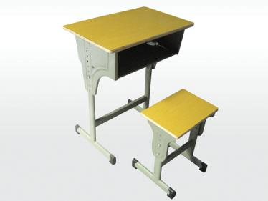
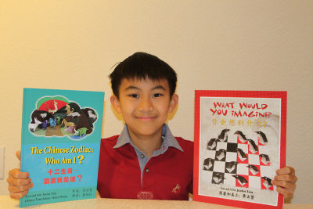
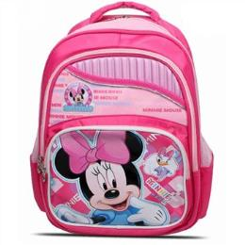
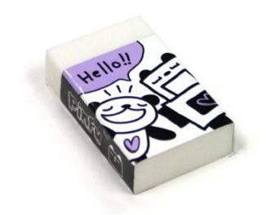
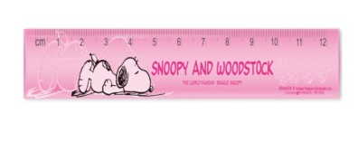
演一演
道具：一张桌子，一张椅子，一个书包，两本书，一块橡皮，一把尺子。

