Slide 1
Module 5 Cartoons
It’s time to watch a cartoon.
WWW.PPT818.COM

Slide 2
Free Talk
Do you like cartoons?
What cartoons have you watched?

Slide 3
Pair work
Talk with your partner about your favourite cartoon and the cartoon character that you like best.

Slide 4
— Which is your favourite cartoon?
— It’s …
— Why?
— Because …
— So who is your favourite cartoon character?
— I like…

Slide 5
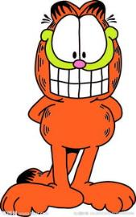
Do you know the names of the following cartoons? Try to describe them.

Slide 6
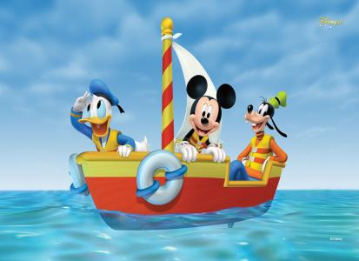
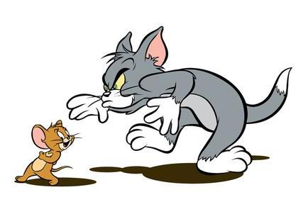
Mickey Mouse and Donald Duck
Tom and Jerry

Slide 7
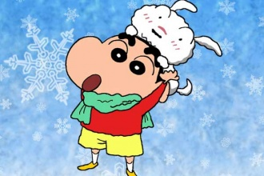
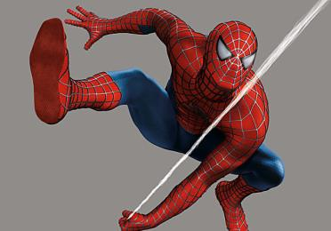
Crayon Shin-chan
Spiderman

Slide 8
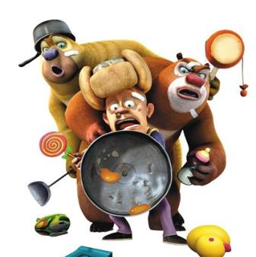
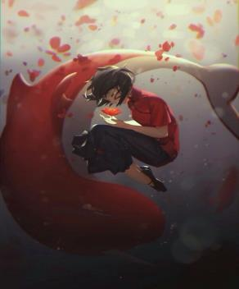
Boonie Bears
Big Fish & Begonia

Slide 9
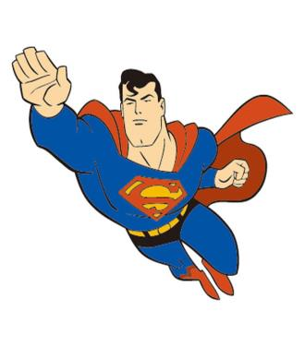
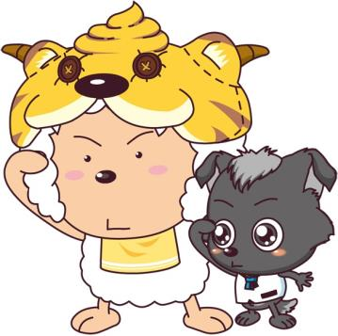
Superman
Pleasant Goat and Big Big Wolf

Slide 10
Focus on
Words:
carton smart handsome fight cool hero humorous laugh
Phrases:
can’t help doing sth. fly through
Patterns:
1. It’s time to …
2. He’s stronger than Spiderman.
3. He keeps fighting bad people.
4. That’s cool.

Slide 11
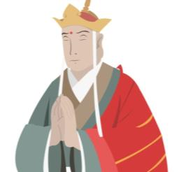
1. Answer the questions.
1. What kind of cartoons do you like?
2. Do cartoons always end in a happy way?
3. What cartoons do you think are funny?

Slide 12
2. Listen and find out Betty’s and Tony’s answers to the questions in Activity 1.
brave cartoon cute funny handsome smart
1. What kind of cartoons do you like?
Betty likes exciting cartoons; Tony likes funny cartoons.

Slide 13
2. Do cartoons always end in a happy way?
Betty and Tony say cartoons always have happy endings.
3. What cartoons do you think are funny?
Tony thinks Tom and Jerry is funny.

Slide 14
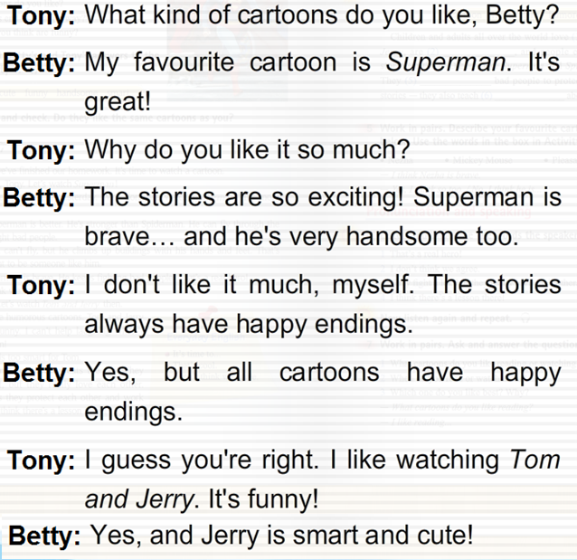
Tapescript:

Slide 15
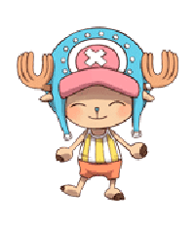
Free Talk
Do they like the same cartoons as you? If not, what kind of cartoon do you like? Why?

Slide 16
Can you finish the table?
My opinion | My classmates’ opinion
I like cartoons _________________ | _____ likes cartoons ____________
I love characters ________________ | ____ loves characters____________
I can’t stand cartoons That __________ | ____can’t stand cartoons that _______
I don’t like cartoons which _________ | ___doesn’t like cartoons which_____

Slide 17
Listen to the conversation and find out the answers.
1. What are they talking about?
They are talking about watching cartoons.
2. What cartoon do they watch at last?
Tom and Jerry.

Slide 18
Read and do true or false.
T
F
F
F
T
1. Tony watched Superman yesterday.
2. Tony thinks Superman is better than Spiderman.
3. Tony thinks Superman is stronger than Spiderman.
4. Spiderman can fly and fight bad people.
5. Tony and Daming both like Tom and Jerry.

Slide 19
3. Listen and read. Now answer the questions.
1. What does Tony think about Spiderman?
2. Why does Daming think Superman is better?
It is more modern and Spiderman is cool.
Because Superman is stronger than Spiderman. He can fly through the sky and fight bad people and he is a real hero.

Slide 20
3. Why do they both like Tom and Jerry?
4. What lesson can Tony learn from Tom and Jerry?
Because it’s humorous and Tom and Jerry are very funny.
He can learn a lot about people and life from them – although they fight a lot, they love, help and protect each other too.

Slide 21
Free Talk
Which of the cartoons do you like best, Superman, Spiderman, Tom and Jerry? Why?

Slide 22
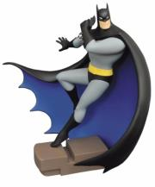
I like Superman best. Because he
can fly through the sky and fight
bad people and he is a real hero.

Slide 23
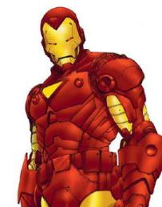
I like Spiderman best. Because he
can climb up buildings with his
hands and feet. That’s cool.

Slide 24
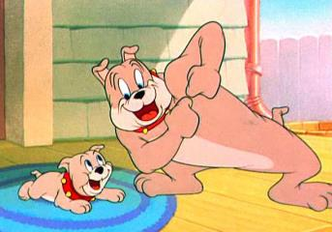
I like Tom and Jerry best.
Because they are very funny.

Slide 25
4. Complete the passage with the correct form of the words in the box.
cartoon fight hero
humorous laugh lesson
Children and adults all over the world love __________. Some, like Tom and Jerry, are ___________, and people enjoy _________ at the funny stories in them. Others, like Superman and Spiderman, are about _______. They ______ bad people to protect the world. These cartoons are not just stories — they also teach ________ about good and bad.
cartoons
humorous
laughing
heroes
fight
lessons

Slide 26
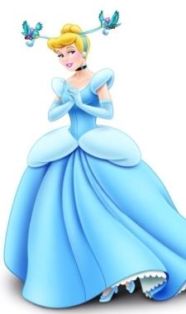
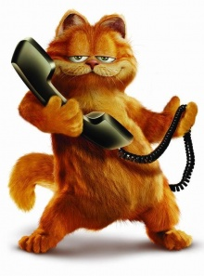
How many cartoon characters do you know?
Cinderella
Garfield

Slide 27
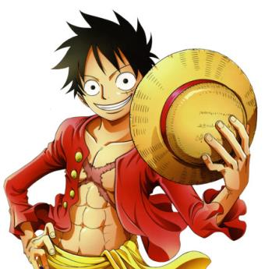
Nezha
Monkey D Luffy

Slide 28
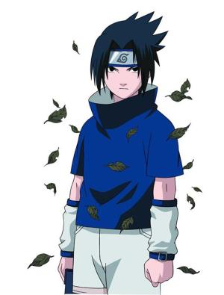
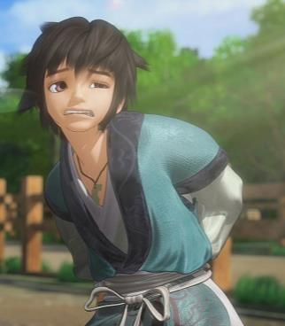
Sasuke Uchiha
Jing Tianming

Slide 29
5. Work in pairs. Describe your favourite cartoon character or the characters below. Use the words in the box to help you.
brave cartoon cute funny handsome smart
Nezha Mickey Mouse
Pleasant Goat Snow White
— I think Nezha is brave.
— Yes, I think so, too. / No, I think he is…

Slide 30
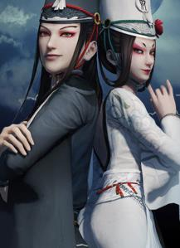
Everyday English
Read and make a dialogue with
each one.
It’s time to …
That’s cool!
I don’t think we agree.

Slide 31
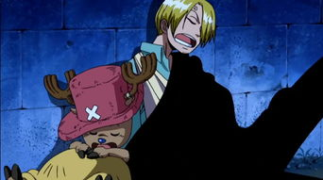
A: It’s time to get up!
B: Please give us another five minutes, Nami.

Slide 32
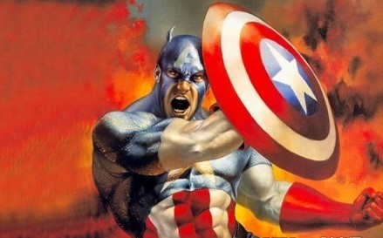
A: What do you think of Captain America?
B: That’s cool!

Slide 33
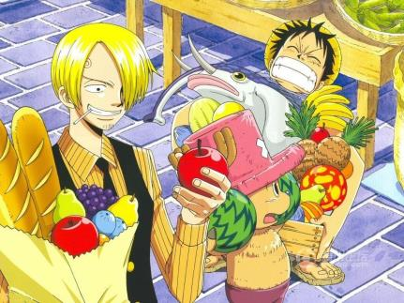
A: Going shopping is fun.
B: I don’t think we agree.

Slide 34
Pronunciation and speaking

Slide 35
6. Listen and underline the words the speaker stresses.
1. That’s a real hero!
2. I don’t think we agree.
3. They fight a lot, but they really love each other.
4. I think there’s a lesson there!

Slide 36
7. Work in pairs. Ask and answer the questions.
1. What cartoons do you like reading
or watching on TV?
2. When do you read or watch
them?
3. Which one do you like best? Why?

Slide 37
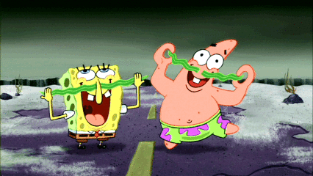
— What cartoons do you like reading best? Why?
— I like reading …
SpongeBob

Slide 38
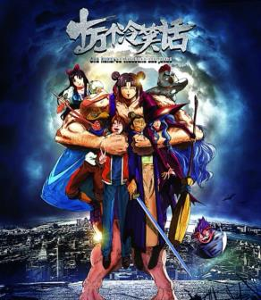
— What cartoons do you like reading best? Why?
— I like reading …
100000 Ways To LMAO

Slide 39
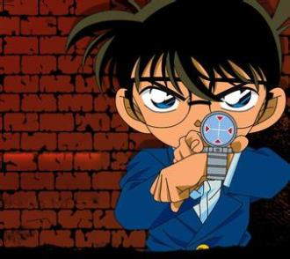
— What cartoons do you like reading best? Why?
— I like reading …
Detective Conan

