Slide 1
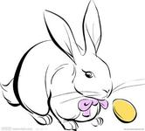
Unit 12
Whose rabbits are these?
WWW.PPT818.COM

Slide 2
Let's sing a song
Old MacDonald had a farm

Slide 3
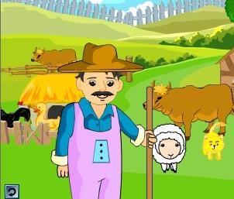
If you want to go to the farm,
you have to pass the 3 levels!
如果要进入农场，要过三关哦！

Slide 4
The first pass
第一关
What’s missing?

Slide 5
mice
mouse
horse
monkey
ducks
birds
chickens
rabbits
dogs
Notes:
5

Slide 6
The second pass
第二关
Magic ears

Slide 7
What can you hear?
monkeys
birds
pigs
dogs
horses
chickens

Slide 8
The third pass
第三关 我猜猜猜
Are there any···？

Slide 9
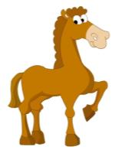
Are there any…s in the picture?

Slide 10
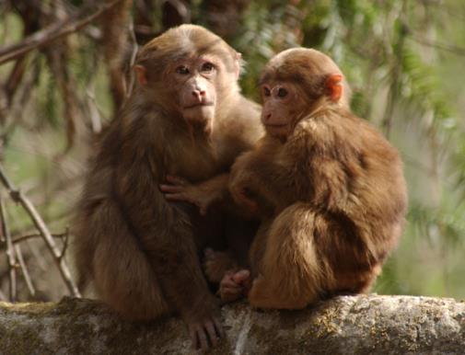
Are there any…s?

Slide 11
Great!
Let’s go to the farm now!

Slide 12
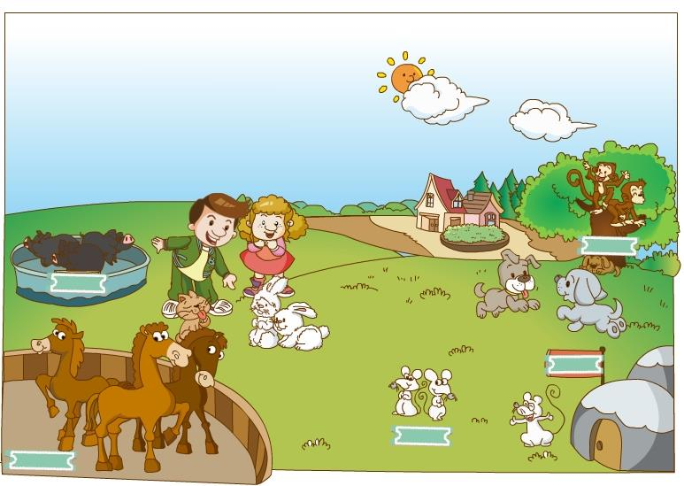
What animals can you see?
What do they have?

Slide 13
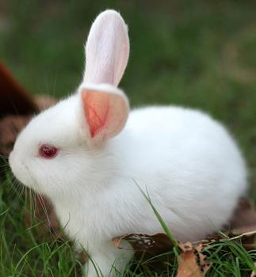
What are these?
They are rabbits.
What colour are they?
They are white.
These rabbits are white. They have short tails.

Slide 14
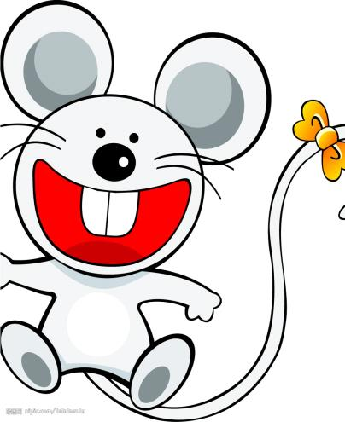
tail

Slide 15
a short tail
a long tail

Slide 16
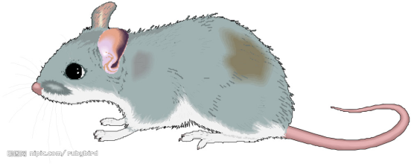
a big mouse
a small mouse

Slide 17
These are .
mice
grey
They have,
small eyes,
small noses
small mouths,
small ears,
and long tails.
They are very cute.

Slide 18
rabbits
These are .
white
They have,
red eyes,
small noses
small mouths,
long ears,
and short tails.
They are very lovely.

Slide 19
Guessing game

Slide 20
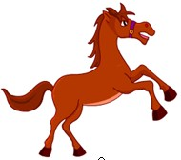
They have long legs, long tails and long faces.
They are horses.
They are very strong.

Slide 21
They have no legs, big tails and big eyes.
They are fish.
They are very lovely.

Slide 22
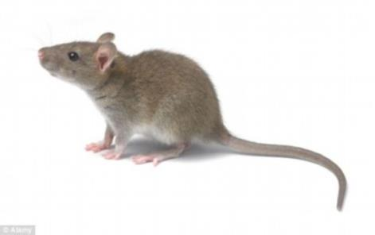
They have four legs, long tails and small eyes.
They are mice.
They are very small.

Slide 23
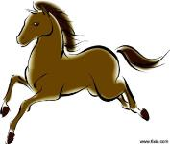
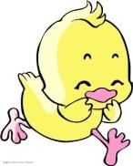
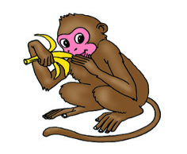
Describe your animals
描述你的动物( 图画本)
pink
These ____ are____.
pigs
They have
_____ eyes,
_____noses,
_____ ears,
_____ mouths,
and _____ tails.
They are very _____.

Slide 24
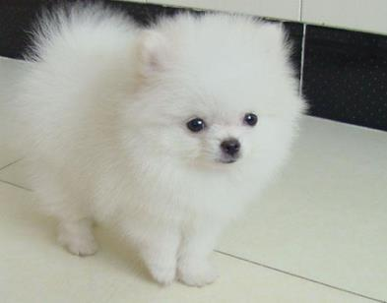
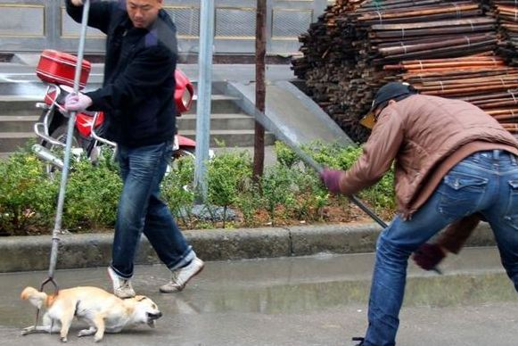
The pets are lovely.
Please don’t hurt them .请不要伤害他们

Slide 25
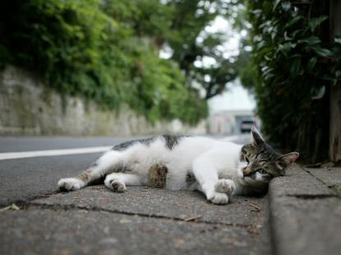
If you give them a little love. 如果你给它们一点点爱
They will love you forever! 它们就会永远爱你

Slide 26
Animals are our friends.
Love animals please!
Don’t feed the animals in the zoo!
动物是人类的好朋友。
请爱护动物！
请不要给动物园里的动物喂食！

Slide 27
Can you make a riddle(谜语)?
Homework:
Make riddles about animals.

