Slide 1
Unit 5 Good manners
Welcome to the unit
WWW.PPT818.COM

Slide 2
Do you have good manners?
Smile
Thank you
Good morning
Sorry
Hello

Slide 3
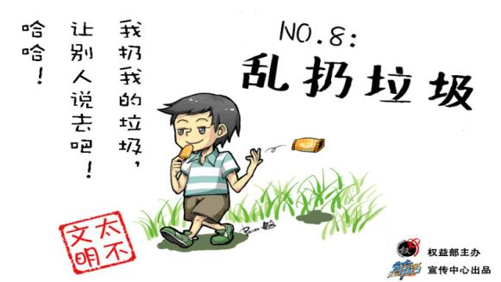
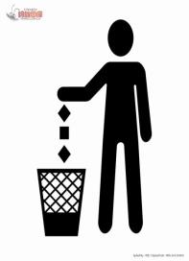
Doing the right things in the public places.
We can’t drop litter everywhere!
We should drop litter into the rubbish bin!
litter [‘lɪtə] n.[U]垃圾，杂物

Slide 4
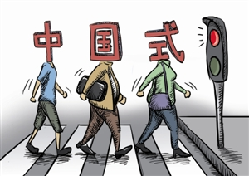
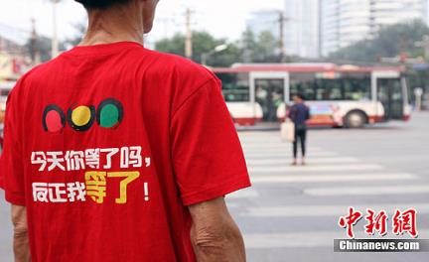
Can you cross the road like this way?
Doing the right things in the public places.
We should obey traffic rules.
/ə’bei/ 遵守，顺从

Slide 5
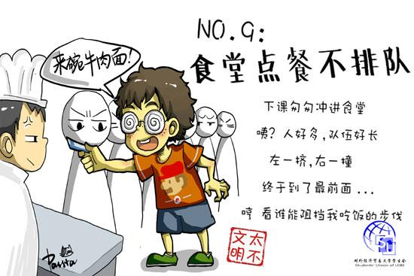
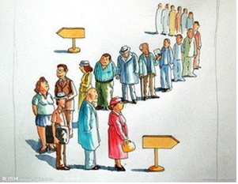
Can we jump the queue like this way?
jump the queue
queue for our turn
/kju:/ (人、车等)排队等候

Slide 6
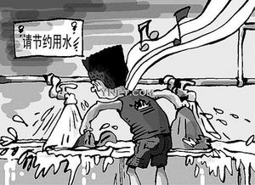
leave the taps running
Save water
/tæp/ 水龙头，旋塞

Slide 7
Good manners in the library
1. What should you do in the library?
We should keep quiet, keep the library clean and put books back after reading.
2.What should you not do in the library?
We shouldn’t drop litter everywhere.
We can’t chat and eat in the library.

Slide 8
Please complete the form.
In the library
We should | keep ______
 | keep the library ______
 | _____ the books _____ after reading
We shouldn’t | chat or _____ in the library
 | _____ _____ everywhere
 | _____ in the books
quiet
Good manners
clean
put
back
eat
Bad manners
drop litter
write

Slide 9
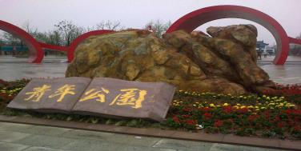
Manners in different places.
A: Can we …?
B: No , we can’t. We should….
A: Can we…? B: Yes, …
……
At the cinema
At the park

Slide 10
Write down more right things and wrong things in the video as possible as you can.
Team work

Slide 11
Watch the video and answer questions.
1. What does Eddie teach Hobo?
2. What does Eddie really want from Hobo?

Slide 12
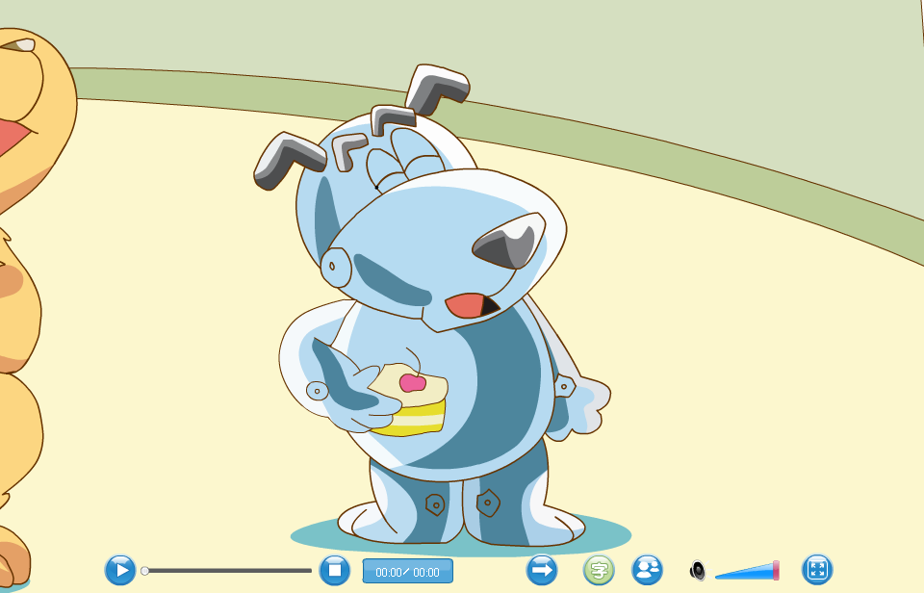
Listen, see and answer the questions.
Role play
Role play

Slide 13
Watch the video and answer questions.
1. What does Eddie teach Hobo?
First, share your things with others.
Second, don’t cut in on others.
Always wait politely.
/pə’laitli/礼貌地
2. What does Eddie really want from Hobo?
He wants to eat Hobo’s cake.

Slide 14
Role play

Slide 15
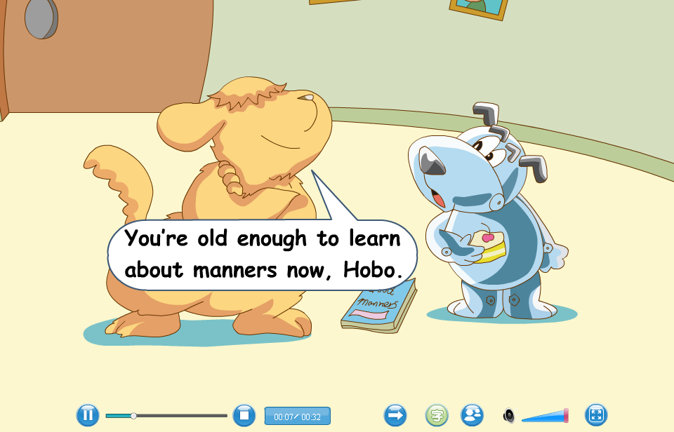
Listen, see and answer the questions.
Role play
Role play

Slide 16
Lines(台词)
Eddie: You’re old enough to learn about manners, Hobo.
Hobo: Eh? What do you mean?
Eddie: First, always share your things with others. Second…
Hobo: Hey, that’s my cake!
Eddie: Second, don’t cut on others. Always wait politely.
Hobo: You should learn about manners too.
You’re never too old to learn.
/pə’laitli/礼貌地

Slide 17
Fill in the blank.
Eddie tells Hobo that he is old _____ to learn about manners. Hobo doesn’t ___________what Eddie means. Eddie starts to _____ hobo some good manners. First, Eddie asks Hobo to always _____ things with others. While saying so, he takes the _____ from Hobo’s hand.
enough
understand
teach
share
cake

Slide 18
Hobo is surprised, and he shouts, “Hey! That’s my _____ !” But Eddie asks Hobo to always _____ politely instead of _____ in on others.
Hobo is very _____ . He thinks Eddie should learn about manners too.
cake
wait
cutting
angry

Slide 19
Discussion
May day is coming. What should you do and should not do when you go travelling?

Slide 20
Homework
Have a summary(总结)about good manners you have known.
Find out your bad manners and know how to get rid of(改正) them.

Slide 21
Never too old to learn!
Thank you!

